Slide 1
Possibility of the Conceptualization of ‘Agency of the Dead’
An analysis based on the dialogue of autochthony between Japan and Africa
Kiyoshi Umeya
Professor
Social Anthropology
Graduate School for Intercultural Studies
Kobe University

Slide 2
Introduction
In this paper, we would like to introduce and analyse the concept of the ‘agency of the dead’, which we will examine through the ethnographies of various groups of people in Japan and Uganda.
There exists the phenomenon that living people make decisions and act according to the considerations of those who have already died, usually their ancestors.
Based on this idea, the concept of society or citizenship, which normally only applies to the living, should be reconstructed to also include deceased people.
By introducing such an idea, we attempt to analyse occult concepts and magic without being bothered by the questions, ‘Do you really believe in ghosts?’ and ‘Are magical acts truly effective?’

Slide 3
Ethnographies of Sado Island, Japan
In the villages of Sado Island, Niigata prefecture, we have observed the reality of communities left behind by the neoliberal political and economic system, and investigated the folk religion that is said to be disappearing.
However, in examining the present situation of human mobility, we found that ancestor rituals are still a significant part of people’s lives.
Former residents of Sado Island who left home did not search for places to live and work all over Japan out of free economic and rational interest.
Rather, there are many examples of residents buying and migrating to land in an area that is economically prosperous among the islands to remain close to the land of their birth.

Slide 4
Ethnographies of Sado Island, Japan
In that case, it is the residence of the ancestral family, Buddhist altar, and ties to the ancestors that become a large problem.
Many who live in a city a few hours away by car from their home village, return to their empty houses for the maintenance of Buddhist altars and Buddhist mortuary tablet once or twice a week.
In these cases, their ancestors are dead, but these family members can still be said to be exercising some agency over the lives of their living descendants.
In this way, the messages of the dead form the basis of a fierce resistance to the demands of modern neoliberal society: 'do not leave the land of your birth', and ‘do not to sell the land of your ancestors’.

Slide 5
Case of Great East Japan Earthquake
Another such case is that of the Japanese government’s proposed relocation of residents after the Great East Japan Earthquake.
While some residents agreed to relocate immediately, other residents, even while disposing of all their household goods that were damaged by the tsunami, did not accept the government’s proposal, and strongly hoped to continue living close to the sea, which is the source of many people’s livelihoods.
This case is different because it was not the dead who were demonstrating the agency, but the living’s obsession with the natural environment: the sea. This occurrence surprised many people.

Slide 6
Bududa of Eastern Uganda
A similar case exists in the Bududa district of Eastern Uganda. People living in the steep highlands at the foot of Mt. Elgon have been suffering from landslides for a long time.
The government has provided relocation sites, but most of the residents chose to return to the dangerous land after landslides occur.
The motive for them to return to their lands is not only that the land is fertile, but that it is the land where their ancestors’ bodies are buried, where their umbilical cords were buried, and where they underwent their circumcision rituals.
In this case, it may be necessary to take the ‘agency of umbilical cords’ into consideration in addition to the ‘agency of the land’ and the agency of the dead.

Slide 7
Landslide in Bududa
2010.03.01：More than 300 were killed, still several hundreds people are missing. No hope to additional survivors will be found.
2011.03.02: Three villages were buried by another landslide caused 365 buried and killed 92 bodies were found.
2012.06.25:Four villages were buried but 448 people still remain to live the area.
2013.08.10: Five villages were buried.

Slide 8
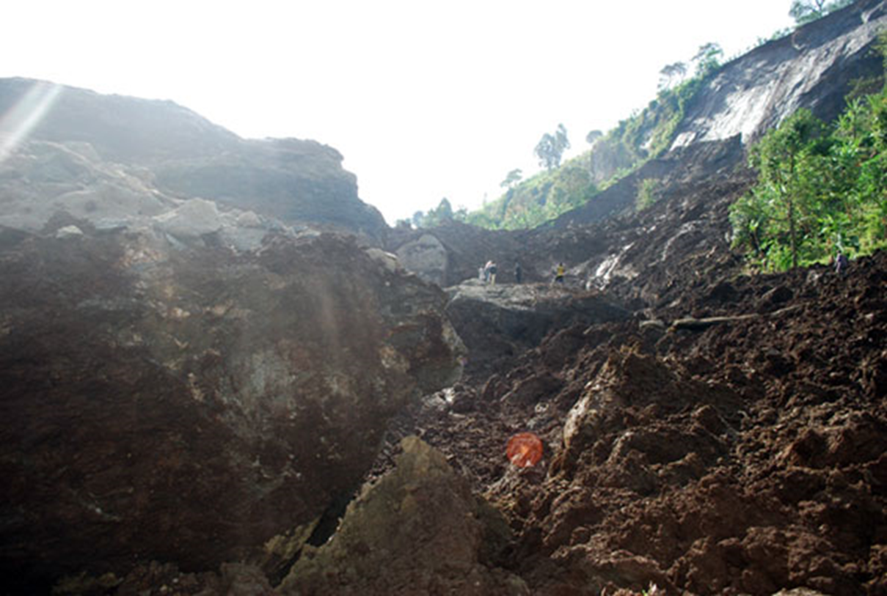
Landslides bury five villages in Bududa
Daily Monitor, October 29, 2013

Slide 9
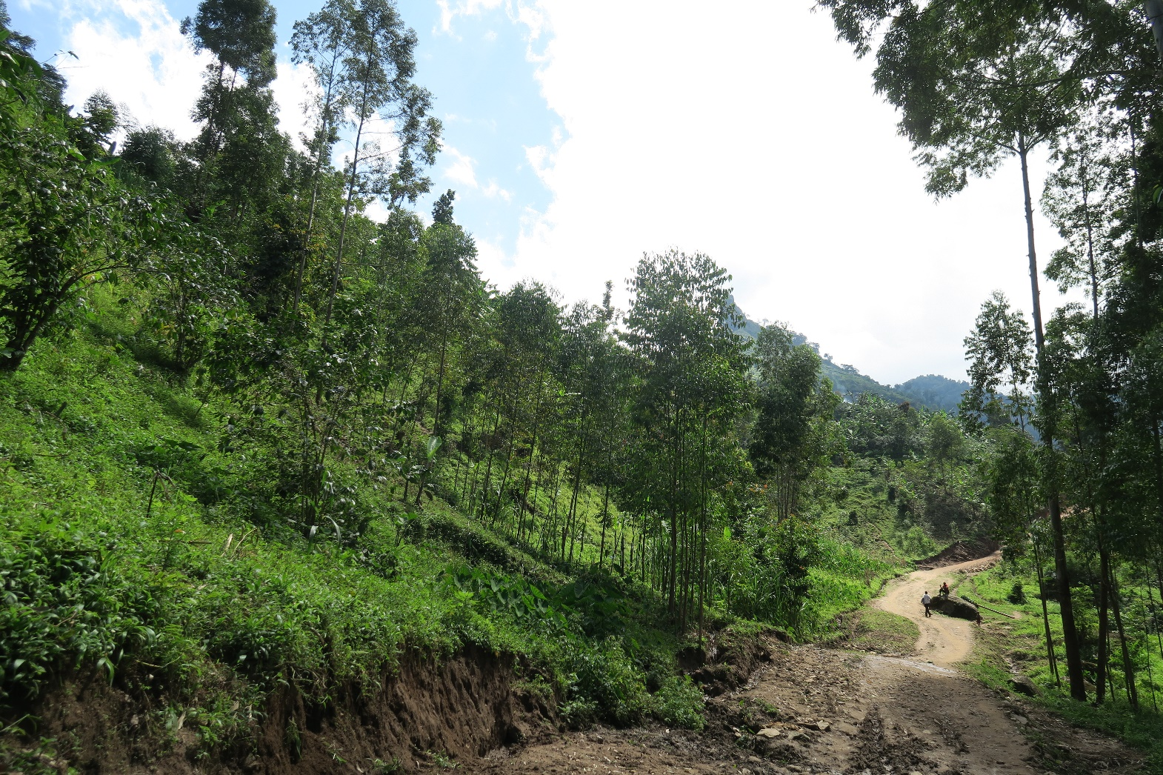
Bududa 2016

Slide 10
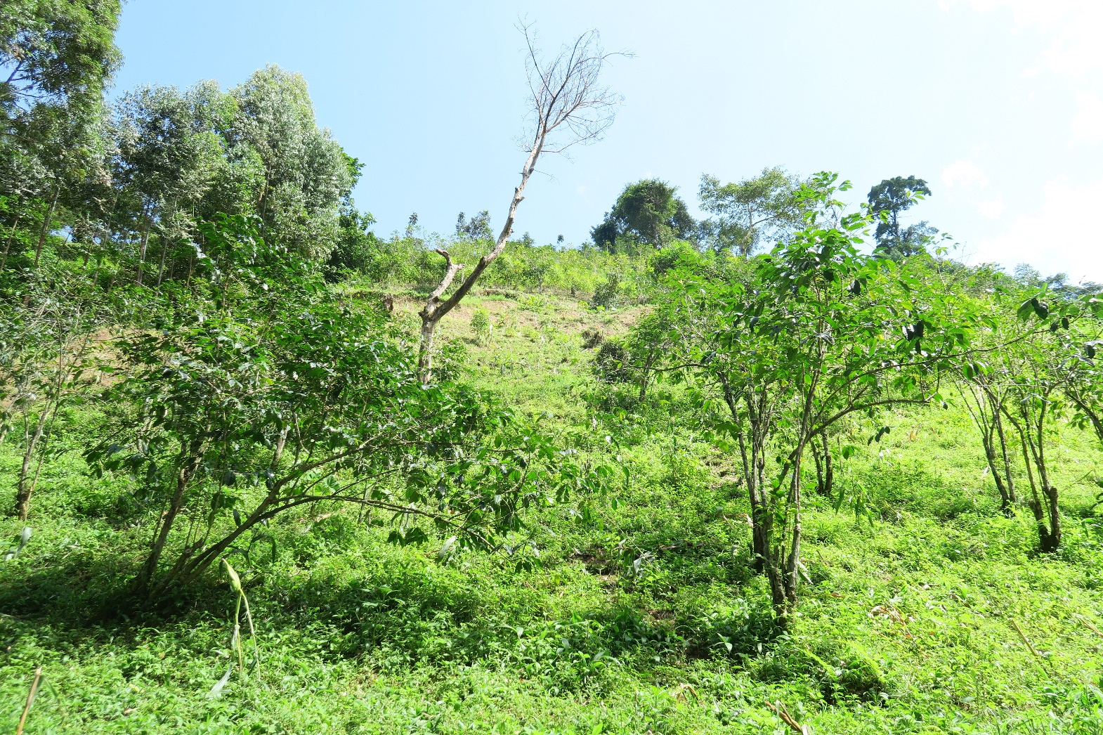
Bududa 2016

Slide 11
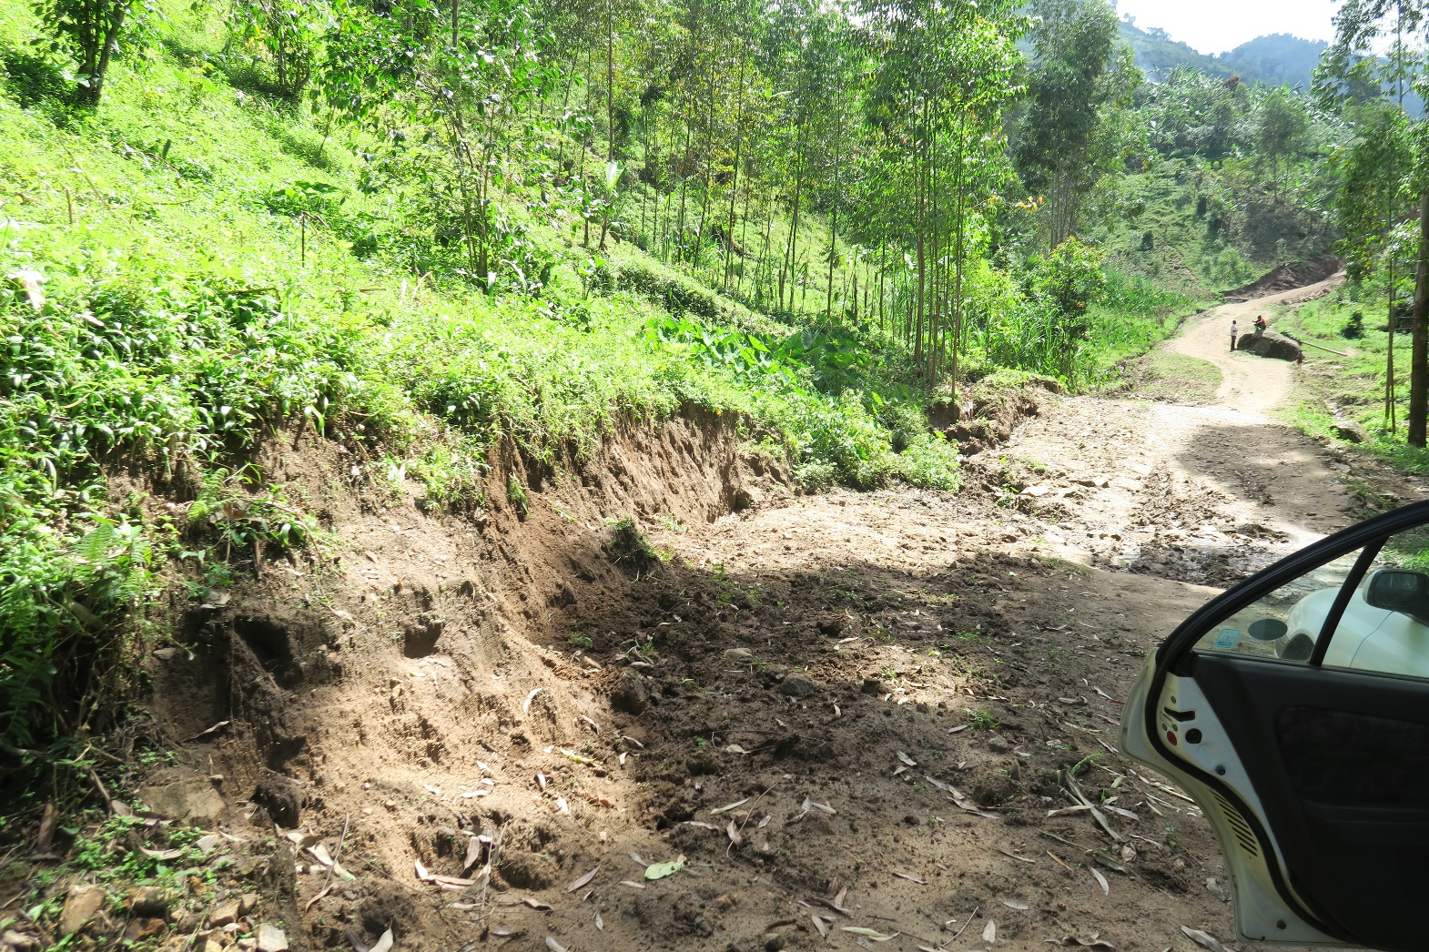
Bududa 2016

Slide 12
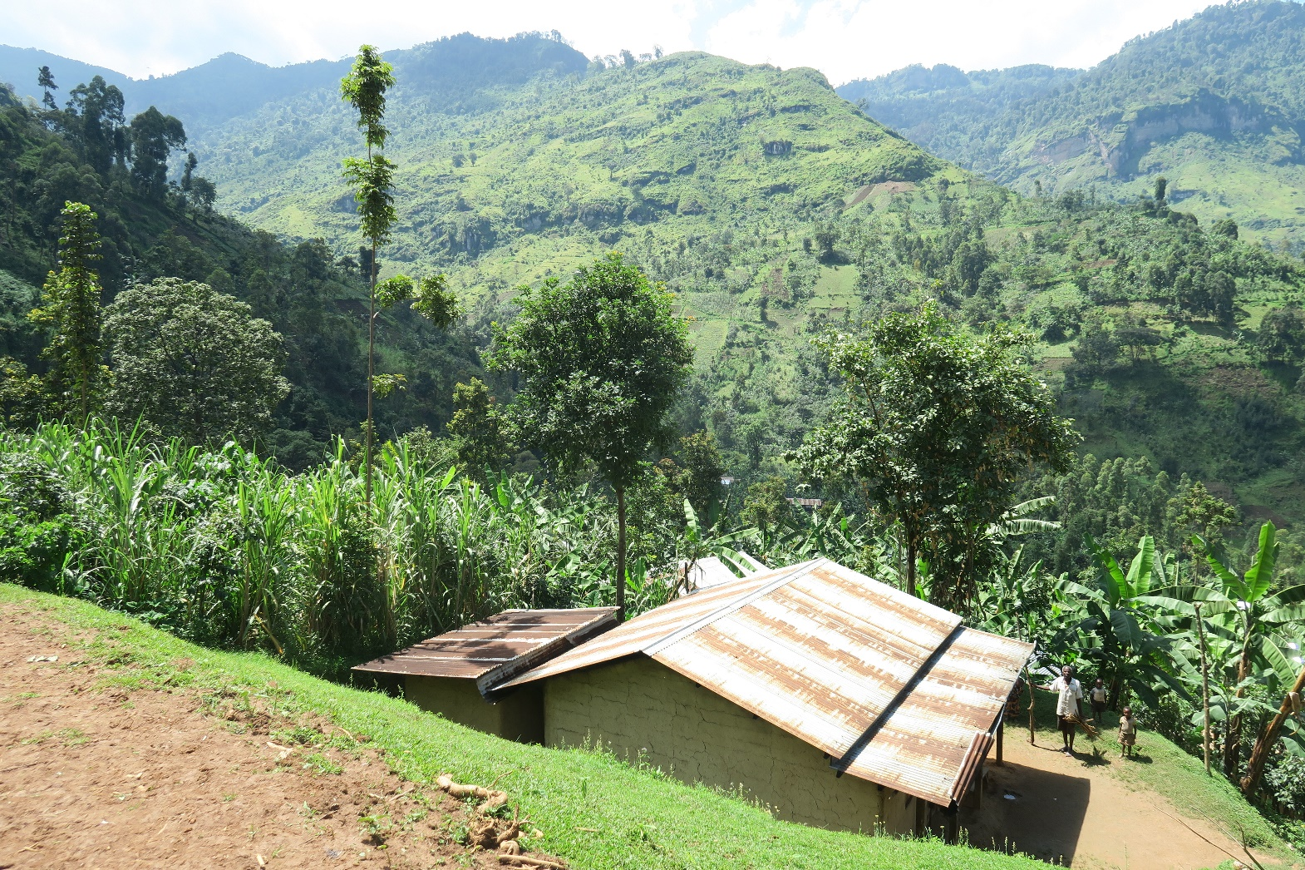
Bududa 2016

Slide 13
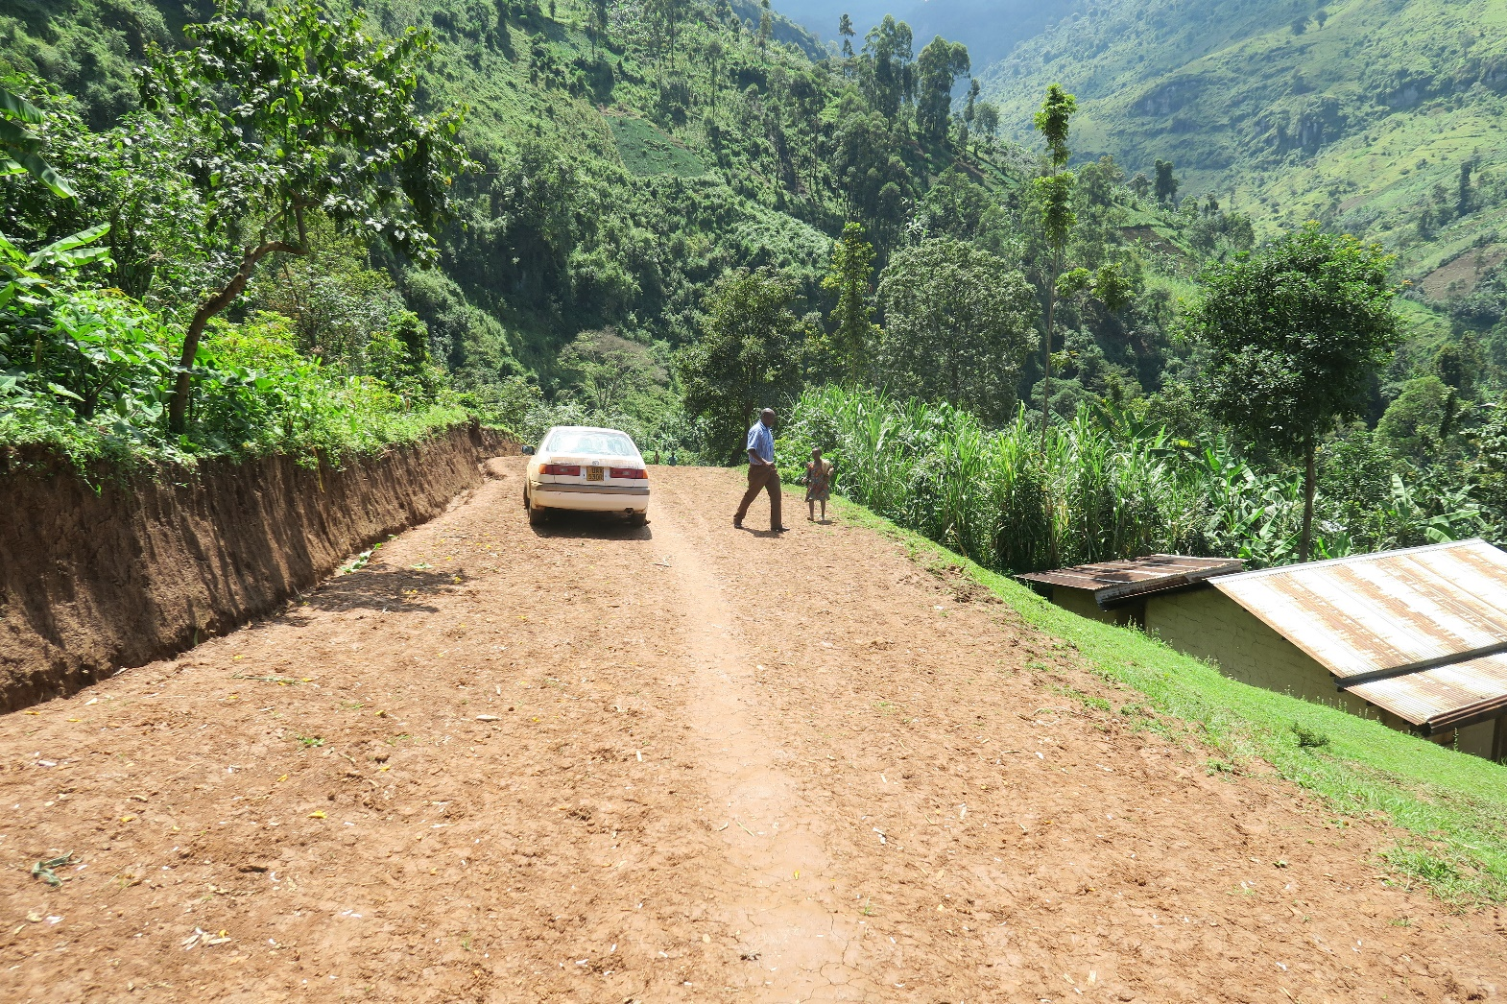
Bududa 2016

Slide 14
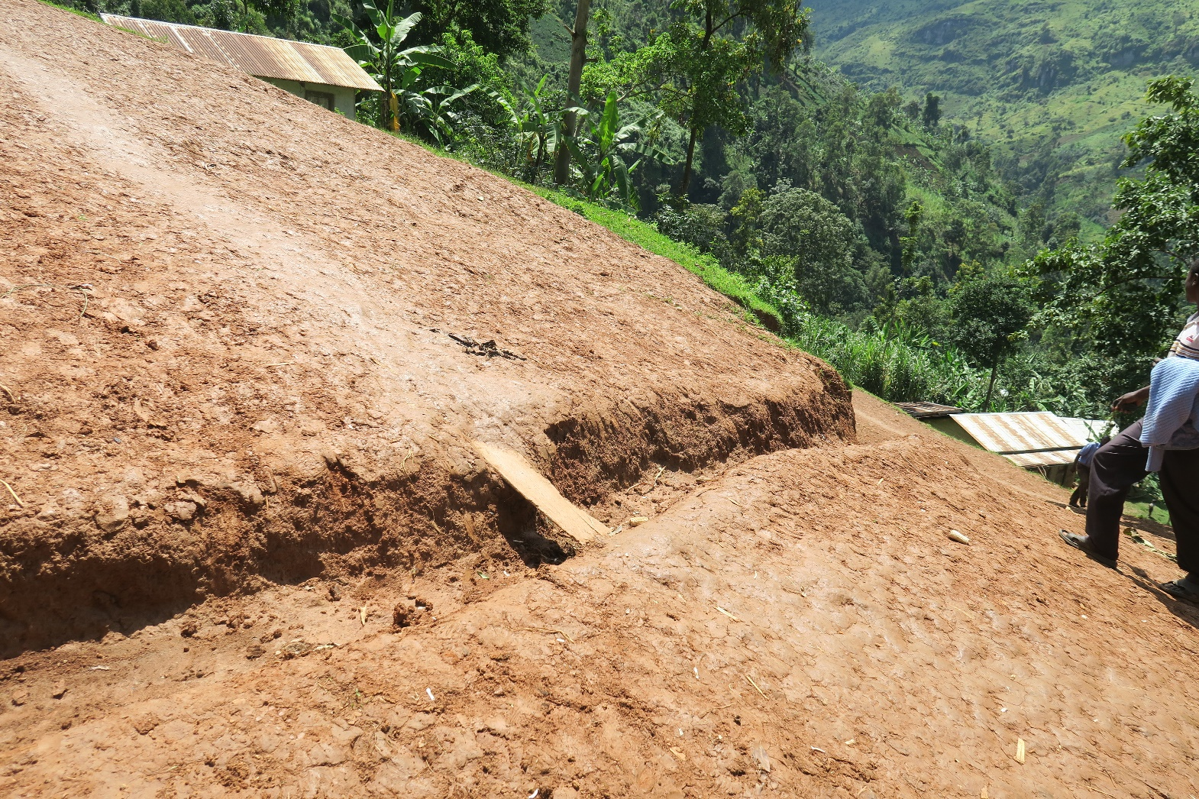
Bududa 2016

Slide 15
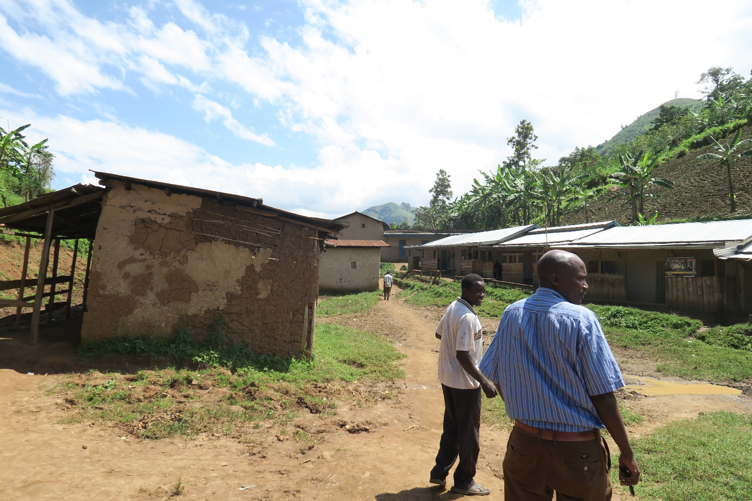
Bududa 2016

Slide 16
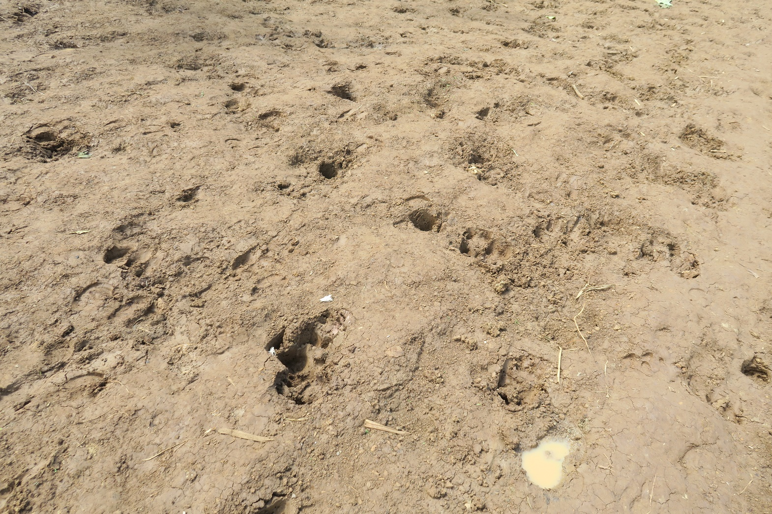
Bududa 2016

Slide 17
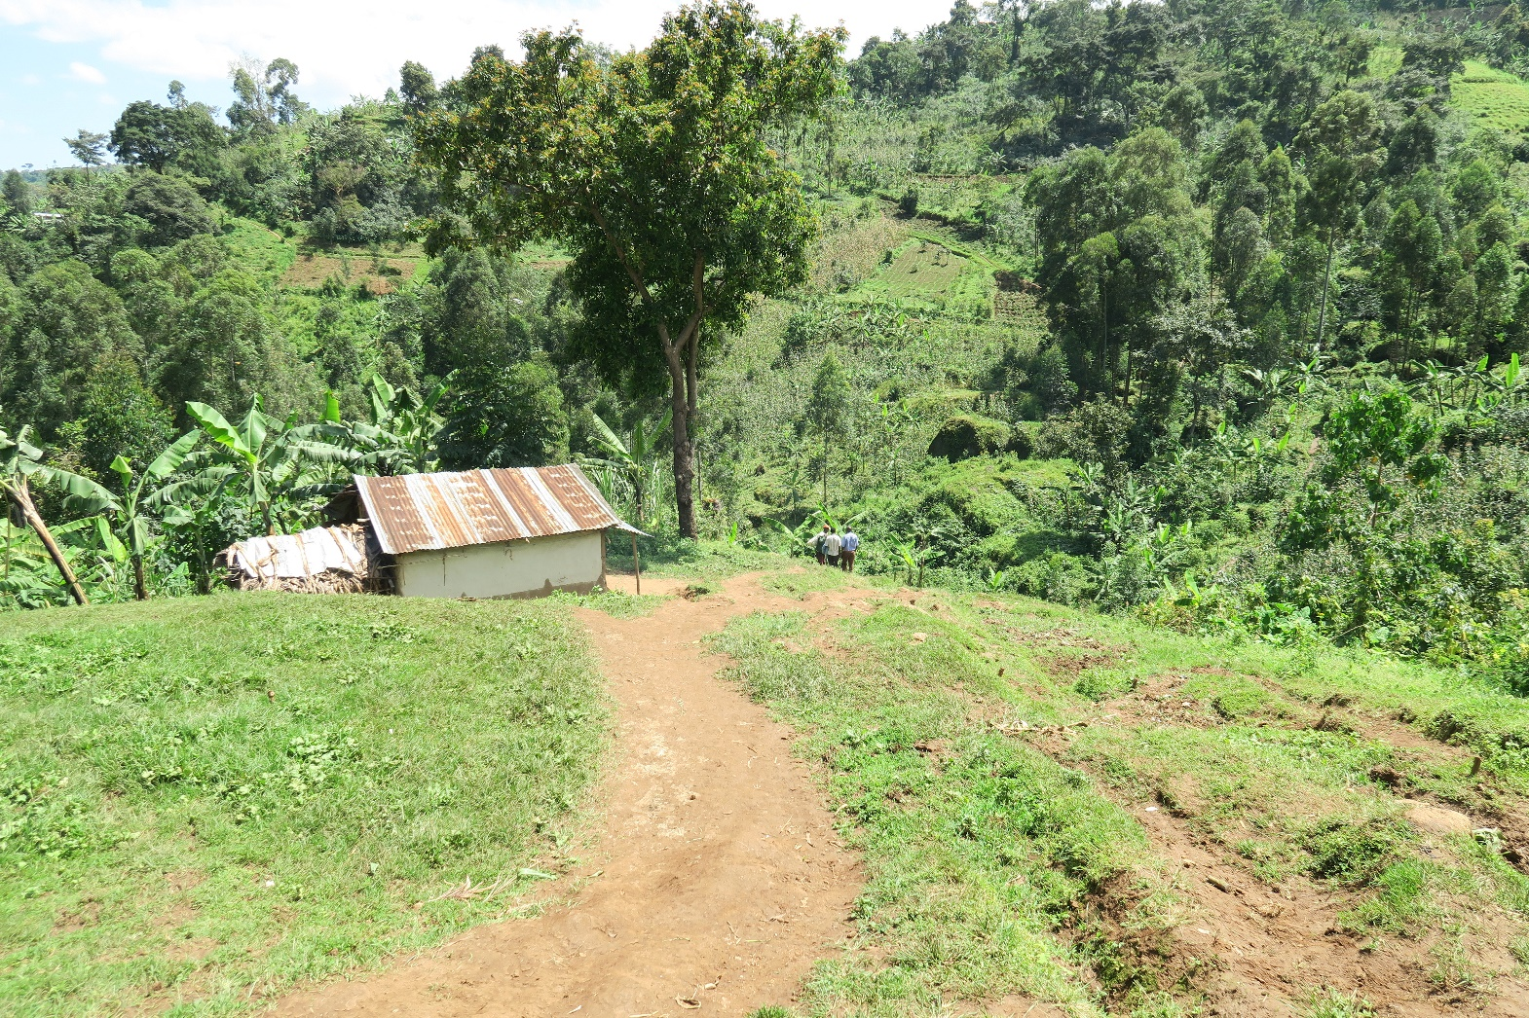
Bududa 2016

Slide 18
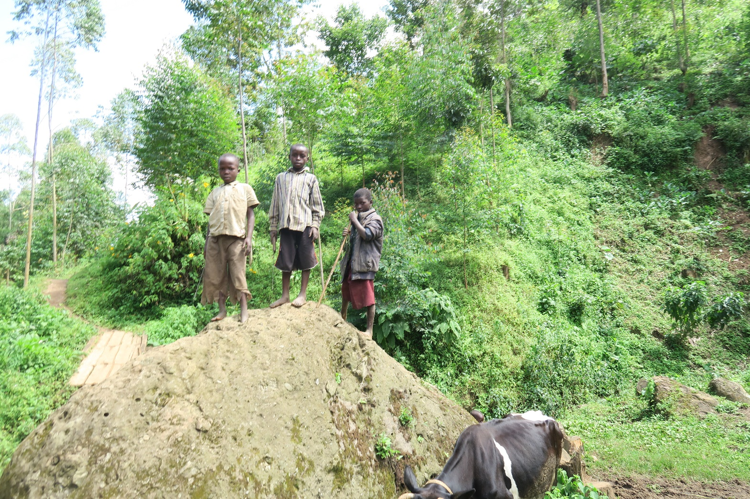
Bududa2016

Slide 19
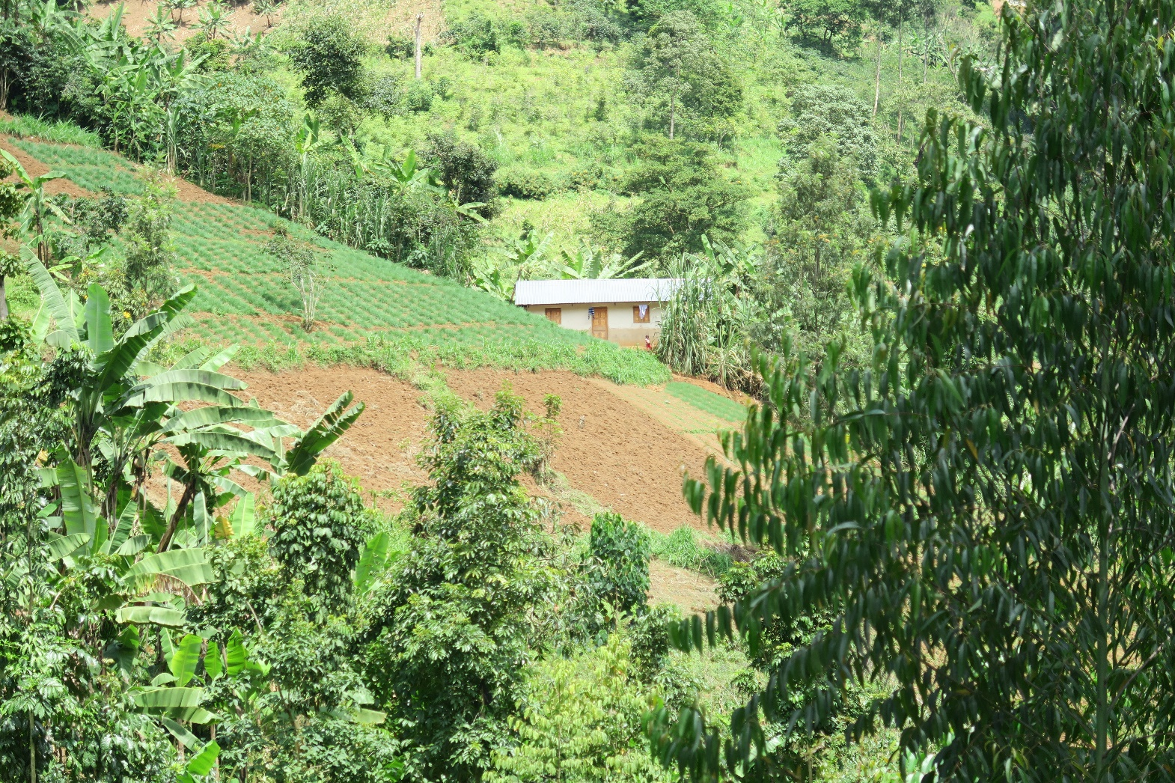
Bududa 2016

Slide 20
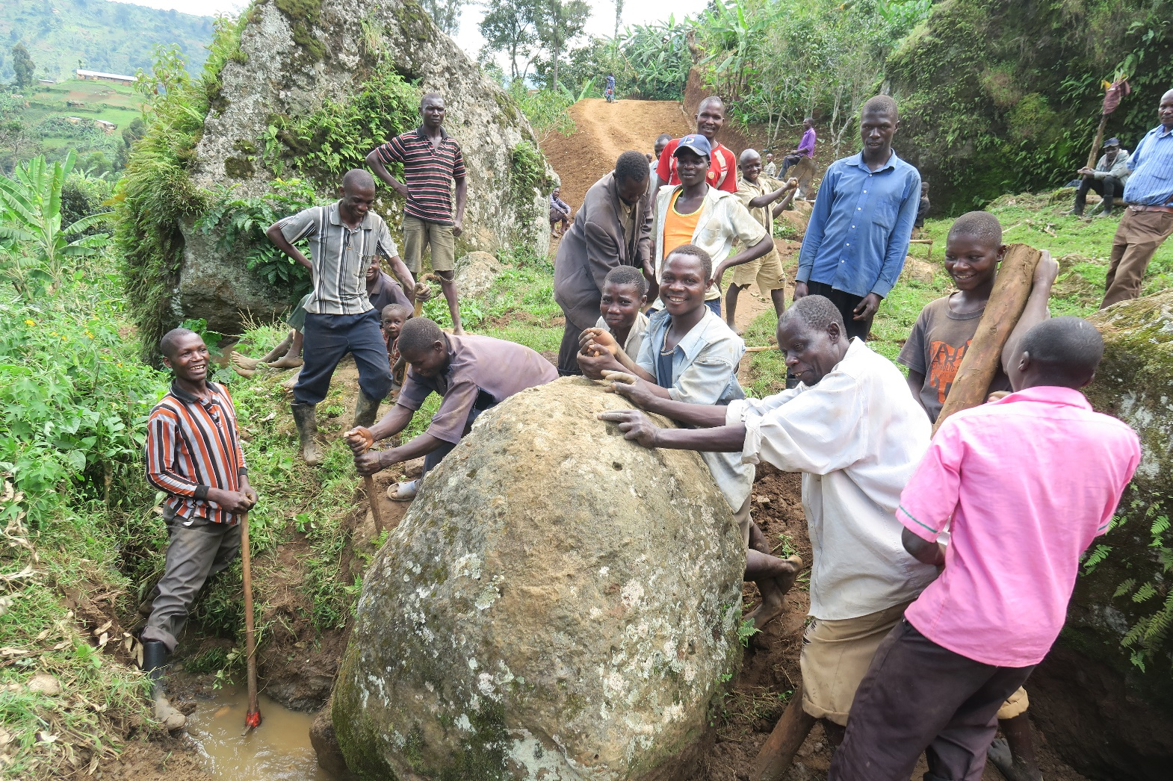
Bududa2016

Slide 21
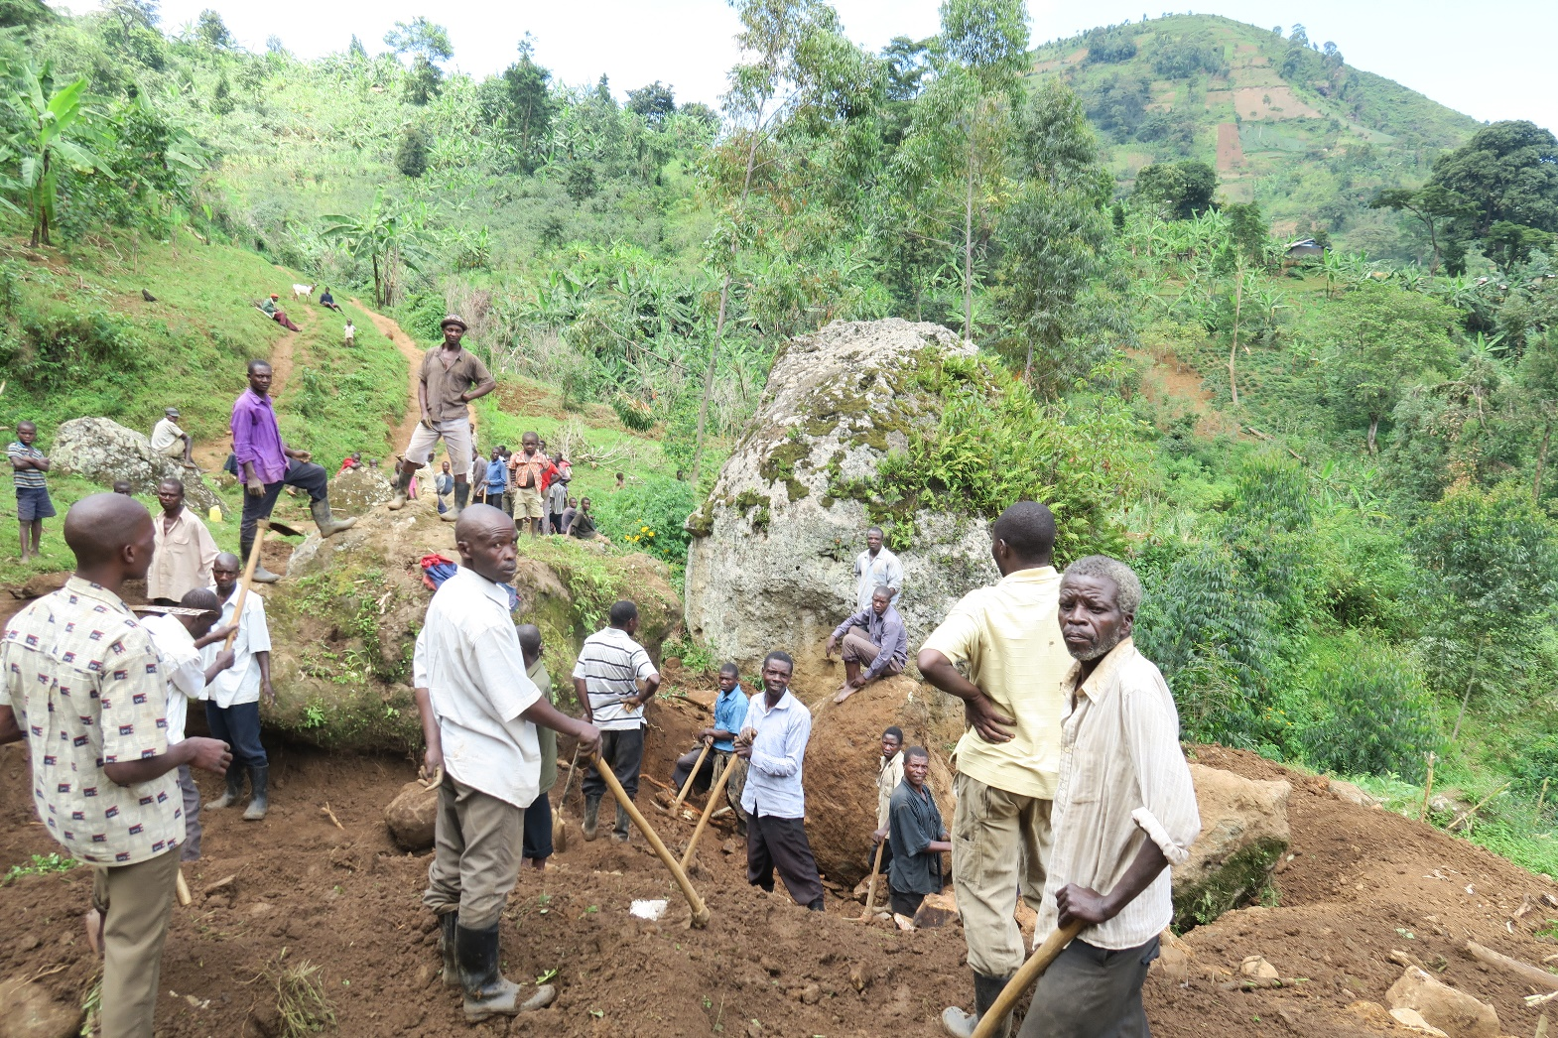
Bududa 2016

Slide 22
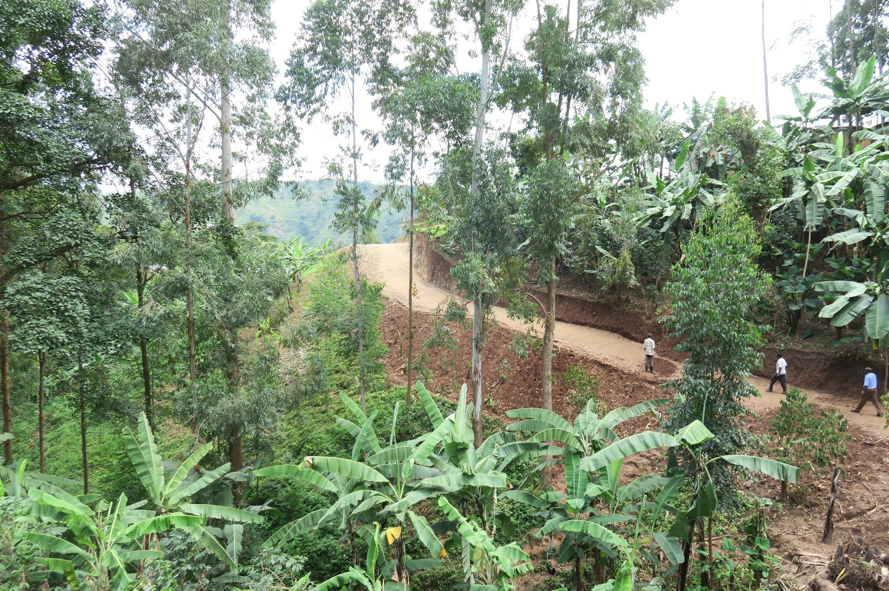
Bududa 2016

Slide 23
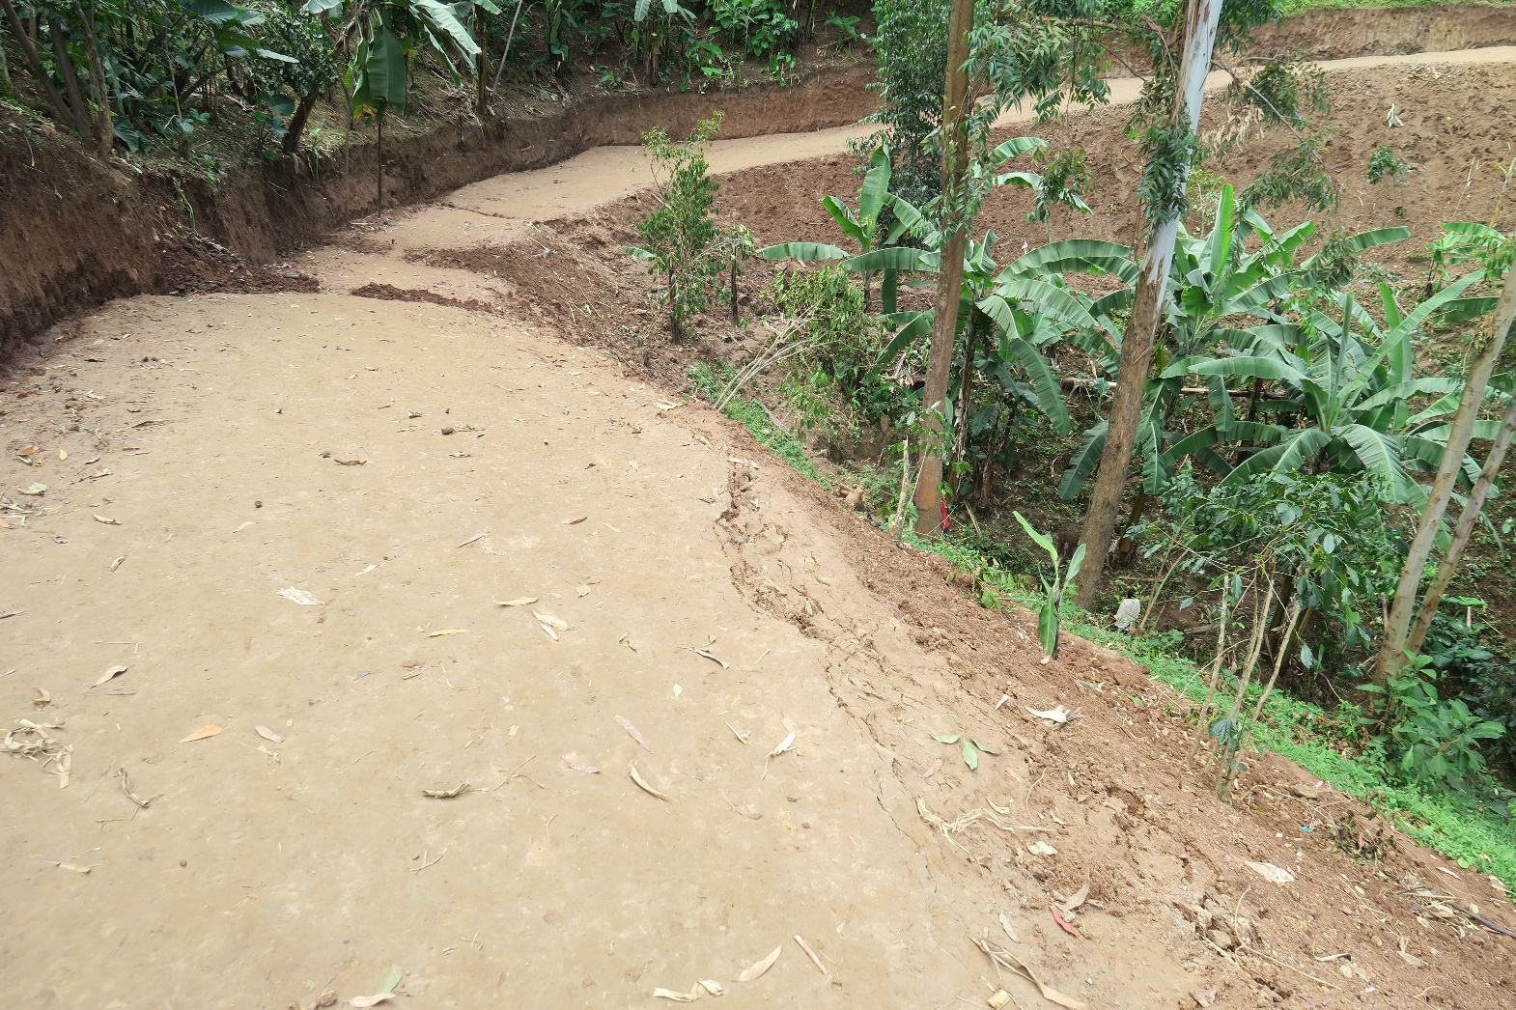
Bududa 2016

Slide 24
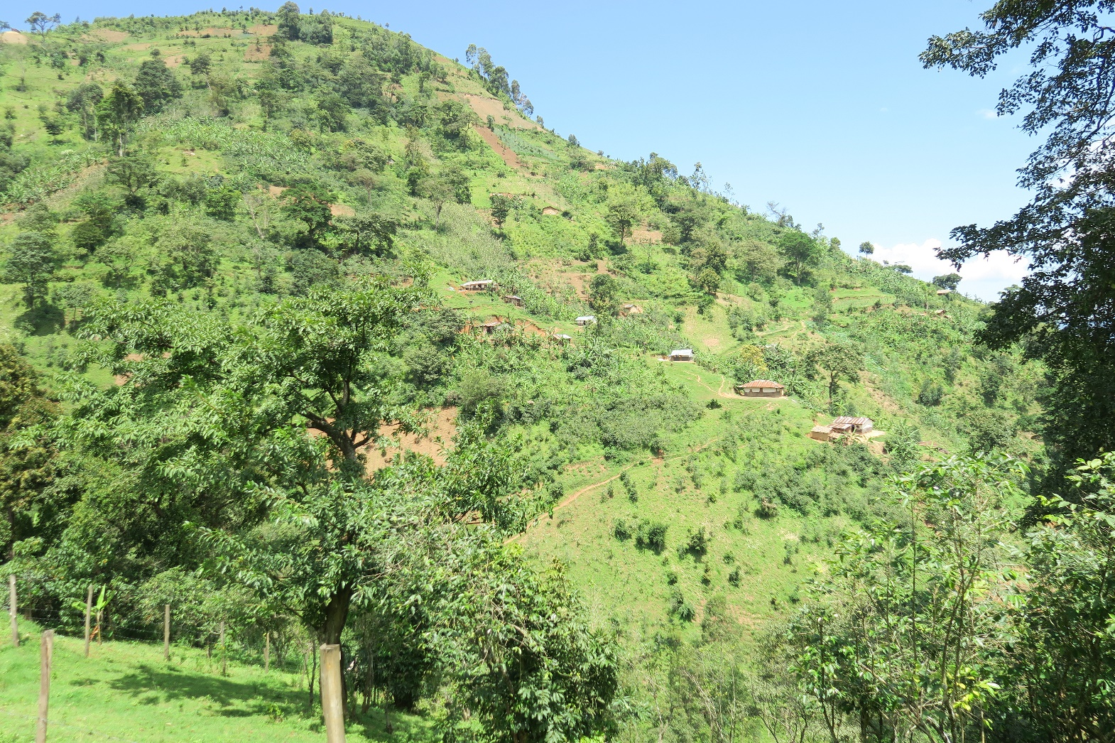
Bududa 2016

Slide 25
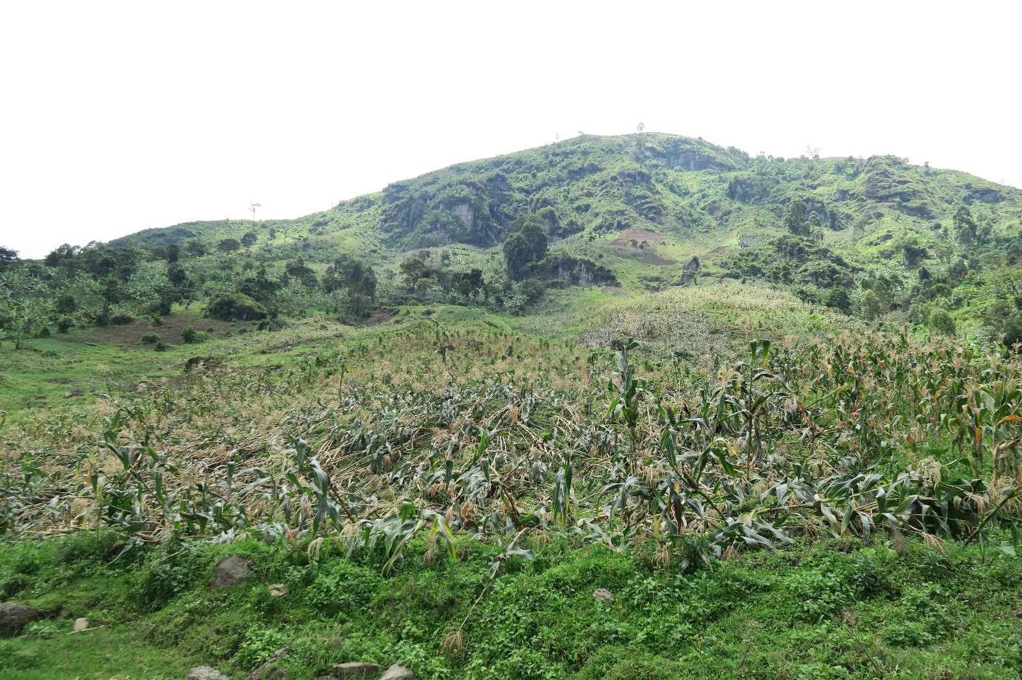
Bududa 2016

Slide 26
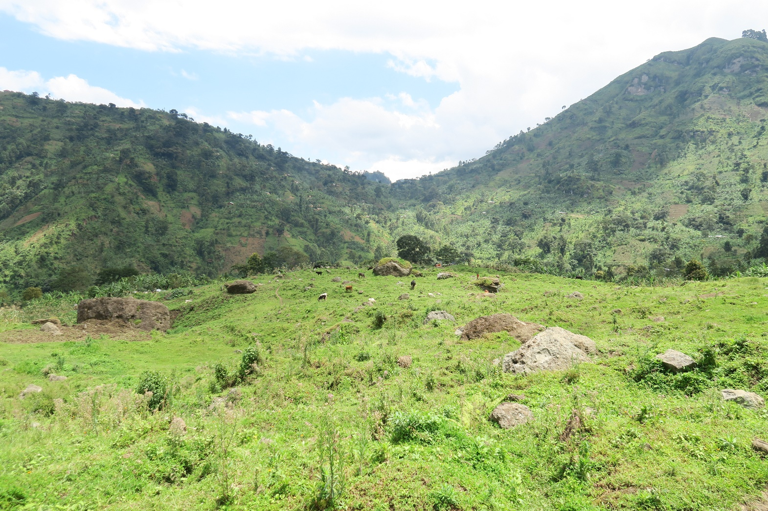
Bududa2016

Slide 27
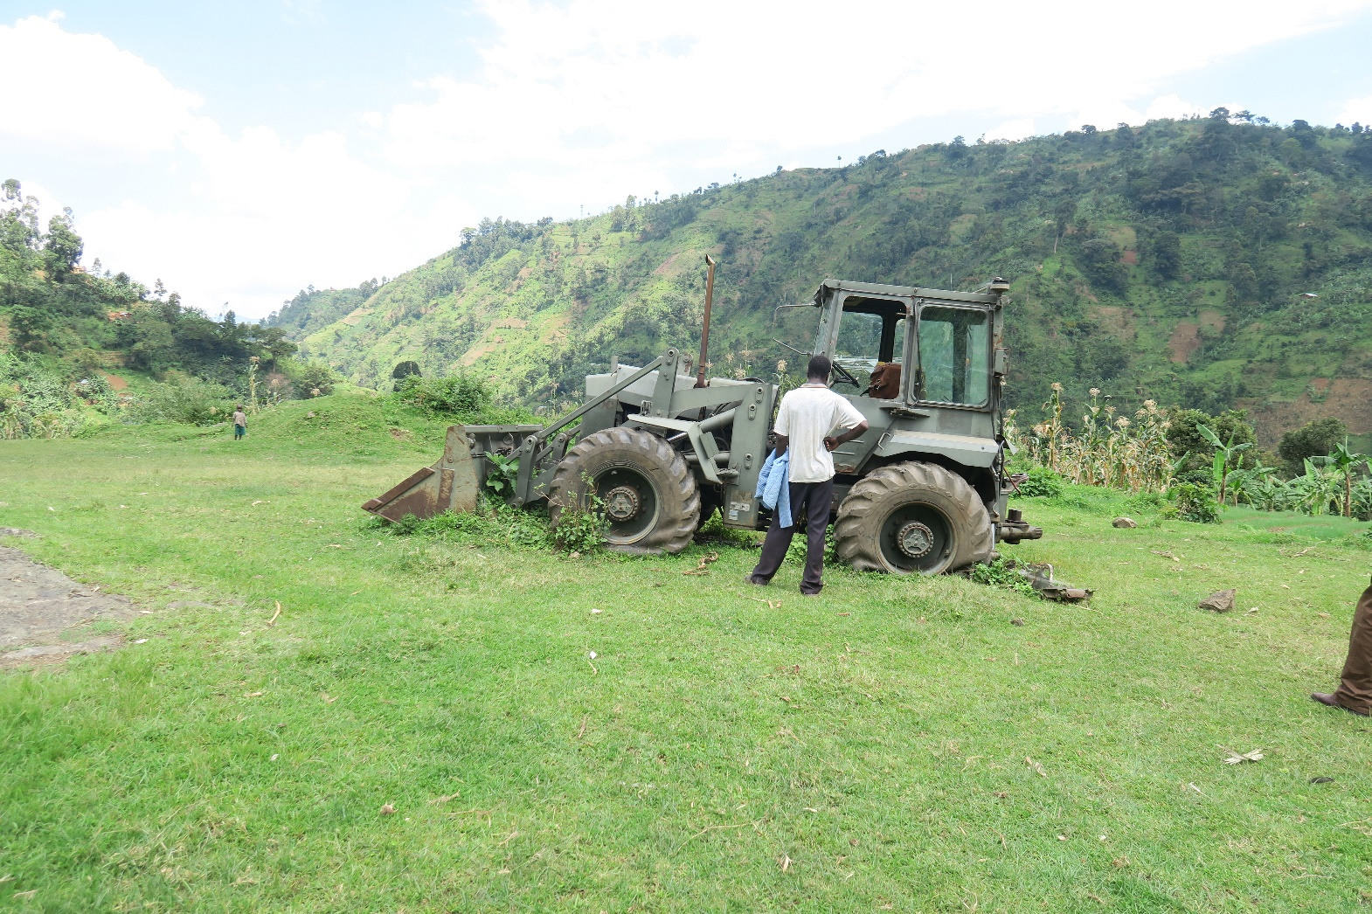
Bududa2016

Slide 28
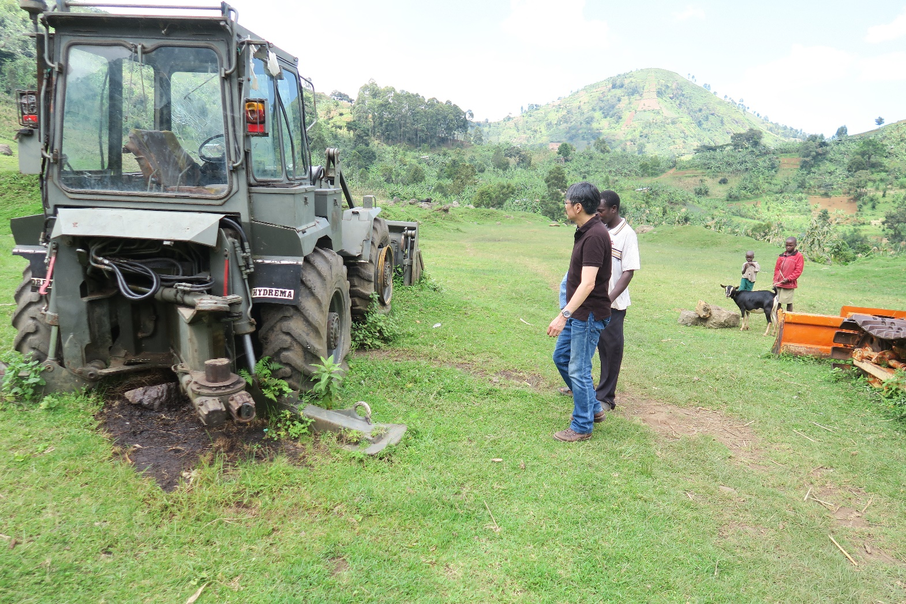
Bududa2016

Slide 29
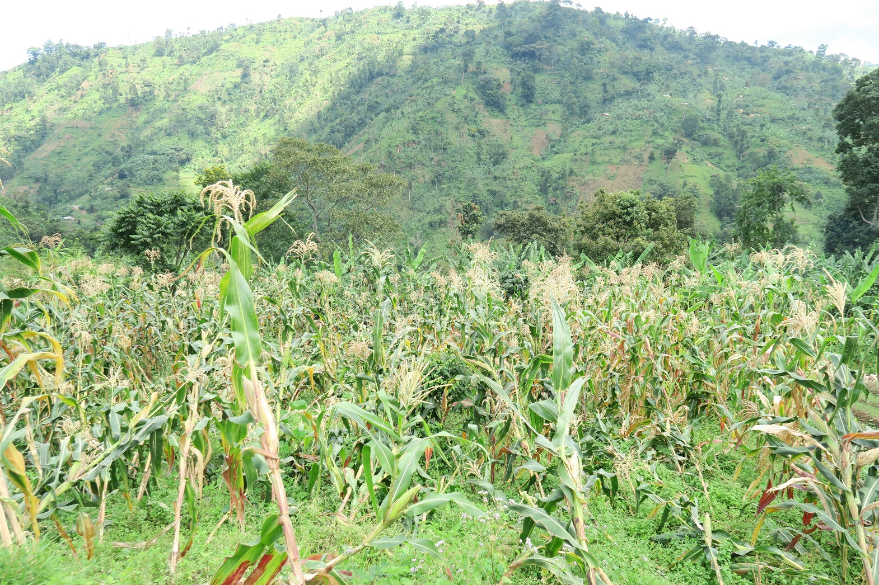
Bududa2016

Slide 30
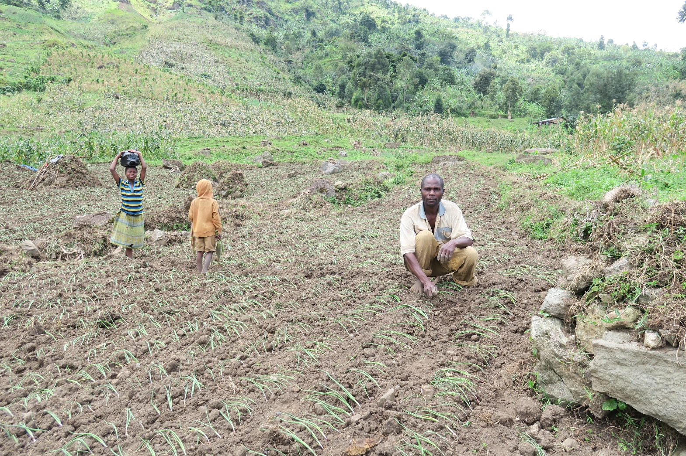
Bududa2016

Slide 31
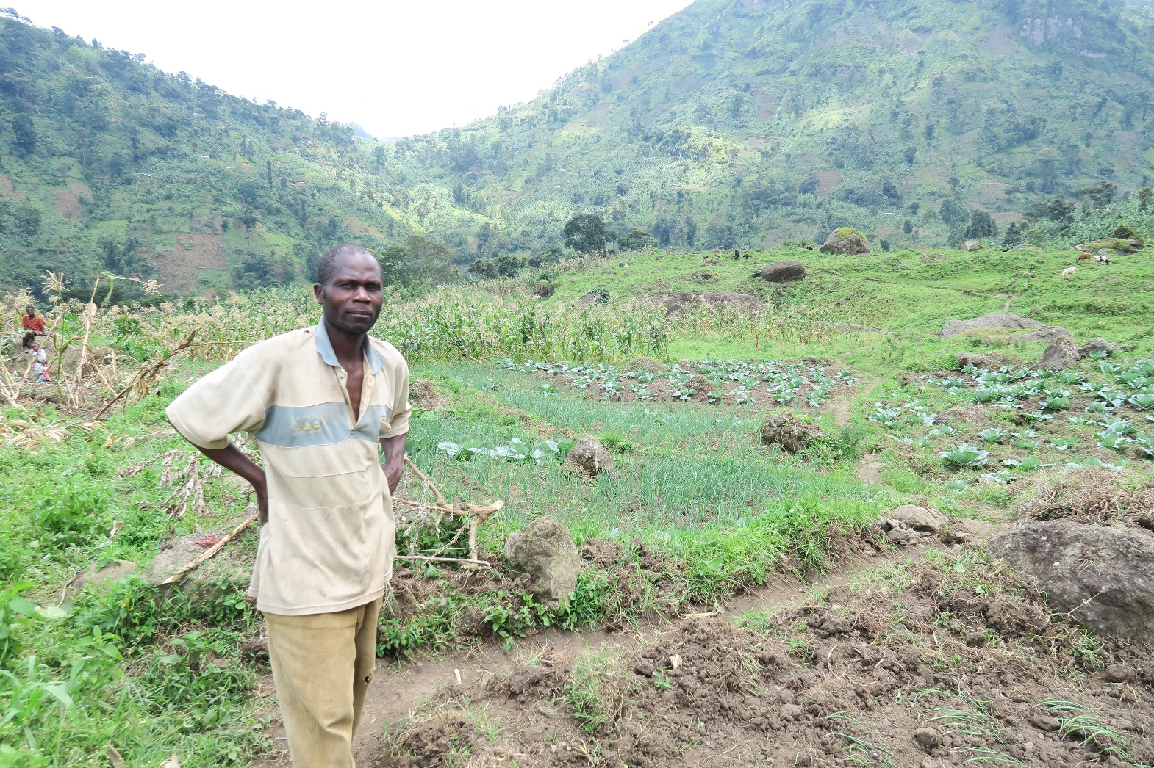
Bududa2016

Slide 32
Relocation and ‘the Agency of the Dead’
Globally, cases of relocation have met with mixed results.
There have been successful cases of migration to temporary housing, and cases that were unsuccessful, such as the case of the Andaman Islands post-tsunami.
In some regions, people refused to relocate because they did not want to leave the sea or their ancestral lands (which also occurred in the Tohoku region of Japan), while in other regions, it was said that the fear of the ‘ghosts’ of the victims made them agree very quickly to abandon their homelands and move to a new land.
In the former case, as in the case of Sado Island, the residents understood the message of ‘Do not leave this land’, but in the latter case, ‘the agency of the dead’ issued its message of ‘leave this land’.

Slide 33
Kampala Seminar and a Case of Uganda General Election
At a meeting held in Kampala, Uganda, as part of the project led by Dr. Hazama, which included Francis and most of the Japanese team, I presented another example of the Uganda general election’s contribution to the discussion on the agency of the dead. It seems that this example was more familiar to this audience.

Slide 34
Re-burial of Oryema and Luwum’s Day
On September 18, 2014 a reburial ceremony for Erinayo Wilson Oryema (1917–1977) was held in Nyowa District.
He was Uganda's first African Inspector General of Police (1964-1971), In Amin’s regime, he was appointed Minister of Land, Mineral, and Water Resources (1971-1974) and Minister of Land, Housing and Physical Planning (1974-1977).
He was superior authority in KAR to Amin, in 1940s and best man at Amin’ s wedding to Kay Adoroa, who was later killed. In a sense, he was accepted to be Amin’s the most trusted OB in the world.
In February 1977, Oryema, together with Archbishop Janani Luwum and Interior Minister Charles Oboth-Ofumbi, is generally considered as having been murdered by the SRB of President Idi Amin.

Slide 35
Re-burial of Erinayo Oryema
For Oryema's re-burial, the son of the late Charles Oboth-Ofumbi, another of the three victims, and who attended on behalf of their family, told me,
‘…There was no other house around, there were only a few grave tombs near the place like a national park where you can encounter wild animals, the Oryema’s family no longer lives around, it was desolate place.
Since tomb room was not made of concrete at the time of burial, the coffin had not kept the form. I can see cloth seems to have wrapped the body, such as the vinyl tent, and part of the skull, and a few bones to be confirmed as his remains.
Ordinary military uniform not attached with a medal etc. was seemingly put on, but what surprised me is that it is stained with blood. Even after 38 years in the earth, I did not expect that blood stain can stand as recognizable for such a long time…’

Slide 36
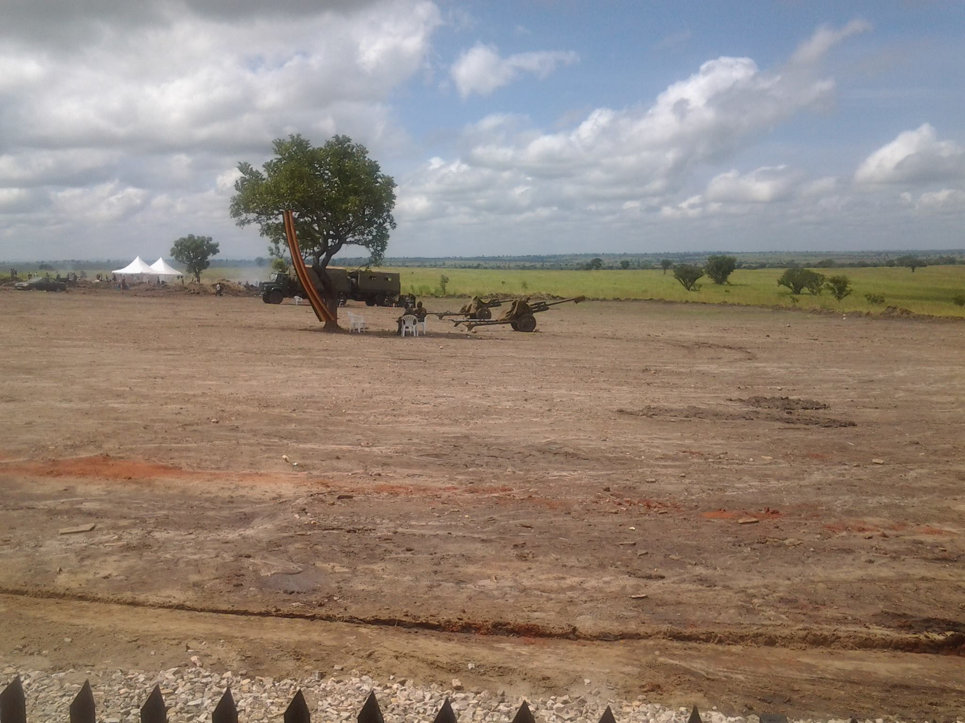
Oryema’s body was buried in the desolate place

Slide 37
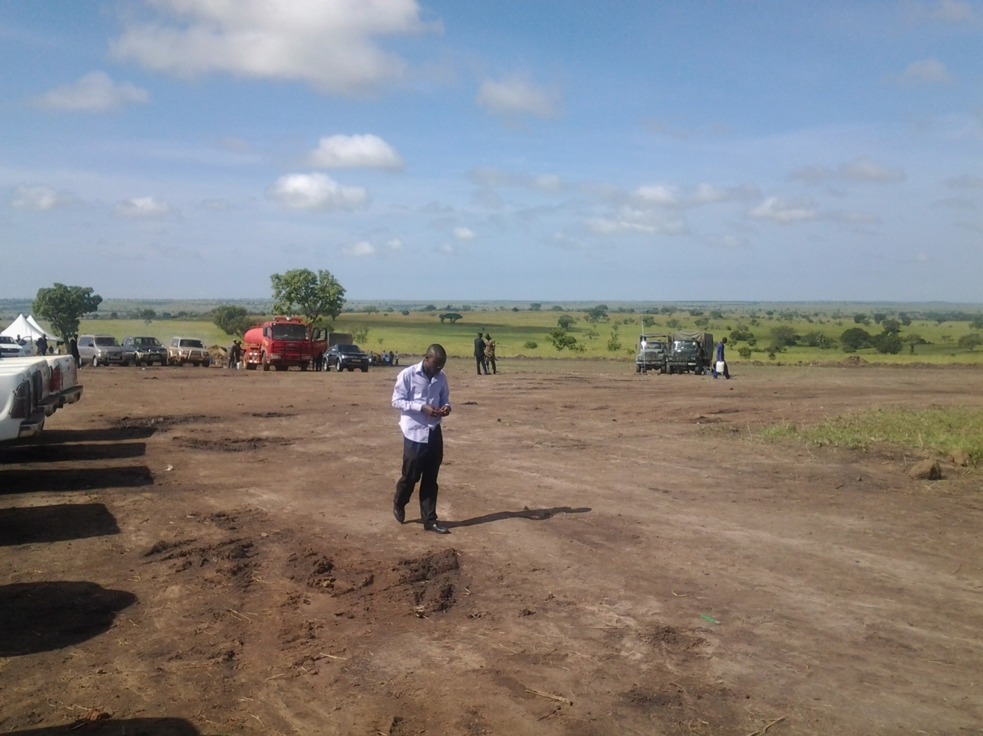
Oryema’s body was buried in the desolate place

Slide 38
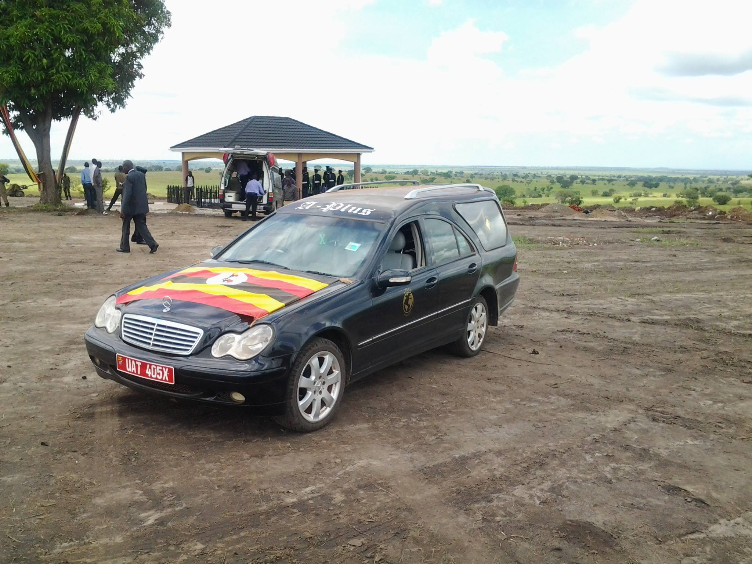
Re-burial of Oryema

Slide 39
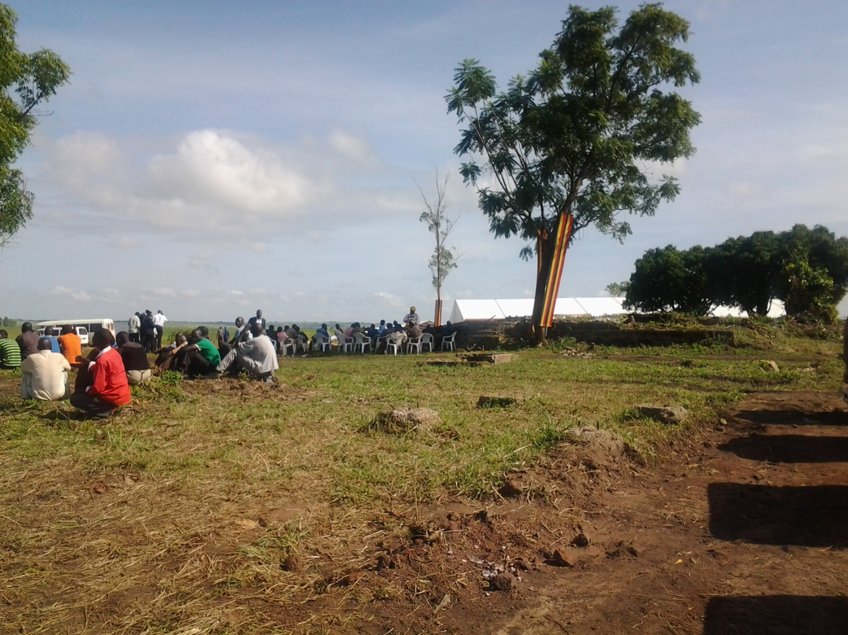
Re-burial of Oryema

Slide 40
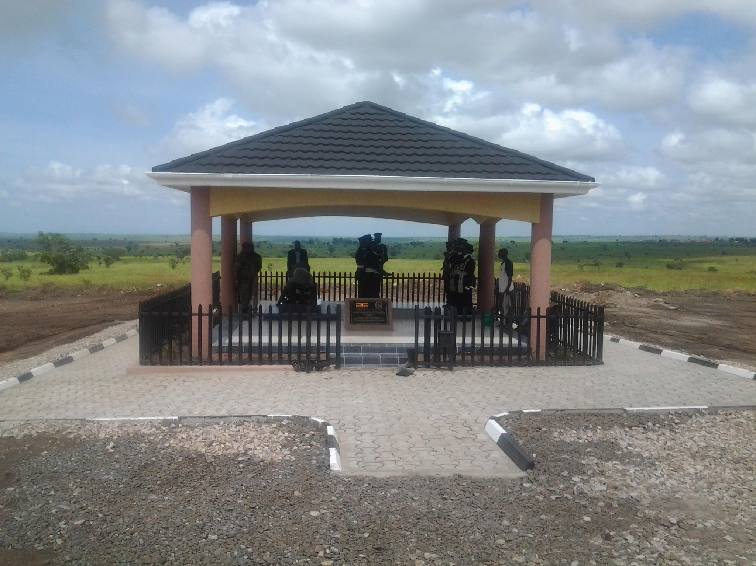
Re-burial of Oryema

Slide 41
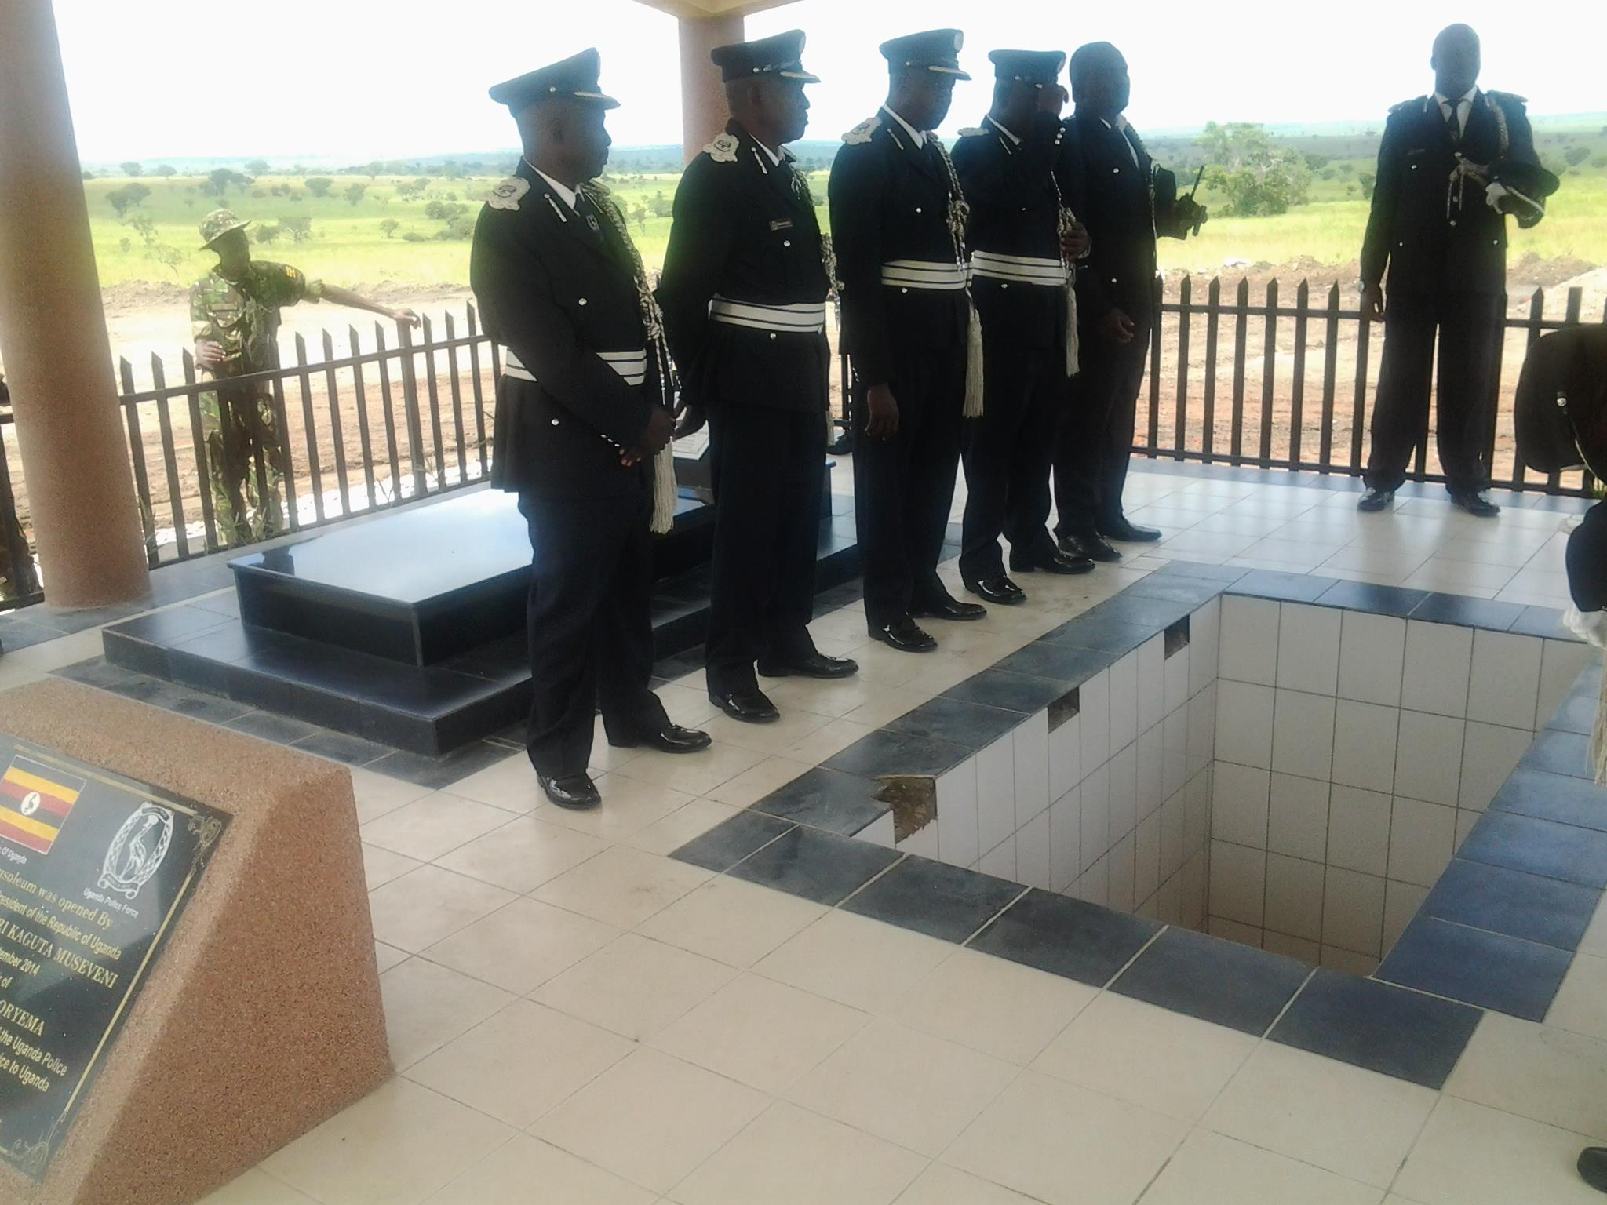
Re-burial of Oryema

Slide 42
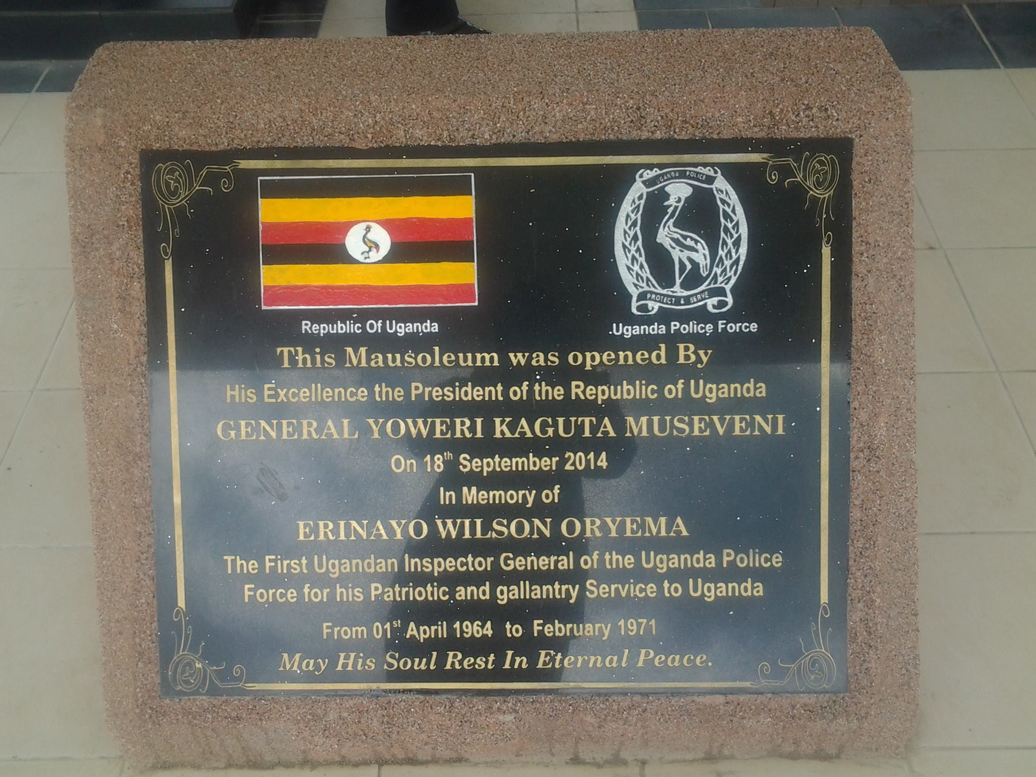
Re-burial of Oryema

Slide 43
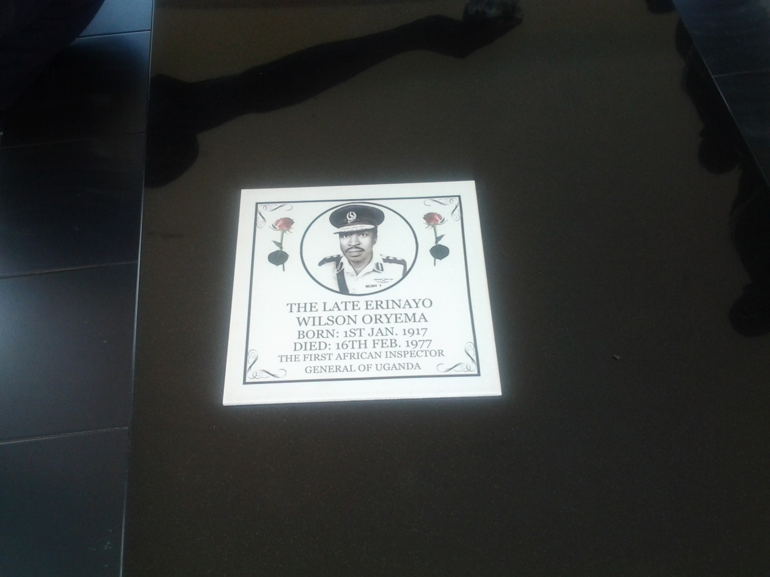
Re-burial of Oryema

Slide 44
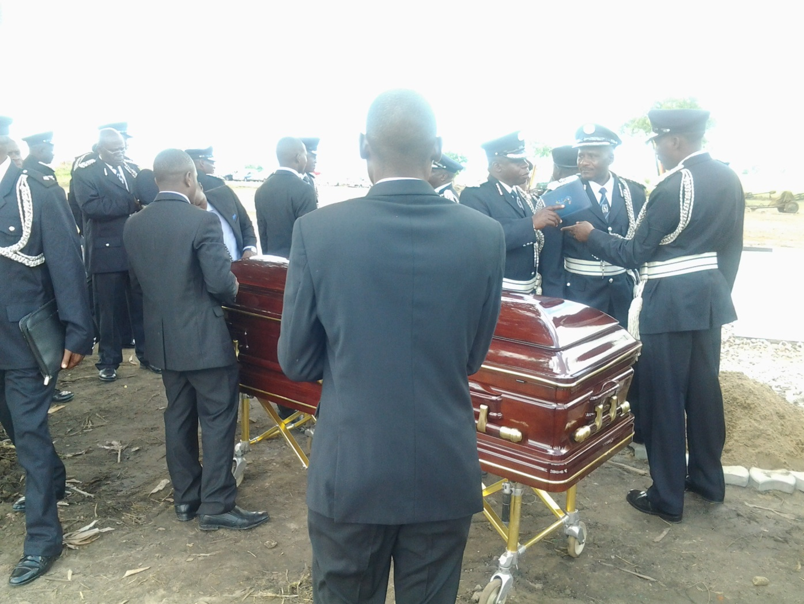
Re-burial of Oryema

Slide 45
Janani Luwum Day
February 16, 2015 marked the 38th Anniversary Commemoration of Archbishop-martyr Janani Luwum, the second African Archbishop of the Church of the Province of Uganda, Rwanda, Burundi and Boga Zaire and the second Bishop of Kampala Diocese, 1974-1977.
Here, the president declared February 16th as a national holiday with the title of ‘Janani Luwum Day’, commemorating the killings of three people including Oryema, allegedly by President Amin, on that day in 1977.
Taking the opportunity, UPC leader, Olara Otunnu (2015) published biography of Luwum, it was less effective strategy for the reader of such a book is limited to educated and literate people.

Slide 46
Commemorative Ceremony in Tororo
In addition, on July 25, 2015, His Excellency the President of the Republic of Uganda, Yoweri Kaguta Museveni, suddenly visited the compound of the late Arphaxad Charles Kole Oboth-Ofumbi(1932-1977) by helicopter.
Oboth-Ofumbi was secretary to the cabinet in Obote’s government. After the Coup by Idi Amin, in 1971, he was promoted to Minister of the state for Defence(1971), Minister for Defence (1971-1973), Minister of Finance(1974-1976), Minister of Internal Affair(1974-1977) in Amin’ s cabinet.

Slide 47
Commemorative Ceremony in Tororo
The President was welcomed by the widow, Elizabeth, and sons and daughters; he praised the contribution to the nation of the deceased, and offered flowers at the tomb.
In the compound in Tororo, former CAO, other local celebrities align the face, and the face of the author of that "State of Blood", Henry Kyemba who was one of the colleagues of the deceased as cabinet minister of Amin’s government could be identified.

Slide 48
Commemorative Ceremony in Tororo
This ceremony was reported by the UBC (Uganda Broadcasting Channel) and the newspapers ‘New Vision’ and ‘Daily Monitor’.
Among them, Henry Rubega, a ‘Daily Monitor’ reporter, had posted feature articles twice, including the previous day. Particularly noteworthy is the article reconstructing the nine days that served as the acting president of Amin based on the description of the diary of the late (existing).
In the article printed the previous day, Mrs. Oboth-Ofumbi was quoted as saying that the transporting of the body of Mutesa II from the UK and having the funeral take place in Uganda was made at the suggestion of Oboth-Ofumbi to Amin.
It is wellknown that this event made Amin immensely popular, especially in Buganda.

Slide 49
Commemorative Ceremony in Tororo
President Museveni's visit, although there was prior notice to the family, the final notice was the previous day.
In response to a preliminary announcement, his second son Samuel and family members returned home from the United States, established asylum and stayed in Tororo for one month.

Slide 50
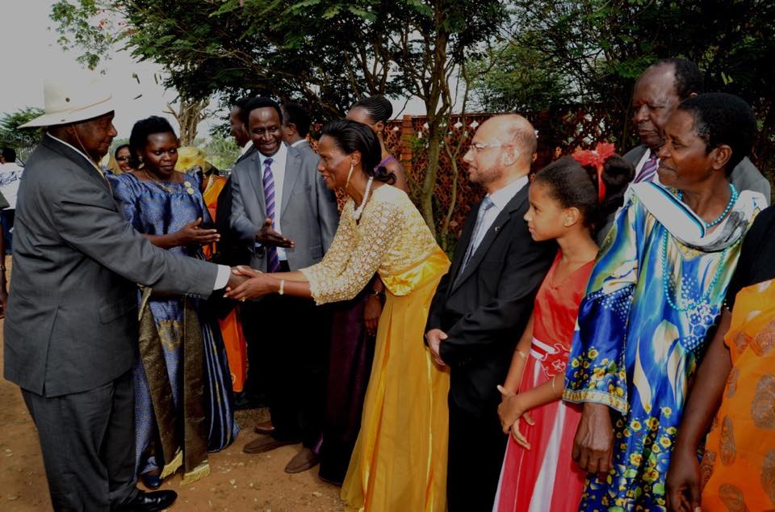
Oboth-Ofumbi’s Commemorative Ceremony

Slide 51
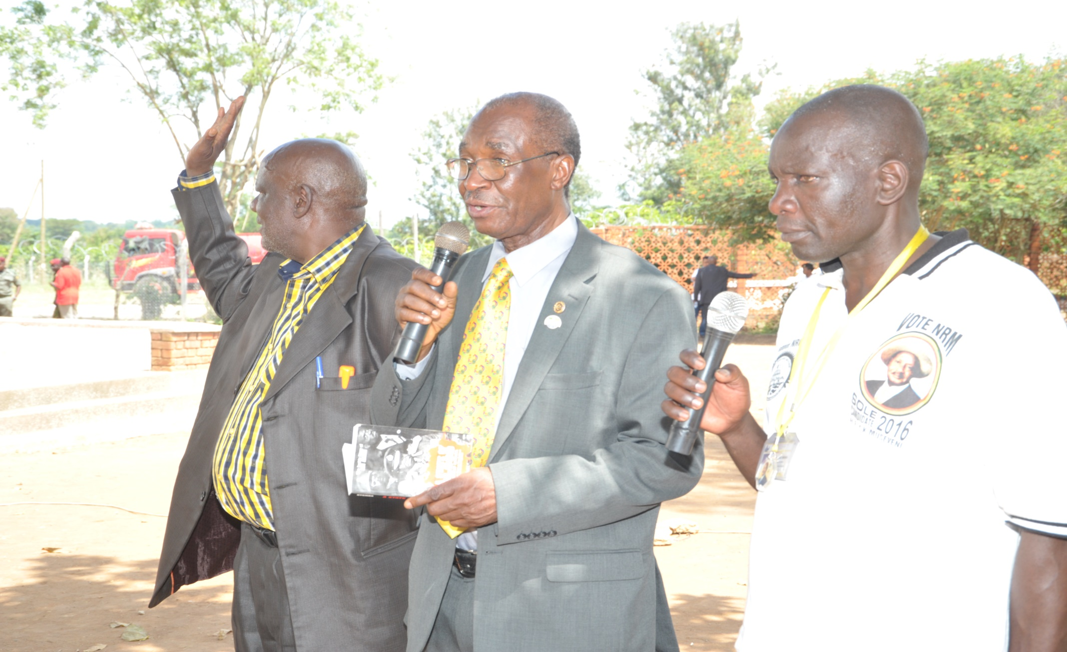
Author of The State of Blood

Slide 52
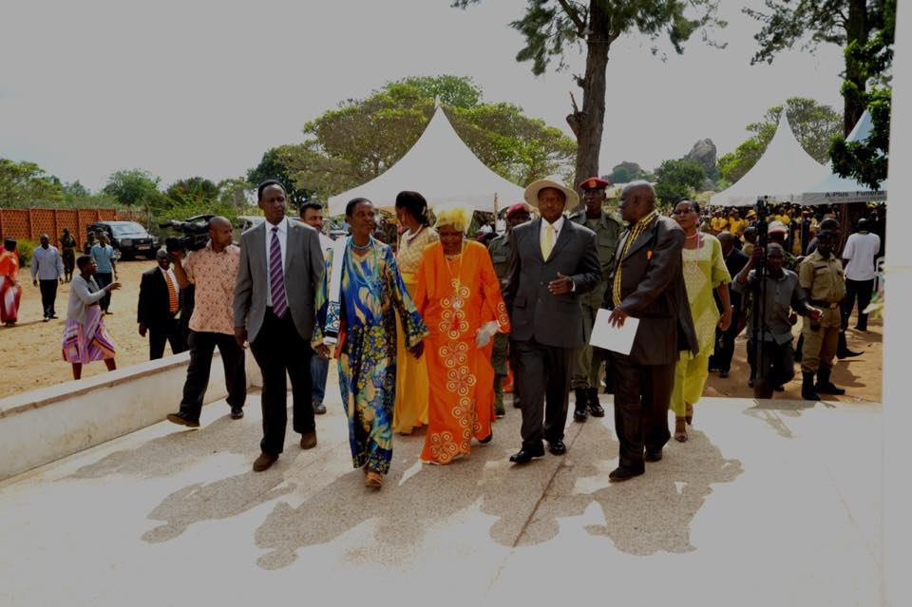
Oboth-Ofumbi’s Commemorative Ceremony

Slide 53
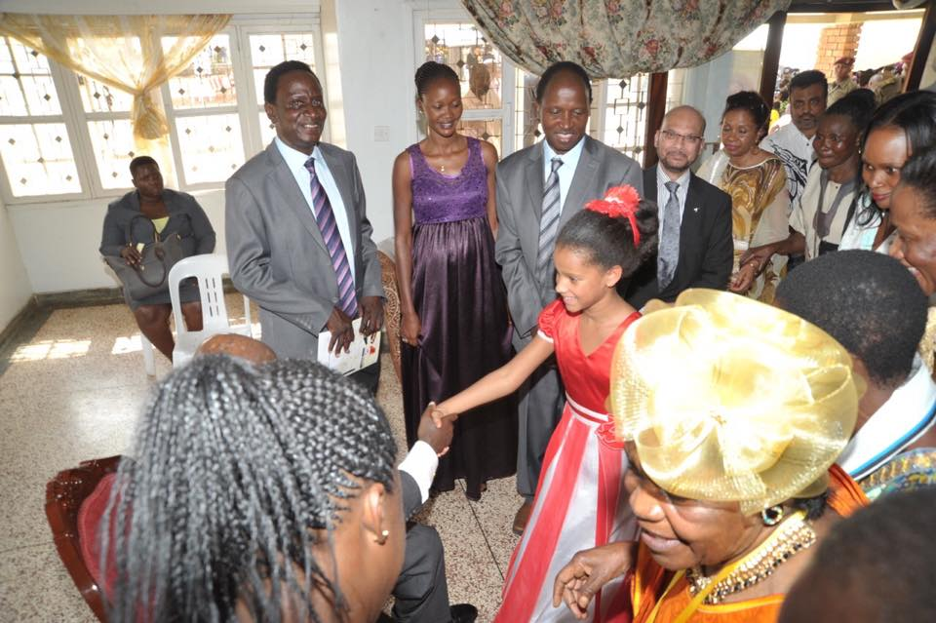
Oboth-Ofumbi’s Commemorative Ceremony

Slide 54
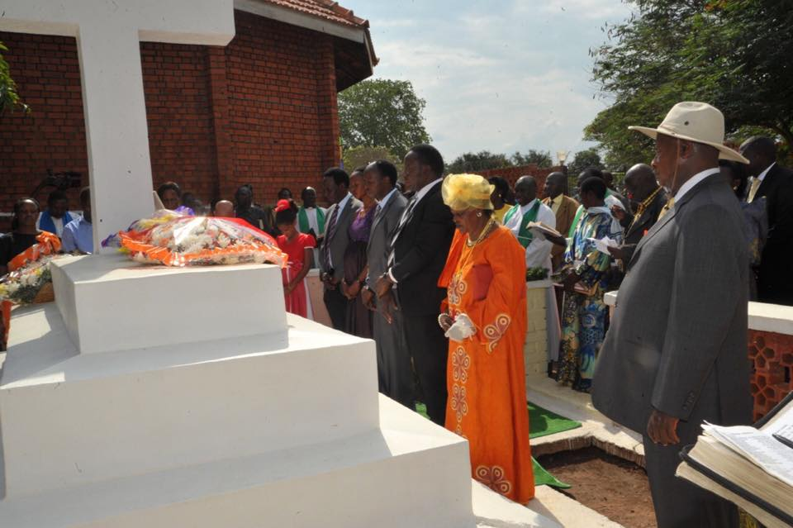
Oboth-Ofumbi’s Commemorial Ceremony

Slide 55
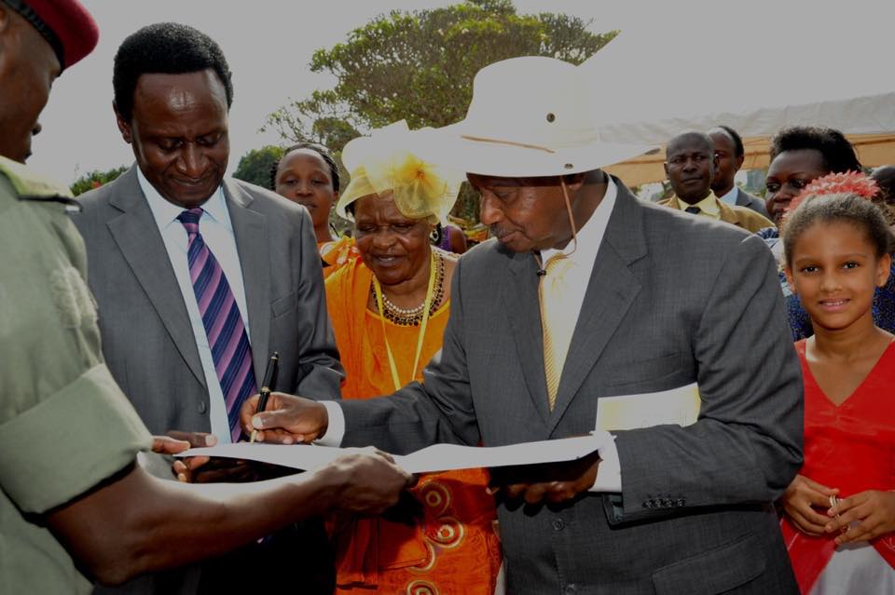
Oboth-Ofumbi’s Commemorial Ceremony

Slide 56
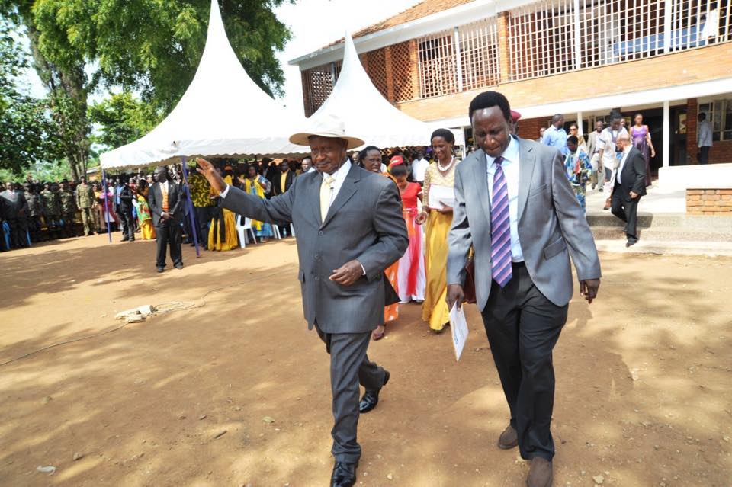
Oboth-Ofumbi’s Commemorial Ceremony

Slide 57
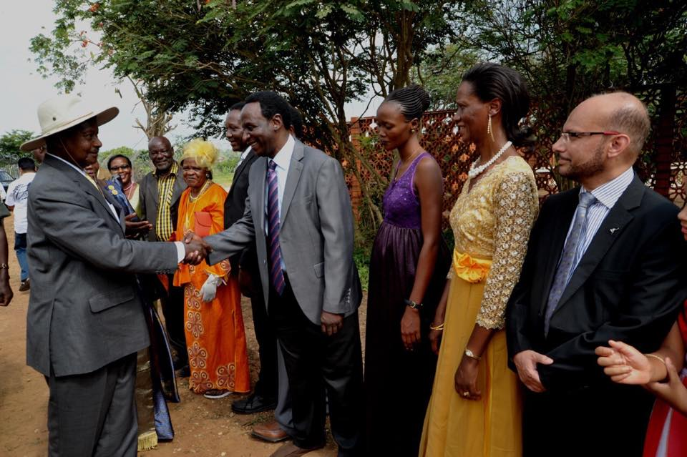
Oboth-Ofumbi’s Commemorative Ceremony

Slide 58
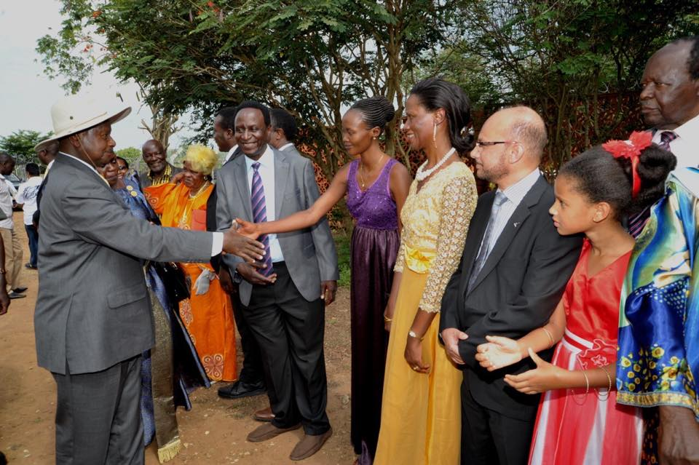
Oboth-Ofumbi’s Commemorative Ceremony

Slide 59
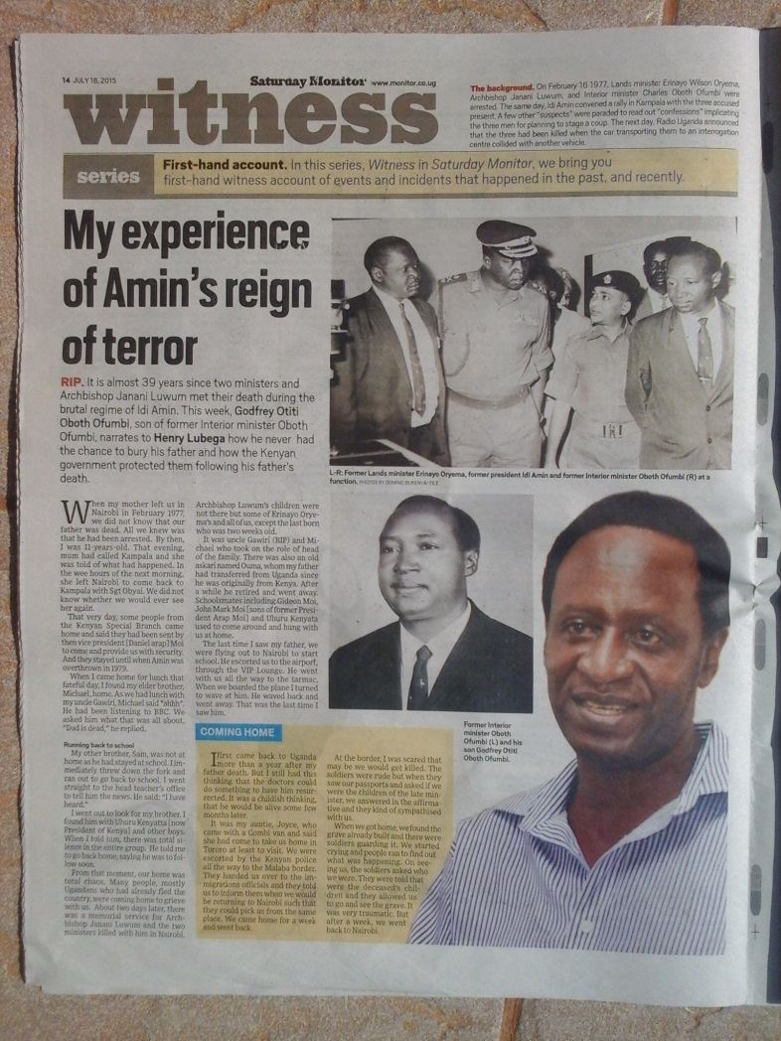
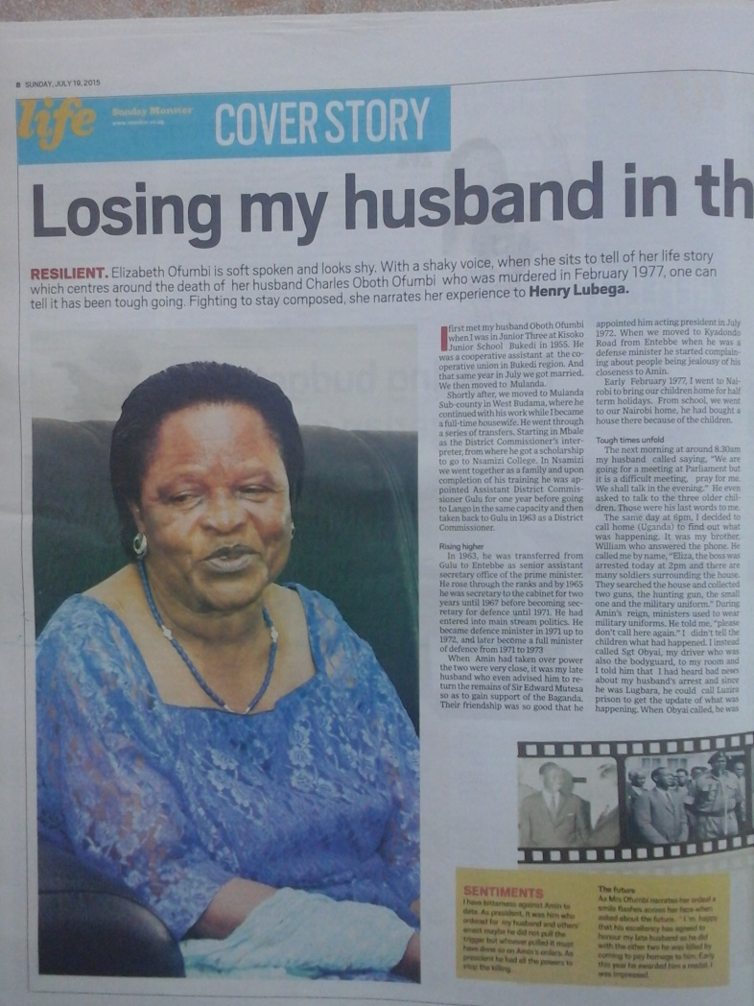
Ceremonies Reported on Newspapers

Slide 60
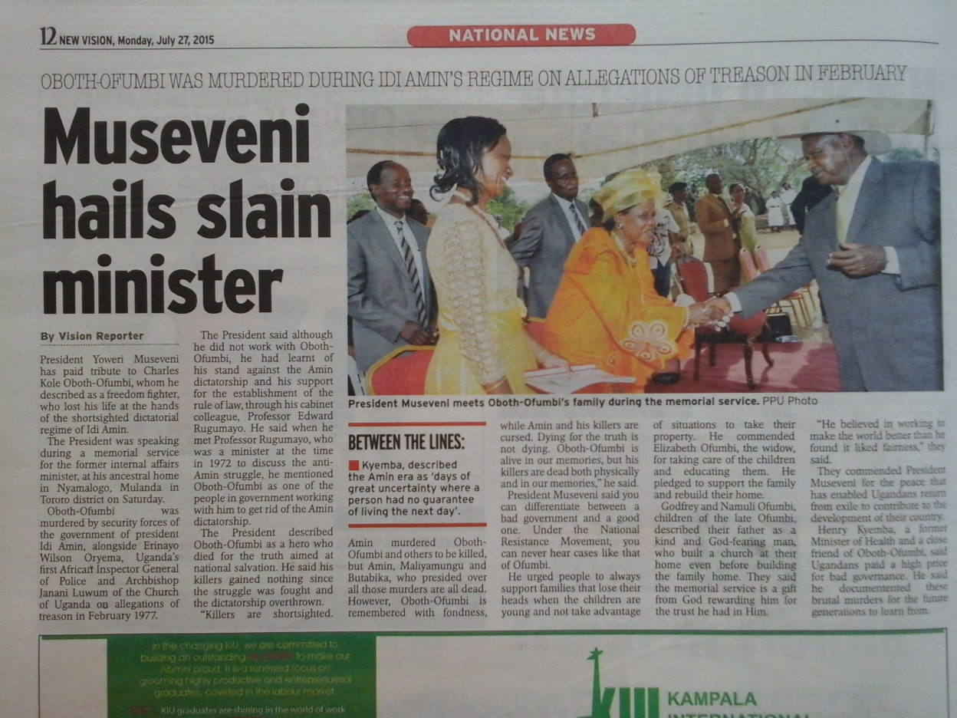
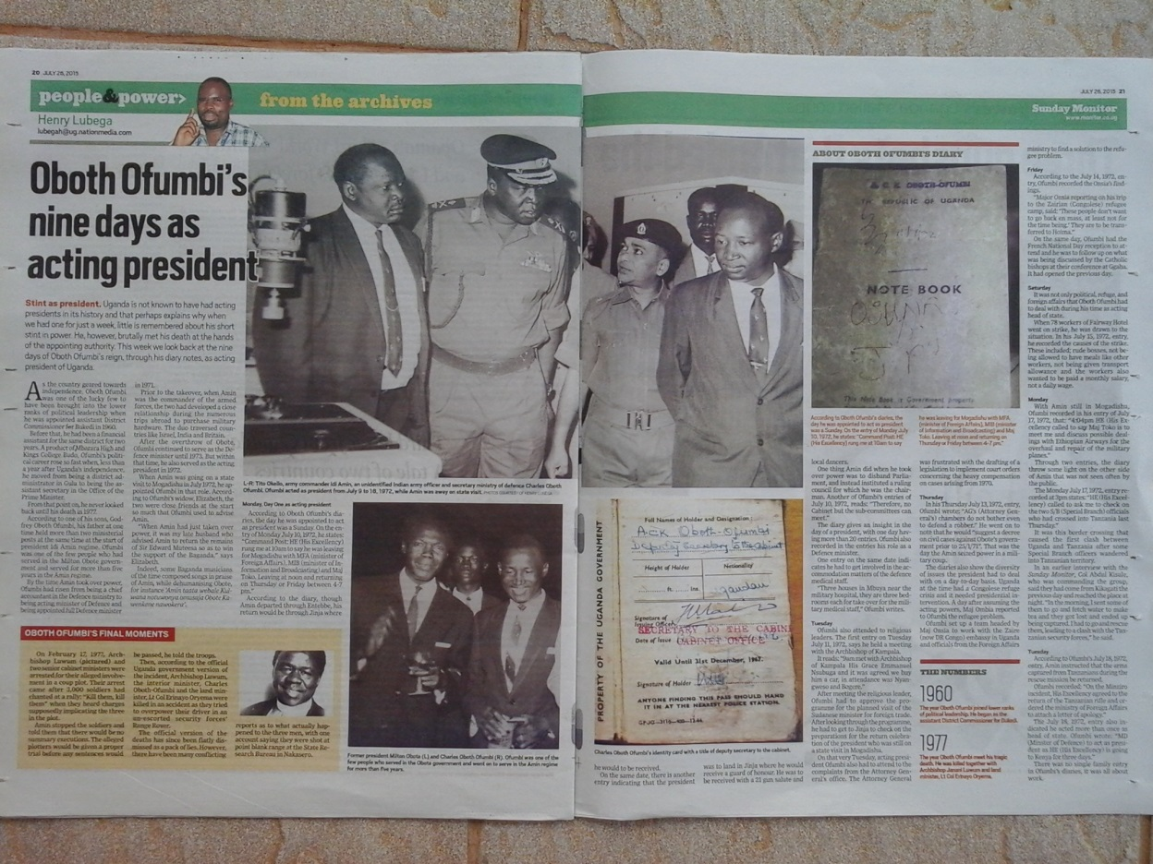
Ceremonies Reported on Newspapers

Slide 61
Ceremonies and Election Campaign
It is generally agreed by analysts that series of commemorative ceremonies like these are held in order to check levels of support for the NRM in the northern and eastern parts of Uganda, where allegedly many UPC supporters are. And eventually succeed to win additional vote.
It seems to have been a really effective strategy.

Slide 62
The power of spirit of the dead
In Padhola, a spiritual tint was added; an Adhola commented on a rumour that "since this election is expected to be a struggle, the president is going around and trying to collect the power of the spirits of the prominent figures of our side in order to get the victory.“
It was a very suggestive comment considering the fact the power of the spirit was thought to be influential to the victory in the election.
People in Padhola believe in the power of tipo the spirit of the dead who was killed by someone.
To control the power of tipo is very significant key issue in Padhola’s ‘spiritual security’(Ashforth 2005).

Slide 63
Universality of Citizenship to be Questioned
This series of events and the strategic effectiveness displayed in the Ugandan Presidential and General Elections of 2016 calls on us to rethink the universality of the idea of the concept of citizenship.
In short, this concept, as with all concepts of Western origin believed to be universal (like human rights, political correctness, etc.), is interwoven with autochthonous concepts in Africa and other area after imported from the West.
As a result of the series of events described above – particularly the last president's visit – the people of Padhola supported the president who honoured the great dead men of their ethnicity.
This means two things.

Slide 64
Citizenship and Ethnicity
One is that in the election, ethnicity play a certain role. This may be stating the obvious, but it is worth noting.
Although the importance of ethnicity has been recognized, it was often presented in terms of conflict axes.
This time the reburial was an epoch-making and unexpected strategy to address the issue and even successfully manage to integrate people on the basis of ethnicity even though the late Oboth-Ofumbi was not especially beloved by all his neighbours.

Slide 65
A Case of Uganda General Election
A series of reburial and memorial ceremonies for politicians from a certain ethnic group who were allegedly murdered by the dictator Idi Amin Dada, which took place under the order of the current president Yoweri Kaguta Museveni just before the general election in Uganda, are thought to have had a major influence on voting behaviour.
Specifically, rituals took place for the Archbishop Janani Luwum, the Minister of Mineral and Water Resources Erinayo Oryema, and the Minister for Internal Affairs Oboth-Ofumbi. The anniversary of their death (presumption) was made a public holiday as ‘Janani-Luwm’s Day’.

Slide 66
Reburial and Memorial Ceremonies
What I observed primarily was the participation of the Jopadhola ethnic group in the ceremonies, even though they did not generally support Museveni, who was dedicated to it despite his negative sentiment toward or even hatred of Oboth-Ofumbi when he was still alive.
Of course, an analysis should be made concerning cosmology as the background of Ugandans’ belief that politicians who achieve great success also possess great spiritual power. It can sometimes be believed to realize their hope, so they thought that Museveni is trying to collect and push his power.

Slide 67
‘The Agency of the Dead’
Moreover, because they were murdered by Amin, Museveni’s criticism of Amin's brutality also demonstrated the rightness and the correctness of his own politics, and served to bring the ‘enemies of his enemies’ into his own political camp.
However, because of Museveni's ceremonies for the dead, prominent people from the victims’ own ethnic group, irrespective of the intention of Oboth-Ofumbi and others while still alive, and even beyond the divide of ethnic groups, ‘the agency of the dead’ led to the Jopadhola’s support of Museveni.
In that sense, in fact the will of the deceased had attracted little attention of the living.

Slide 68
Paradox of Ethnicity
Many of the ethnic groups to which they belonged now support the Uganda People’s Congress (UPC). However, Otunu, the UPC's leader, published a biography of Luwum, but since access to the book was limited to the literate elite, there was absolutely no impact. Thus, votes for the UPC declined in the general election.

Slide 69
Japanese LDP
As a similar example, I would like to draw attention to the fact that current Japanese Liberal Democratic Party (LDP) politicians continue to make official visits to Yasukuni Shrine. At Yasukuni Shrine, victims of war are venerated as ‘special heroic ghosts’.
However, some of the dead have been condemned as war criminals in Tokyo trials, so visits to Yasakuni shrine are controversial. It is doubtful that politicians actively believe in the existence of such spirits. However, they know well that visiting this shrine can help them to gain voter support.

Slide 70
Conclusion
In this paper, we introduced some guidelines of analysis by introducing the concept of the agency of the dead.
Placing the barren controversy of believing or not believing in the existence of spirits aside, and accepting that the spirits of dead, whether real or not, have a certain influence on the behaviour of the living is necessary for the scope of analysis.
Even if they do not believe in the existence of the soul (although there are many people who do believe in it among them), the people of Sado Island continue to live on the island, the people in Northeastern Japan will remain by the sea, and the people of Bududa, Uganda will keep returning to their lands. Moreover, the Jopadhola people voted for Museveni, and unfortunately, the LDP won the general election in Japan.

Slide 71
Conclusion
In many cases, the intentions of the spirits of ancestors have been considerably neutralized and ignored.
For example, the Sado Island ancestors may have supported their descendants leaving the island in pursuit of a better life.
Moreover, the victims of the Tohoku tsunami and the Bududa landslides may not want their living descendants to sacrifice their own lives, and it is not certain whether Oboth-Ofumbi and Janani Luwum would have supported Museveni if they had survived. Finally, I do not think the spirits of the deceased at Yasukuni Shrine would be happy looking at the present situation of the LDP's current politics.

Slide 72
Conclusion
However, when we analyse society, it is not enough to just analyse its living members; we must also consider the agency of the deceased and the effects of the living.
In that sense, we can say that the dead still have citizenship, even though they have died, and their agency can greatly affect the behaviour of the living, even if their intentions are often greatly misunderstood.

Slide 73
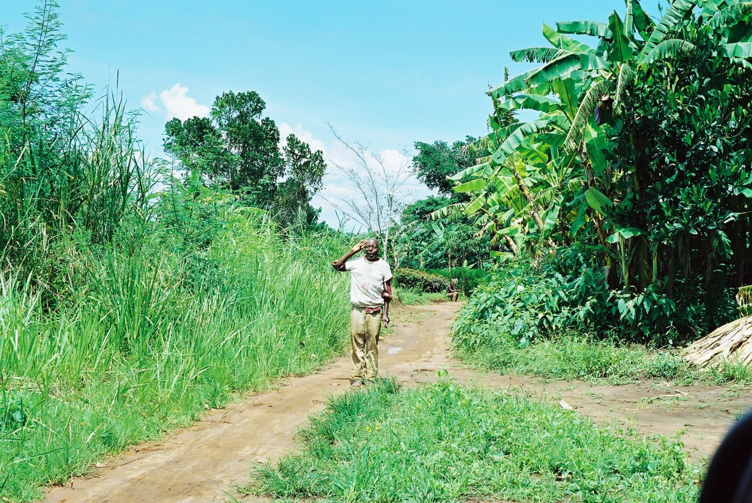
Waluwa wini teki teki

Slide 74
References
Ashforth, Adam (2005)
Witchcraft, Violence, and Democracy in South Africa. Chicago: University of Chicago Press.
Comaroff, J and J. L. Comaroff (1999)
Civil Society and the Political Imagination in Africa, Chicago: University of Chicago Press.
Nyamnjoh, F. B. (2001)
‘ Delusions of Development and the Enrichment of Witchcraft Discourses in Cameroon.’ In Henrietta L. Moore and Todd Sanders (eds.)Magical Interpretations, Material Realities: Modernity, Witchcraft and the Occult in Postcolonial Africa. London & N. Y.: Routledge.
Nyamnjoh, F.B. (2017)
‘ Rethinking Citizenship in 21th Century Africa: Some Conceptual Consideration.’The paper read at the meeting taken place on 26, July, 2017, Abeno Harukas Campus, Shitennnoji University.
Seftel, Adam (ed.)(1994)
Uganda: The Rise and Fall of Idi Amin, From the Pages of Drum. Pretoria: Sigma Press.
Umeya, Kiyoshi (2017)
‘ Citizenship Including the Dead, Ancestors and Gods: Some Clues of Discussion from Northern Villages on Sado Island, Niigata Prefecture, Japan.’ The paper read at the meeting taken place on 26, July, 2017, Abeno Harukas Campus, Shitennnoji University.
Werbner, R. (1999)
‘ Introduction: Multiple Identities, Plural Arenas. ’ In Richard Werbner & T. Ranger (eds.) Postcolonial Identities in Africa. London: Zed Books.

