Slide 1

Re-burial of Prominent Luo People and the 2016 Ugandan General Election
Kiyoshi Umeya
Professor, Dr.
Social Anthropology
Kobe University

Slide 2
Introduction
In this paper, I argue that a series of the government re-burial or commemorative ceremonies of great Luo men from 2014 to 2015, those who were murdered by Amin, was very effective strategy in campaigning for President Museveni’s re-election.
One of the most successful events was naming Janani Luwum Day as a national holiday. I attempt to describe the attitude of the Jopadhola people in eastern Uganda towards a series of events surrounding the re-burials and the election.

Slide 3
Introduction
I thus confirm how individuals with voting rights are inseparably connected to the identity and sentiments of their ethnic group.
The re-burials clearly show that modern presidential elections have an emotional aspect as well as a civic one.
Throughout the discussion, I propose an intricate interwoven relationship between the autonomous concepts of personhood that incorporate a shared social space with the dead and the formal definitions of citizenship imported from the West.

Slide 4
Re-burial of Oryema and Luwum’s Day
On September 18, 2014 a reburial ceremony for Erinayo Wilson Oryema (1917–1977) was held in Nyowa District.
He was Uganda's first African Inspector General of Police (1964-1971), In Amin’s regime, he was appointed Minister of Land, Mineral, and Water Resources (1971-1974) and Minister of Land, Housing and Physical Planning (1974-1977).
He was superior authority in KAR to Amin, in 1940s and best man at Amin’ s wedding to Kay Adoroa, who was later killed. In a sense, he was accepted to be Amin’s the most trusted OB in the world.
In February 1977, Oryema, together with Archbishop Janani Luwum and Interior Minister Charles Oboth-Ofumbi, is generally considered as having been murdered by the SRB of President Idi Amin.

Slide 5
Re-burial of Erinayo Oryema
For Oryema's re-burial, the son of the late Charles Oboth-Ofumbi, another of the three victims, and who attended on behalf of their family, told me,
‘…There was no other house around, there were only a few grave tombs near the place like a national park where you can encounter wild animals, the Oryema’s family no longer lives around, it was desolate place.
Since tomb room was not made of concrete at the time of burial, the coffin had not kept the form. I can see cloth seems to have wrapped the body, such as the vinyl tent, and part of the skull, and a few bones to be confirmed as his remains.
Ordinary military uniform not attached with a medal etc. was seemingly put on, but what surprised me is that it is stained with blood. Even after 38 years in the earth, I did not expect that blood stain can stand as recognizable for such a long time…’

Slide 6
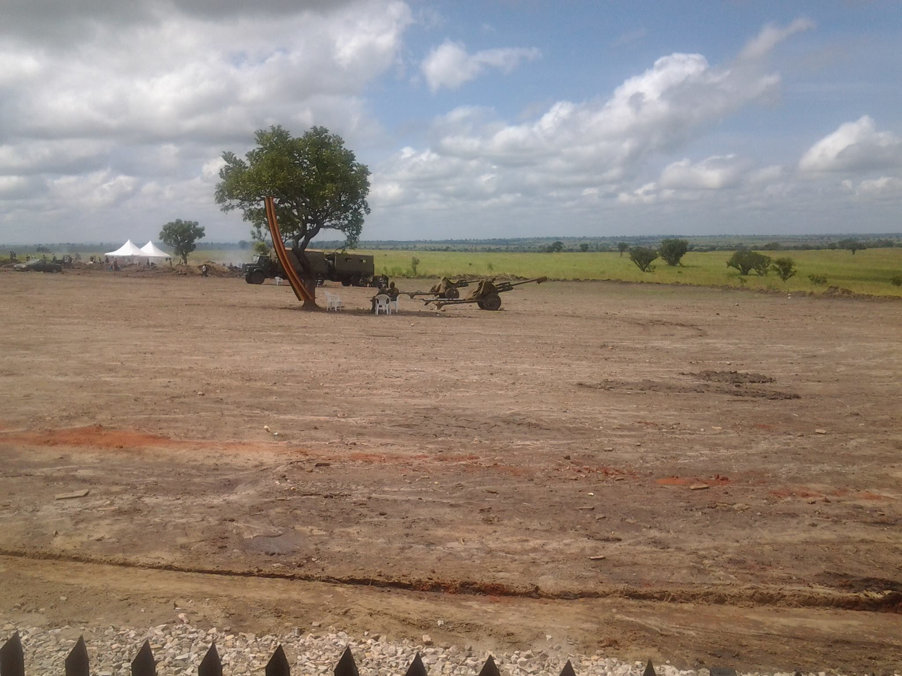
Oryema’s body was buried in the desolate place

Slide 7
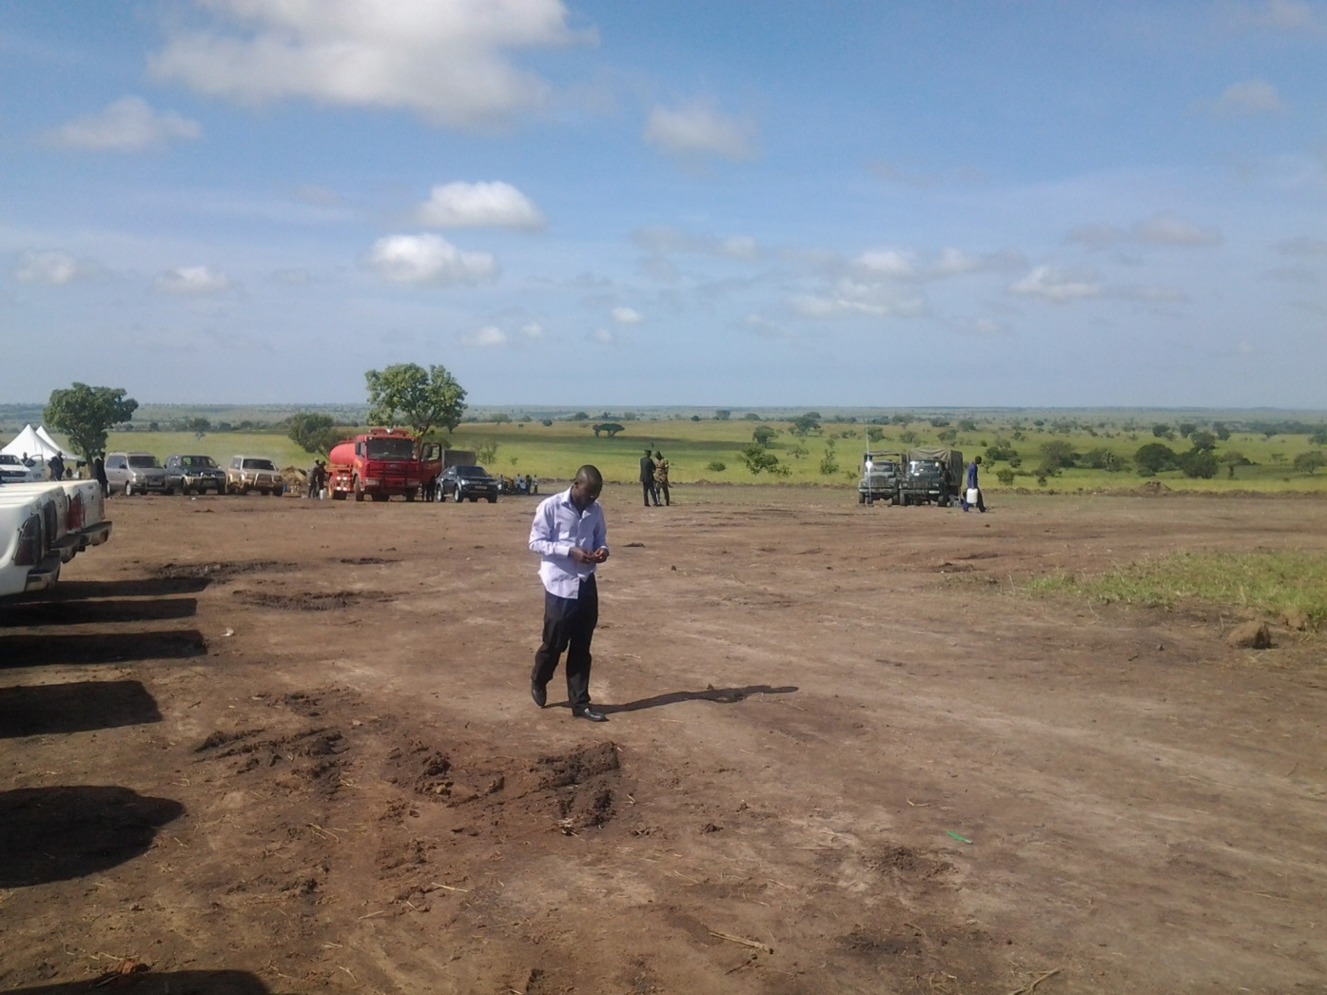
Oryema’s body was buried in the desolate place

Slide 8
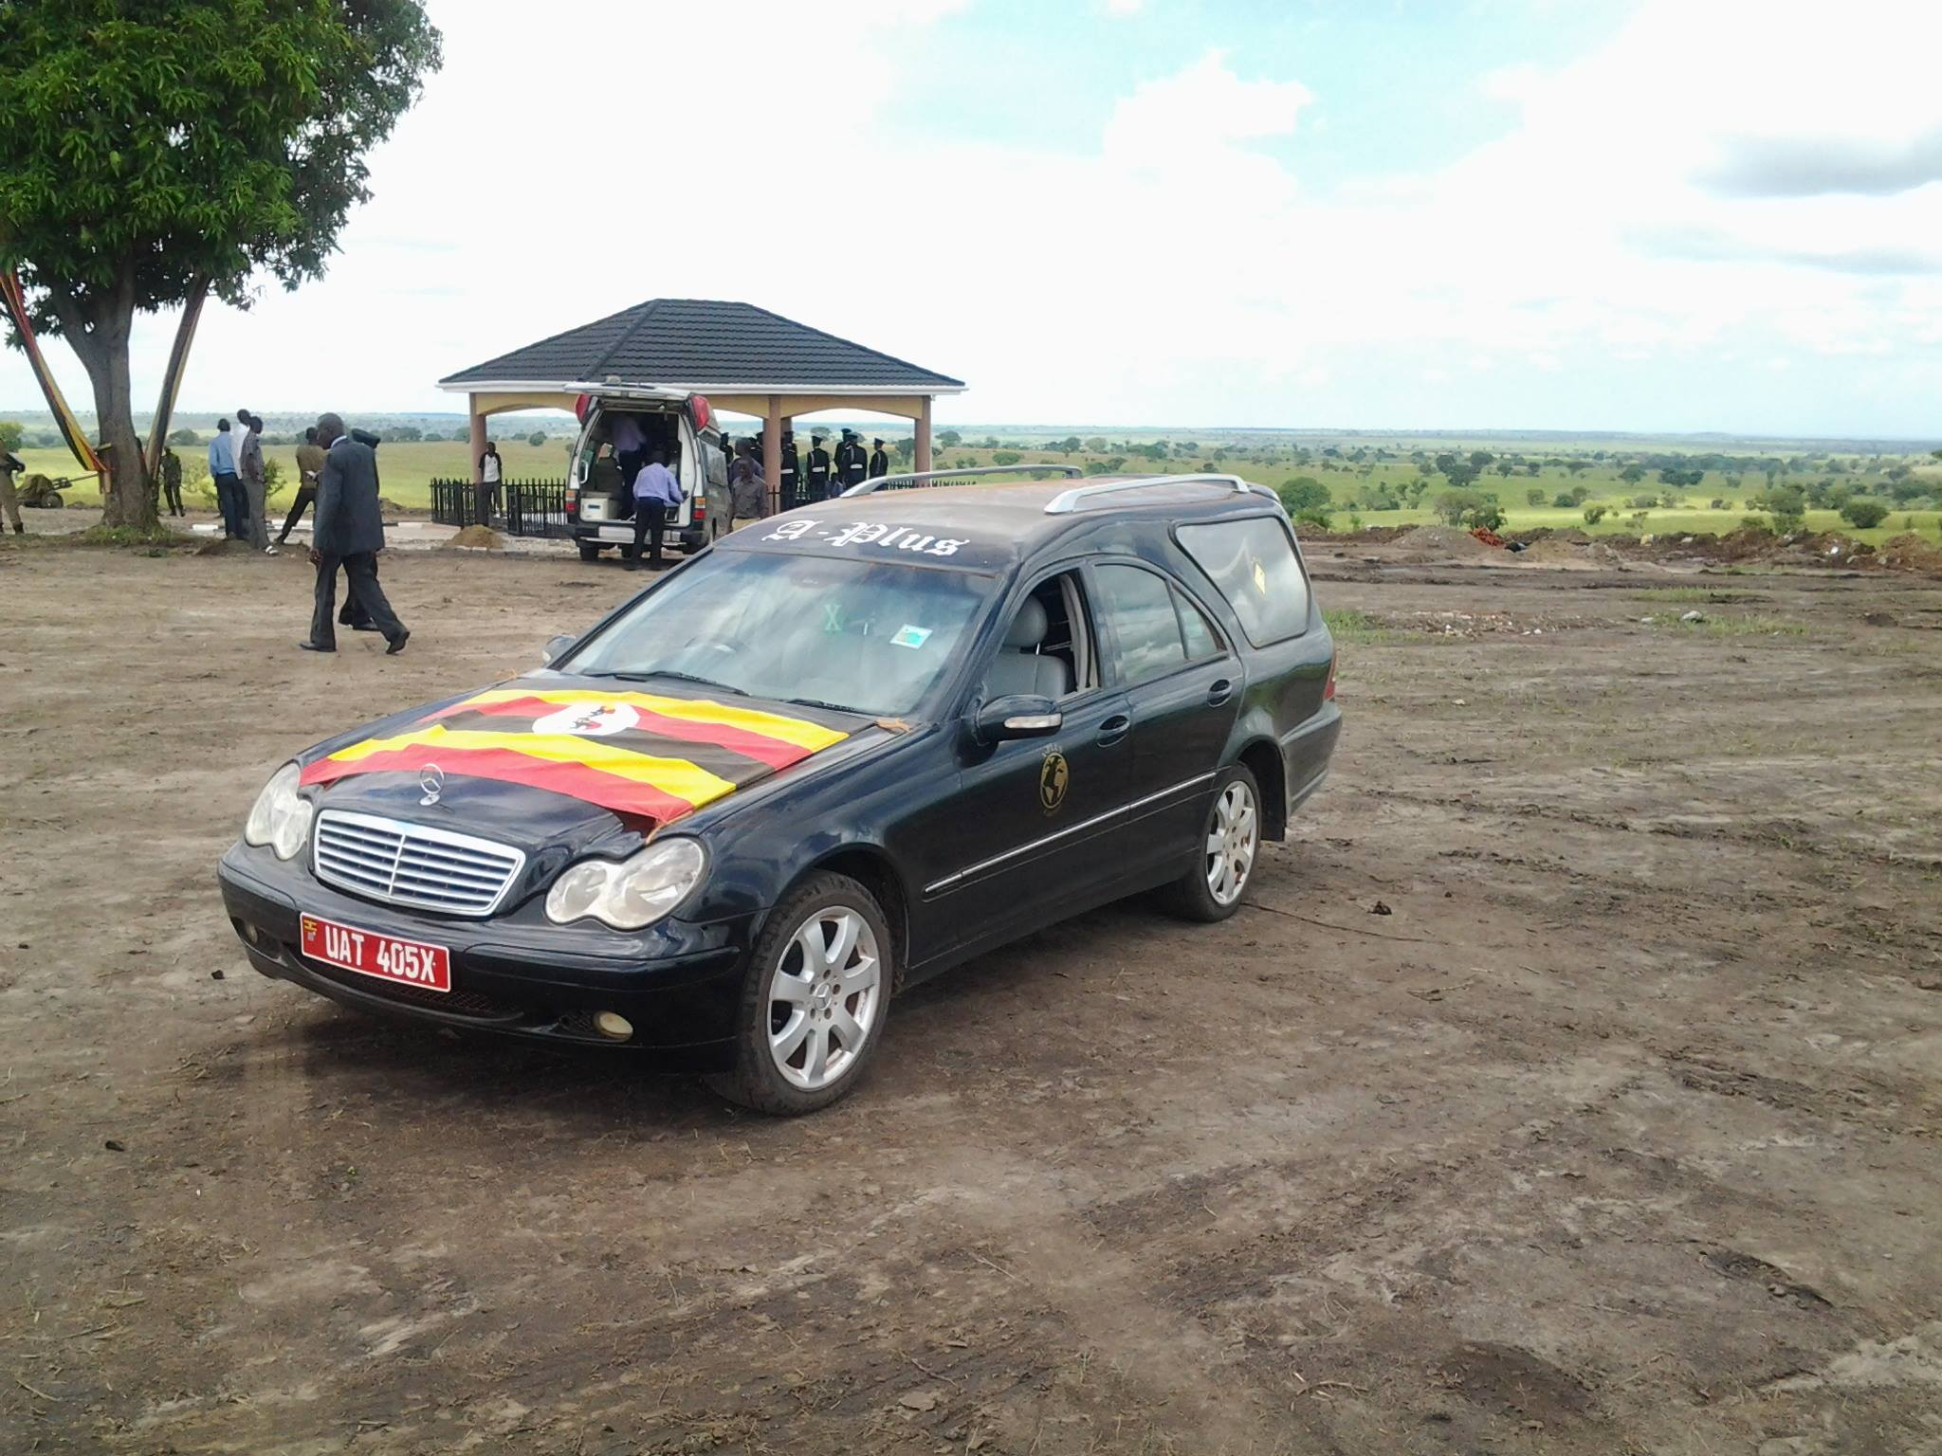
Re-burial of Oryema

Slide 9
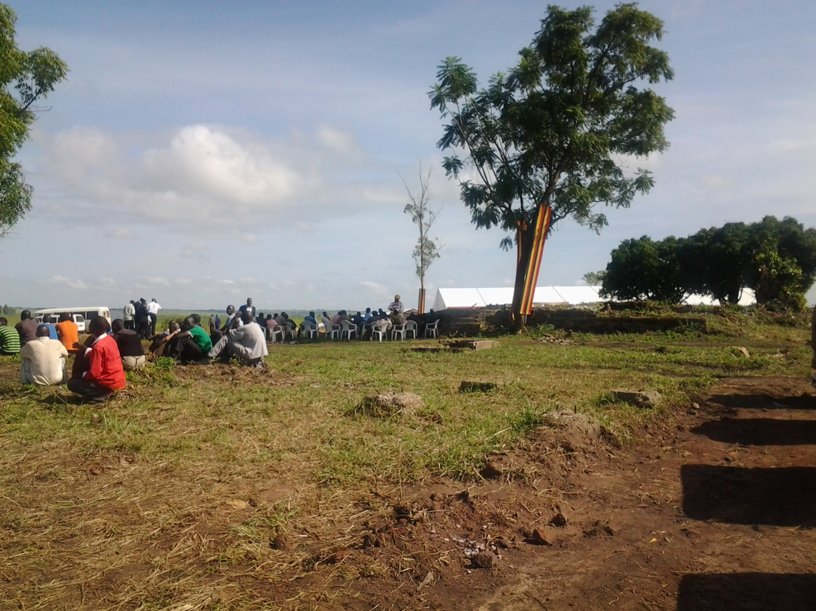
Re-burial of Oryema

Slide 10
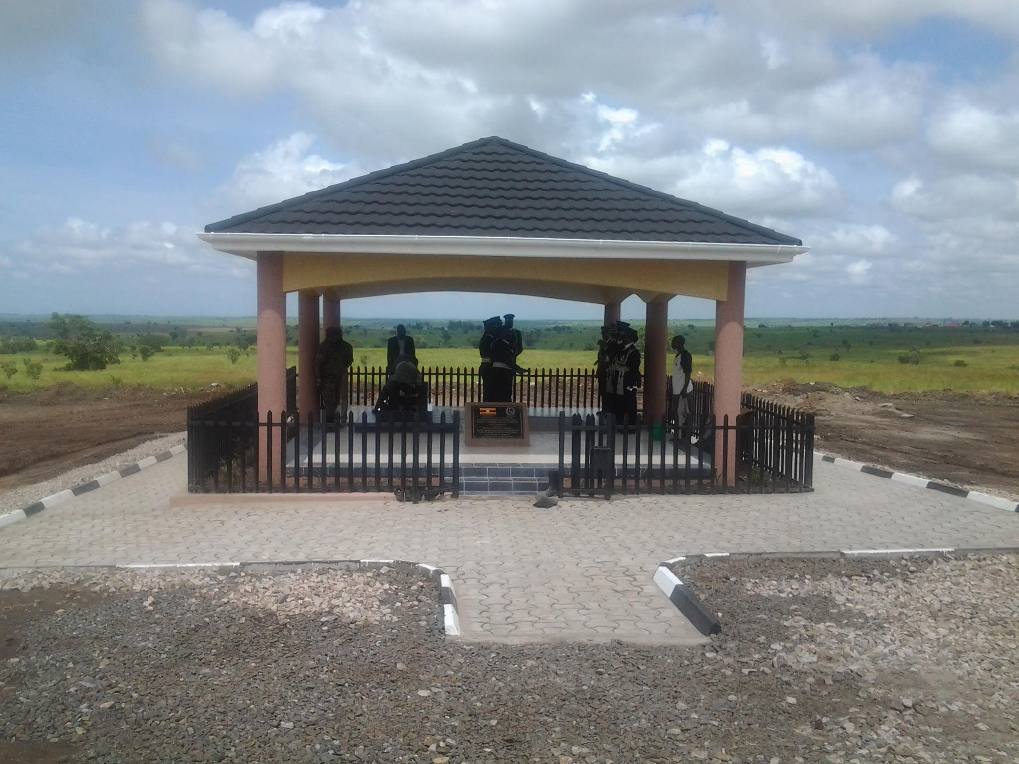
Re-burial of Oryema

Slide 11
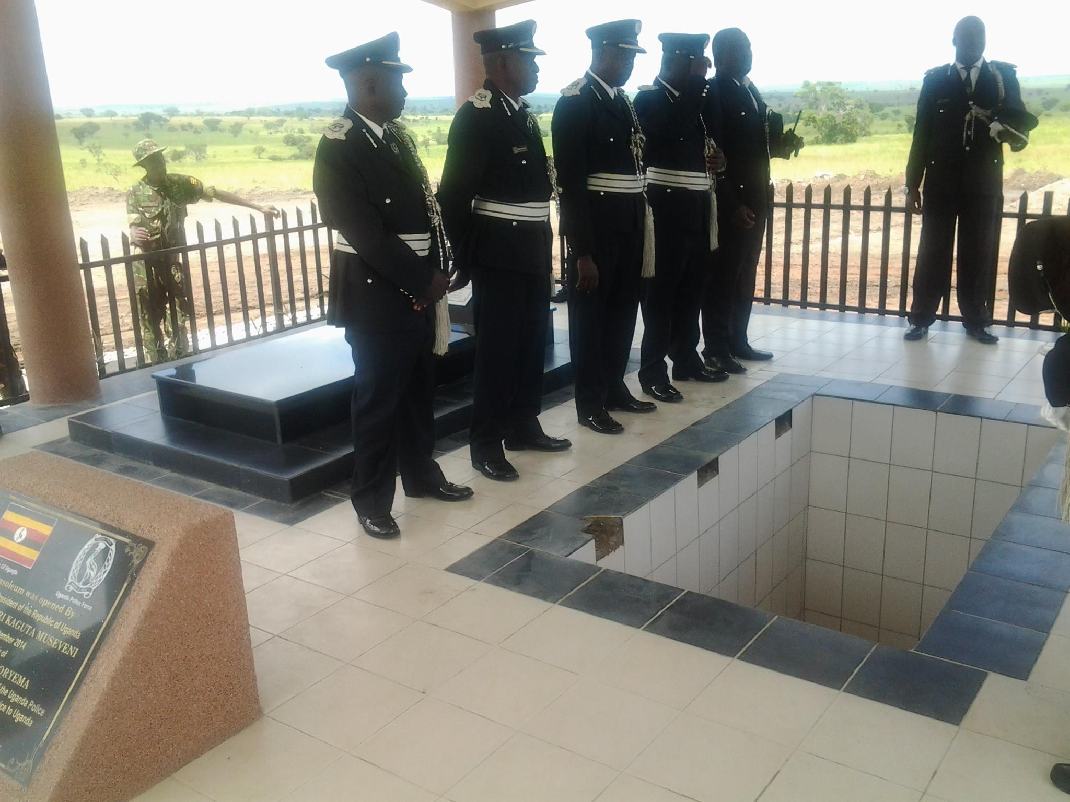
Re-burial of Oryema

Slide 12
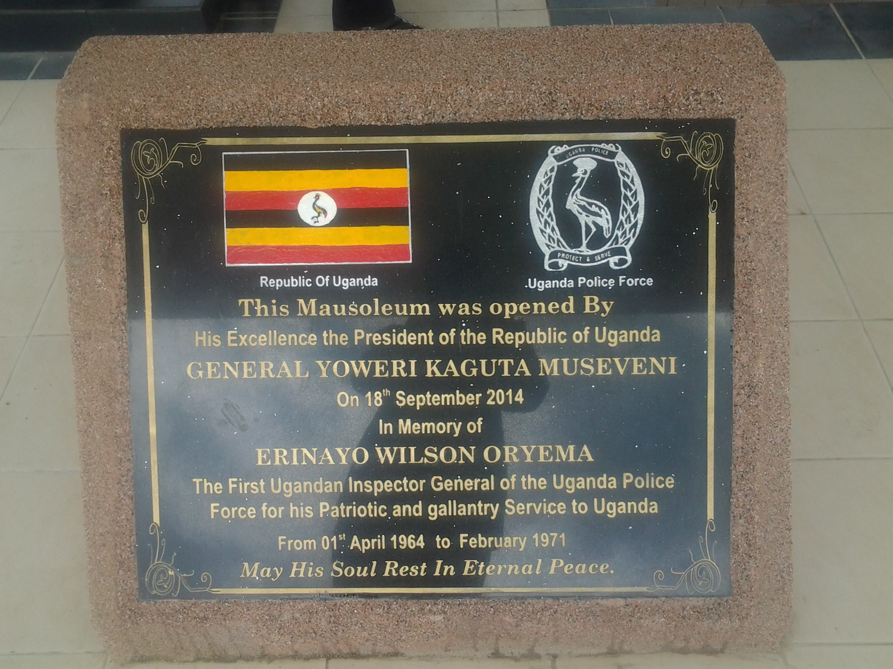
Re-burial of Oryema

Slide 13
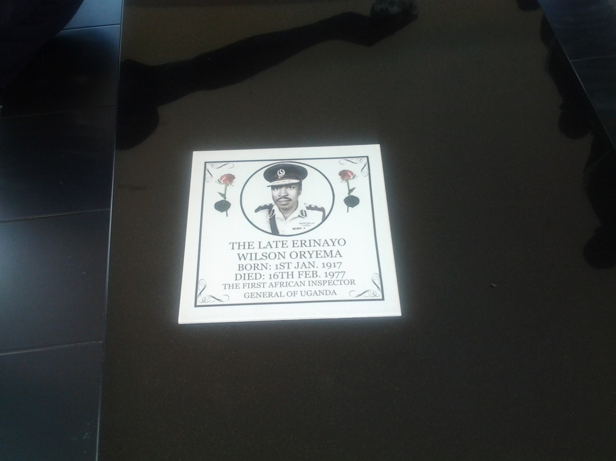
Re-burial of Oryema

Slide 14
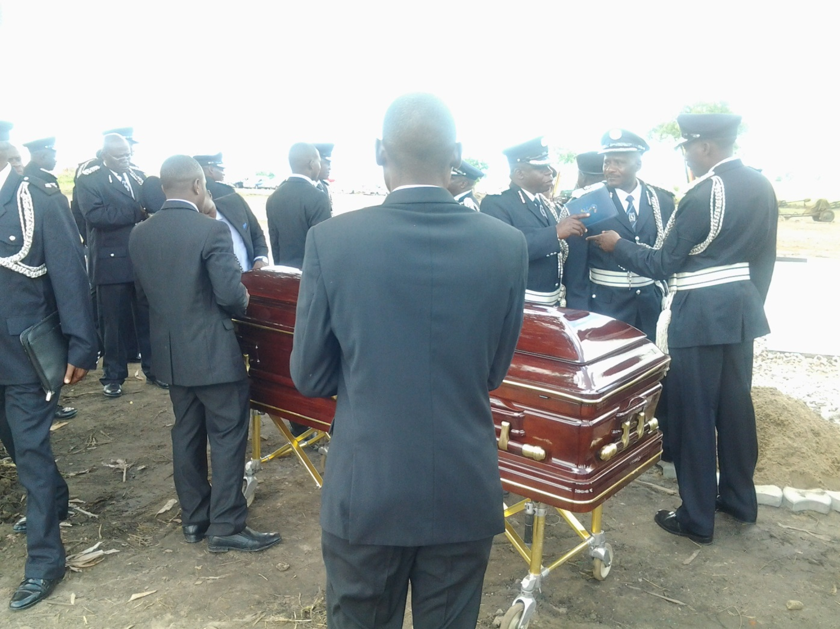
Re-burial of Oryema

Slide 15
Janani Luwum Day
February 16, 2015 marked the 38th Anniversary Commemoration of Archbishop-martyr Janani Luwum, the second African Archbishop of the Church of the Province of Uganda, Rwanda, Burundi and Boga Zaire and the second Bishop of Kampala Diocese, 1974-1977.
Here, the president declared February 16th as a national holiday with the title of ‘Janani Luwum Day’, commemorating the killings of three people including Oryema, allegedly by President Amin, on that day in 1977.
Taking the opportunity, UPC leader, Olara Otunnu (2015) published biography of Luwum, it was less effective strategy for the reader of such a book is limited to educated and literate people.

Slide 16
Commemorative Ceremony in Tororo
In addition, on July 25, 2015, His Excellency the President of the Republic of Uganda, Yoweri Kaguta Museveni, suddenly visited the compound of the late Arphaxad Charles Kole Oboth-Ofumbi(1932-1977) by helicopter.
Oboth-Ofumbi was secretary to the cabinet in Obote’s government. After the Coup by Idi Amin, in 1971, he was promoted to Minister of the state for Defence(1971), Minister for Defence (1971-1973), Minister of Finance(1974-1976), Minister of Internal Affair(1974-1977) in Amin’ s cabinet.

Slide 17
Commemorative Ceremony in Tororo
The President was welcomed by the widow, Elizabeth, and sons and daughters; he praised the contribution to the nation of the deceased, and offered flowers at the tomb.
In the compound in Tororo, former CAO, other local celebrities align the face, and the face of the author of that "State of Blood", Henry Kyemba who was one of the colleagues of the deceased as cabinet minister of Amin’s government could be identified.

Slide 18
Commemorative Ceremony in Tororo
This ceremony was reported by the UBC (Uganda Broadcasting Channel) and the newspapers ‘New Vision’ and ‘Daily Monitor’.
Among them, Henry Rubega, a ‘Daily Monitor’ reporter, had posted feature articles twice, including the previous day. Particularly noteworthy is the article reconstructing the nine days that served as the acting president of Amin based on the description of the diary of the late (existing).
In the article printed the previous day, Mrs. Oboth-Ofumbi was quoted as saying that the transporting of the body of Mutesa II from the UK and having the funeral take place in Uganda was made at the suggestion of Oboth-Ofumbi to Amin.
It is wellknown that this event made Amin immensely popular, especially in Buganda.

Slide 19
Commemorative Ceremony in Tororo
President Museveni's visit, although there was prior notice to the family, the final notice was the previous day.
In response to a preliminary announcement, his second son Samuel and family members returned home from the United States, established asylum and stayed in Tororo for one month.

Slide 20
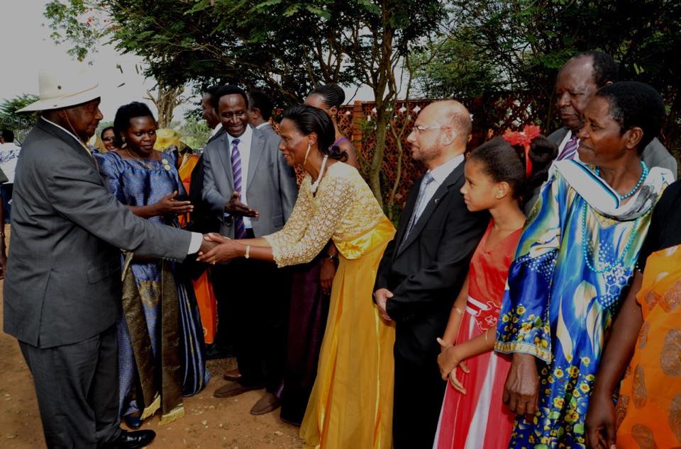
Oboth-Ofumbi’s Commemorative Ceremony

Slide 21
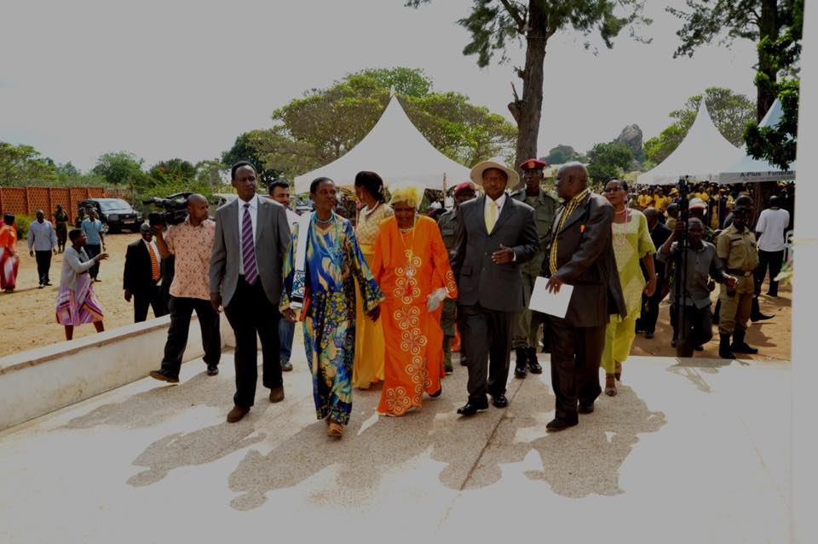
Oboth-Ofumbi’s Commemorative Ceremony

Slide 22
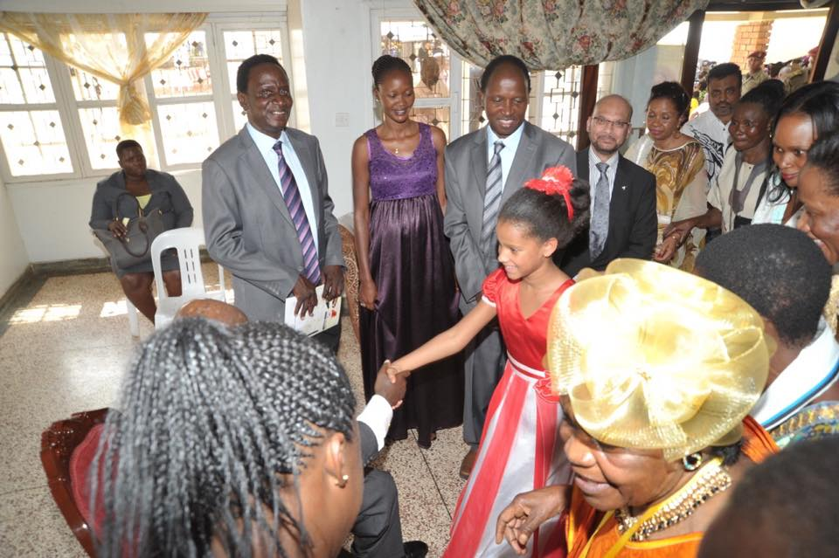
Oboth-Ofumbi’s Commemorative Ceremony

Slide 23
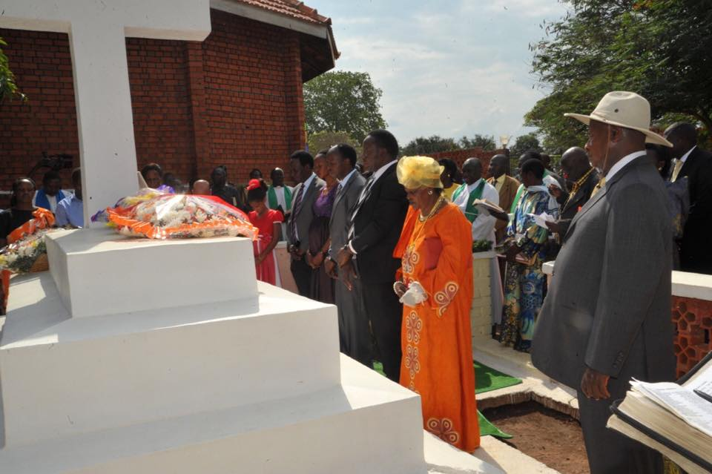
Oboth-Ofumbi’s Commemorial Ceremony

Slide 24
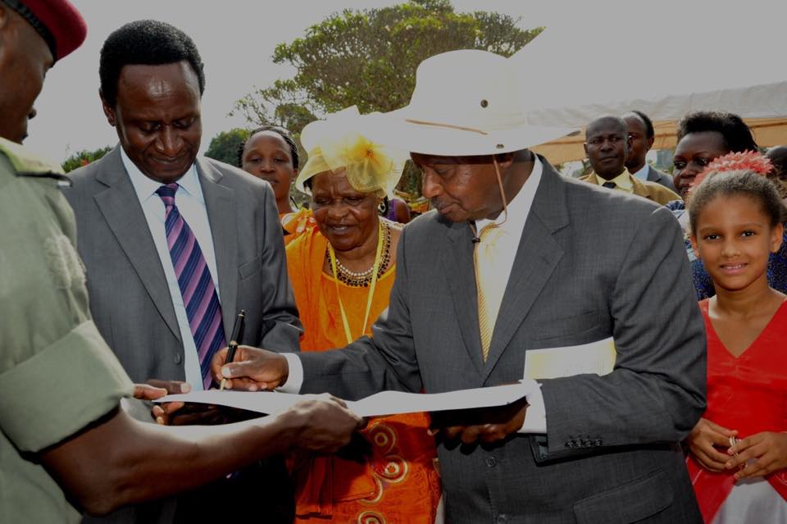
Oboth-Ofumbi’s Commemorial Ceremony

Slide 25
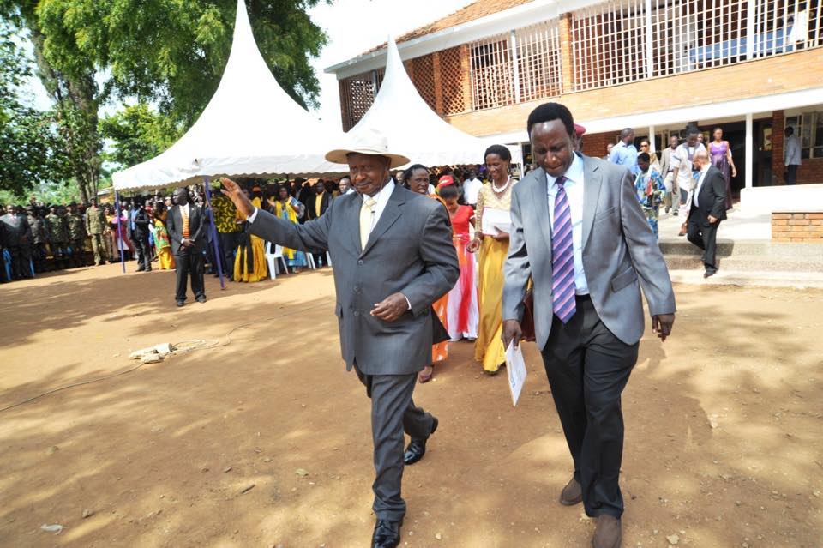
Oboth-Ofumbi’s Commemorial Ceremony

Slide 26
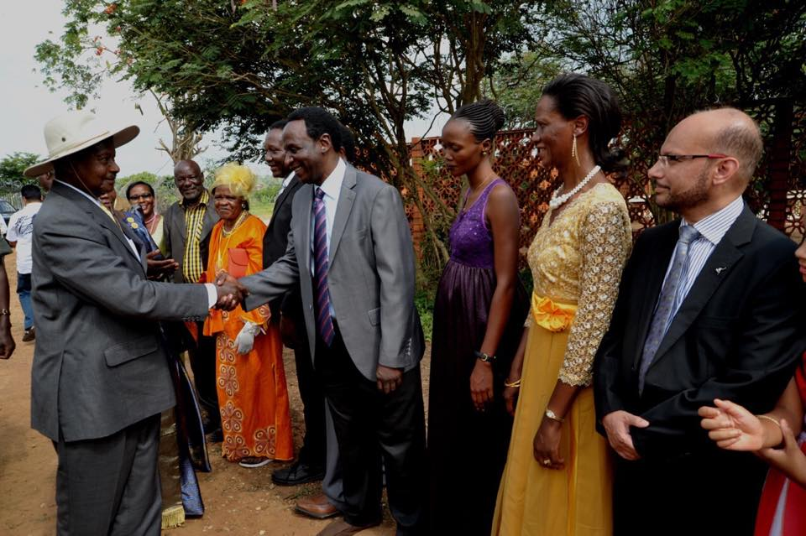
Oboth-Ofumbi’s Commemorative Ceremony

Slide 27
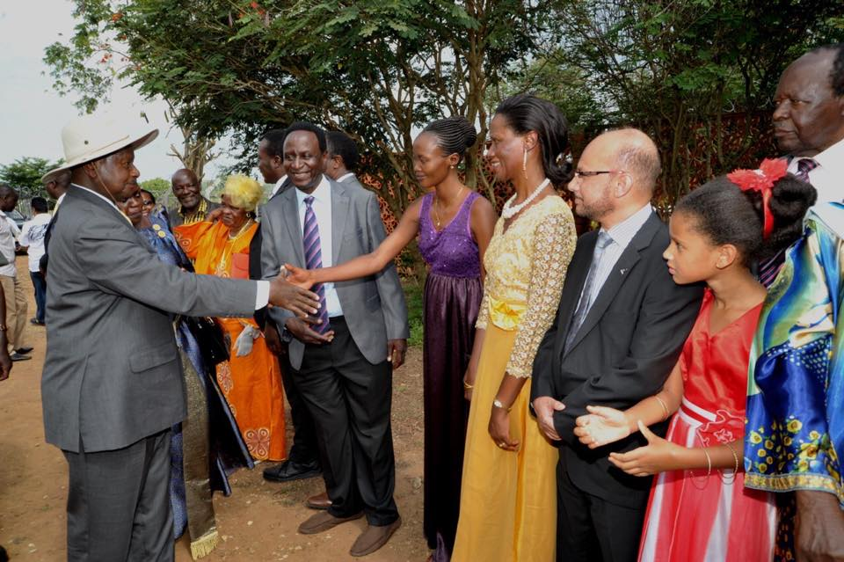
Oboth-Ofumbi’s Commemorative Ceremony

Slide 28
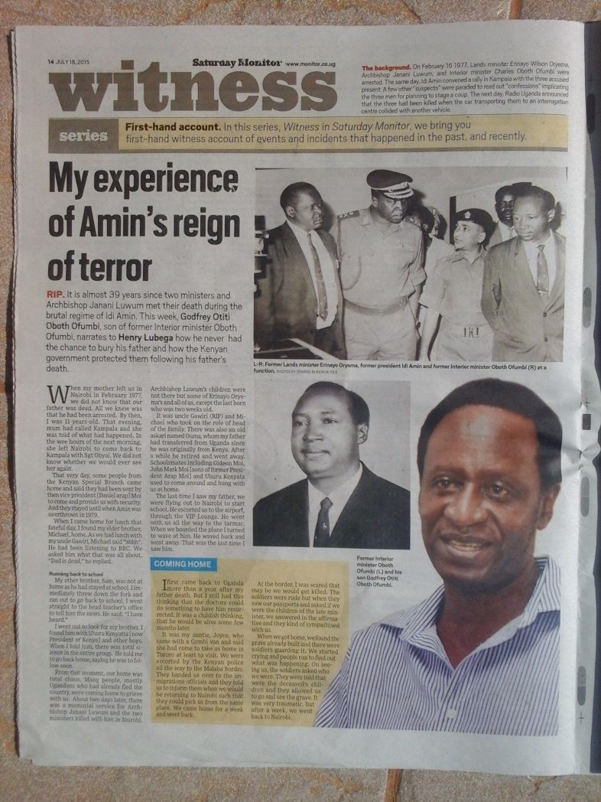
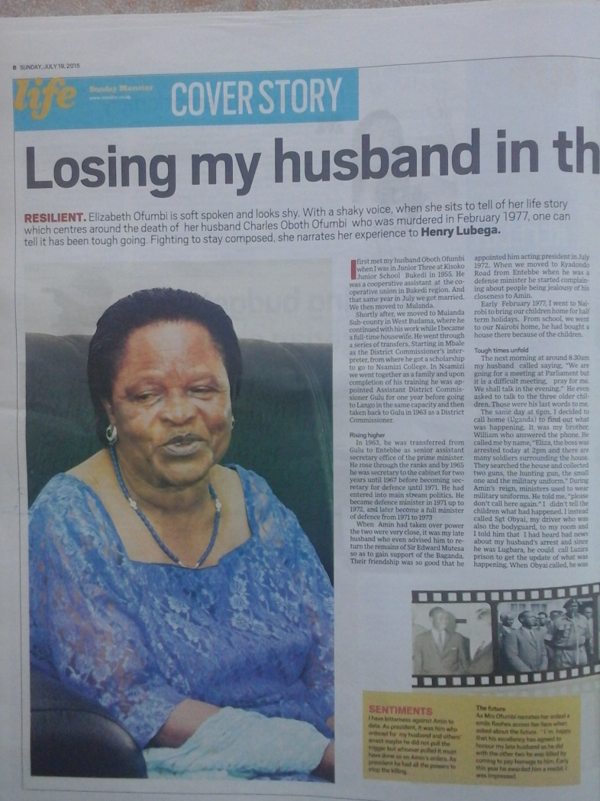
Ceremonies Reported on Newspapers

Slide 29
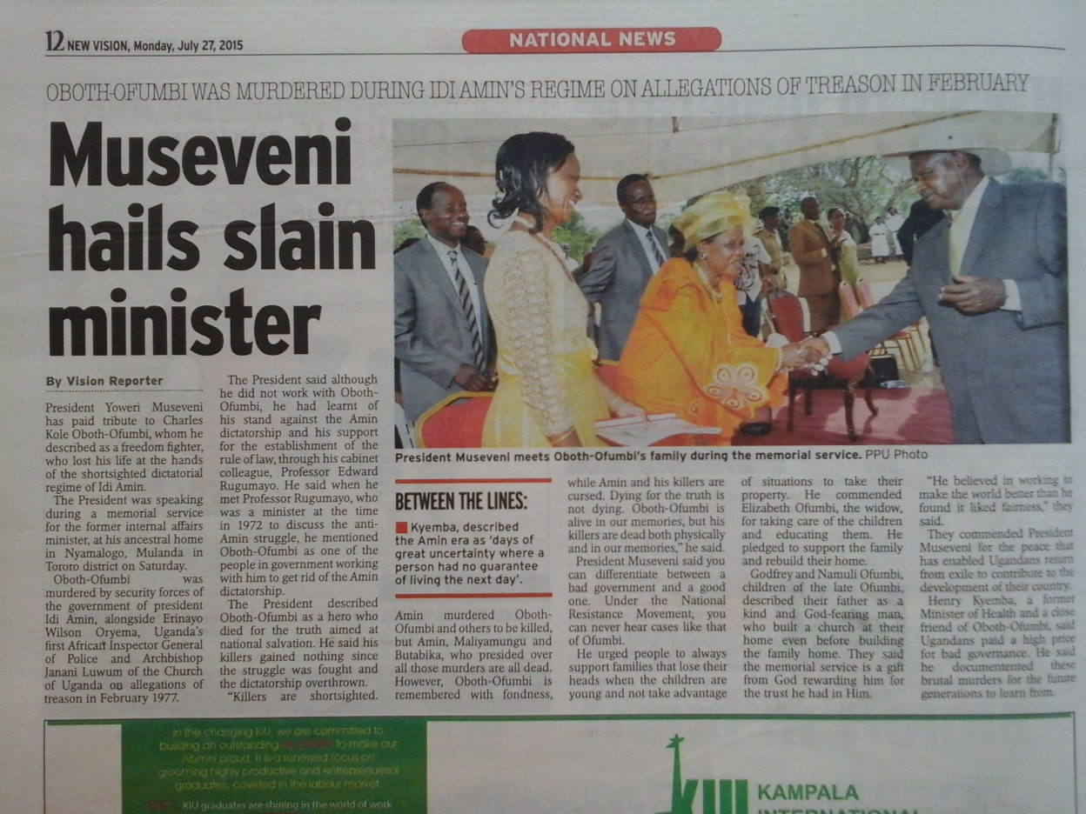
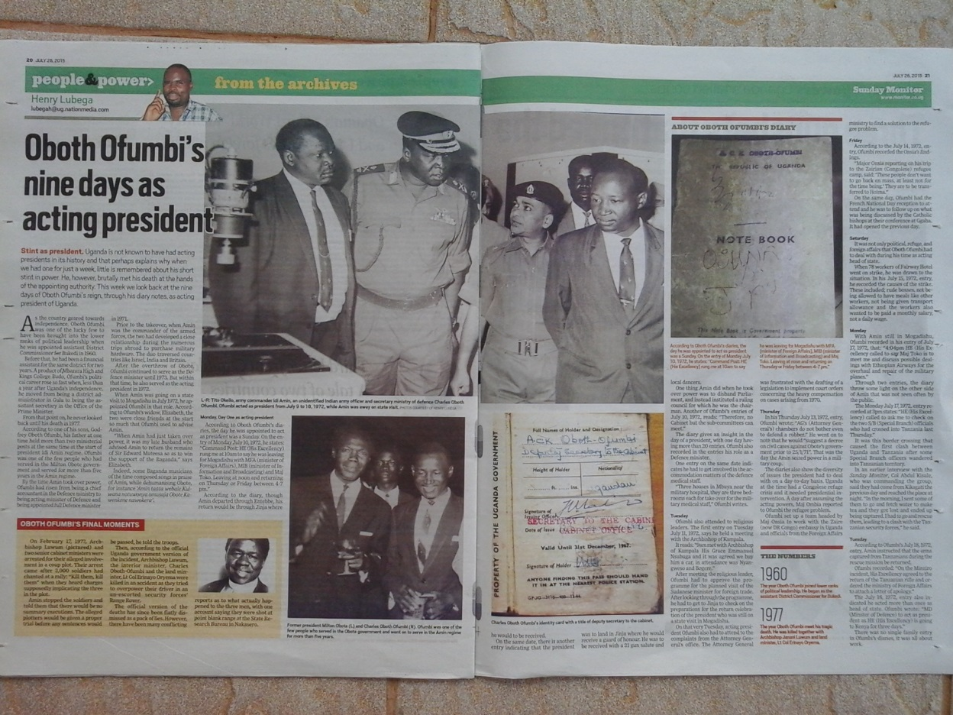
Ceremonies Reported on Newspapers

Slide 30
Ceremonies and Election Campaign
It is generally agreed by analysts that series of commemorative ceremonies like these are held in order to check levels of support for the NRM in the northern and eastern parts of Uganda, where allegedly many UPC supporters are. And eventually succeed to win additional vote.
It seems to have been a really effective strategy.

Slide 31
The power of spirit of the dead
In Padhola, a spiritual tint was added; an Adhola commented on a rumour that "since this election is expected to be a struggle, the president is going around and trying to collect the power of the spirits of the prominent figures of our side in order to get the victory.“
It was a very suggestive comment considering the fact the power of the spirit was thought to be influential to the victory in the election.
People in Padhola believe in the power of tipo the spirit of the dead who was killed by someone.
To control the power of tipo is very significant key issue in Padhola’s ‘spiritual security’(Ashforth 2005).

Slide 32
Universality of Citizenship to be Questioned
This series of events and the strategic effectiveness displayed in the Ugandan Presidential and General Elections of 2016 calls on us to rethink the universality of the idea of the concept of citizenship.
In short, this concept, as with all concepts of Western origin believed to be universal (like human rights, political correctness, etc.), is interwoven with autochthonous concepts in Africa and other area after imported from the West.
As a result of the series of events described above – particularly the last president's visit – the people of Padhola supported the president who honoured the great dead men of their ethnicity.
This means two things.

Slide 33
Citizenship and Ethnicity
One is that in the election, ethnicity play a certain role. This may be stating the obvious, but it is worth noting.
Although the importance of ethnicity has been recognized, it was often presented in terms of conflict axes.
This time the reburial was an epoch-making and unexpected strategy to address the issue and even successfully manage to integrate people on the basis of ethnicity even though the late Oboth-Ofumbi was not especially beloved by all his neighbours.

Slide 34
Spiritual Dimensions and Voting Behaviour
The other issue is the role of religious and spiritual dimensions in people's voting behaviour. The government’s honouring of the dead affected the people in Padhola in a positive way.
It can be said that the dead showed the agency to the living. Or the dead intervened the living’s action.
In a sense, they, ontologically the dead shared the social space with the living as the personhood.
The personhood of people in Padhola inevitably includes those who have already died. Consideration of the will of the dead can influence much on their voting behaviour.
It reminds us the fact that transporting Mutesa II’s body had great significance to promise the popularity of Amin among Baganda in 1970s, even if he was the very one who made the cause for Mutesa II to have gone exile by attacking the palace in 1966 as Army Commander by the order of Apolo Milton Obote.

Slide 35
Strategic Election Campaign
Furthermore, in the case of 2016, throughout the commemorative ceremonies, by criticizing the tyrant Idi Amin as a symbol, the president may successfully and effectively highlight his position as the opposite.
The logic of ‘The enemy’s enemy is a friend’ can be seen in the series of propaganda.
To be sure, I do not really on the position to know the details, if a presidential campaign in a modern nation state like Uganda consciously took these actions as an election strategy, this would be considered as very significant.

Slide 36
Modernity and Autochthony
If nationality and citizenship of a modern nation state have been thought to have been formally cut off from ethnicity, especially since the introduction of the National ID, this was wrong, or too simple-minded.
Citizenship, of course, is conceived as a part of the modern contemplation, aiming at universality to some extent.
However, this case shows, quoting the suggestive title of the book by Bruno Latour, ‘We have never been modern’. I think that the situation is exactly the same in the Europe where the modern originates.
However much modern concepts aim at universality, they are always interwoven with the autochthonous and indigenous concepts on the spot – that is the universal situation.

Slide 37
Rational Alternatives and Sentimental Action
I have recently discussed that citizenship is also affected by the dead. After death, there are things where you decide and cancel migration thinking about where you want to be buried(Umeya 2017).
In the discussion on migration in Africa, Francis Nyamnjoh (2001: 30)criticizing thinkers like Werbner(1999) by asserting that humans are not ‘creative manipulators or jugglers of identity’(op.cit.), who is the subject enjoying the freedom and rational alternatives.

Slide 38
Communal Social Structures Reconsidered
They are ‘also at variance with the tendency in the western export to minimize the power of society, social structures, communal and solidalities by “trumpeting instead the uncompromising autonomy of the individual, right-bearing, physically discrete, monied, market-driven, materially inviorate human subject.”(Comaroff and Comaroff 1999:3)’ (Nyamnjoh 2001: 30)

Slide 39
Motivation for Action and Citizenship
I intended to add a discussion from another perspective to what motivation for the action of citizen here was not simply economic rationality but sentiment.
In other words, here it is also possible to think that voting behaviour is based on sentiments considering the dead.

Slide 40
Conclusion
One cannot ignore the emotional aspects of citizenship, nor can one conclude that each citizen autonomously pursues their own interests, as is generally thought; when seriously considering voting behaviour, it is also important to consider the role of the dead.
Throughout the discussion, I propose the intricate interwoven relationship of the concepts of personhood that incorporate a shared social space with the dead and formal definitions of citizenship imported from the West.

Slide 41
Conclusion
Like other modern concepts, that of citizenship is entangled with indigenous concepts.
Sentiments are involved, and ethnicity – even if the membership is never fixed - is also affected by the agency of the dead.
What I wanted to think about here is that it is a modern invention aiming at the universality, such as citizenship, but it is one of the possible variations shown at the point where it was imported.
That suggests that humans are not individuals who never have complete freedom. The new possibility to the negotiation with autochthonous concept and the Western imported concept brutally aiming at the universality will be moderately vision after considering the situation.

Slide 42
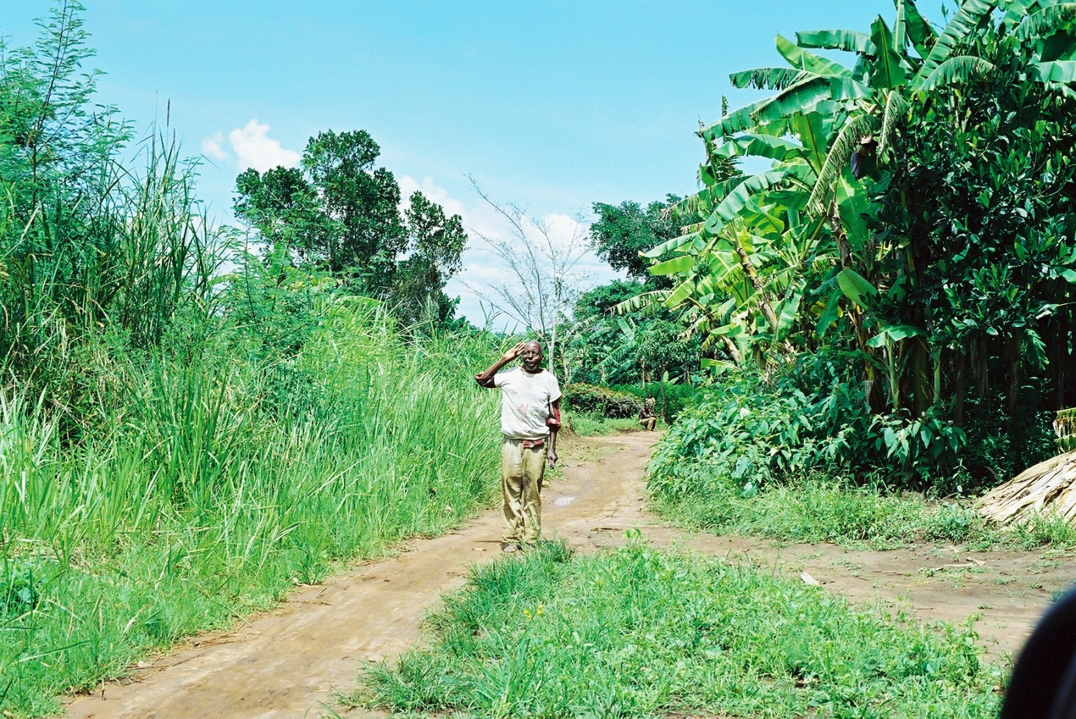
Waluwa wini teki teki

Slide 43
References
Ashforth, Adam (2005)
Witchcraft, Violence, and Democracy in South Africa. Chicago: University of Chicago Press.
Comaroff, J and J. L. Comaroff (1999)
Civil Society and the Political Imagination in Africa, Chicago: University of Chicago Press.
Nyamnjoh, F. B. (2001)
‘ Delusions of Development and the Enrichment of Witchcraft Discourses in Cameroon.’ In Henrietta L. Moore and Todd Sanders (eds.)Magical Interpretations, Material Realities: Modernity, Witchcraft and the Occult in Postcolonial Africa. London & N. Y.: Routledge.
Nyamnjoh, F.B. (2017)
‘ Rethinking Citizenship in 21th Century Africa: Some Conceptual Consideration.’The paper read at the meeting taken place on 26, July, 2017, Abeno Harukas Campus, Shitennnoji University.
Umeya, Kiyoshi (2017)
‘ Citizenship Including the Dead, Ancestors and Gods: Some Clues of Discussion from Northern Villages on Sado Island, Niigata Prefecture, Japan.’ The paper read at the meeting taken place on 26, July, 2017, Abeno Harukas Campus, Shitennnoji University.
Werbner, R. (1999)
‘ Introduction: Multiple Identities, Plural Arenas. ’ In Richard Werbner & T. Ranger (eds.) Postcolonial Identities in Africa. London: Zed Books.

Slide 44
References
First Ugandan Police Inspector General Erinayo Oryema re-buried
（NTV Uganda）
https://www.youtube.com/watch?v=UOAy3Ytl9pI
First National Janani Luwum Commemoration State House Uganda
https://www.youtube.com/watch?v=qonGdw3dSyk
President Museveni at Late Charles K Ofumbi Memorial
（NBS TV Uganda）
https://www.youtube.com/watch?v=1ZkqMpMnXNs

