Slide 1
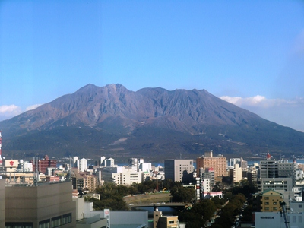
Conguraturations, Noumi san!
Sakura-jima （桜島），Kagoshima
Notes:
We graduated the same high school in Kagoshima. Difference of age is 10, so there is no overlap, but we have spent 6 years there, grown up sharing the same scenery. I think Sakurajima is a kind of symbol of Kagoshima has a big influence to the character of the people there.

Slide 2
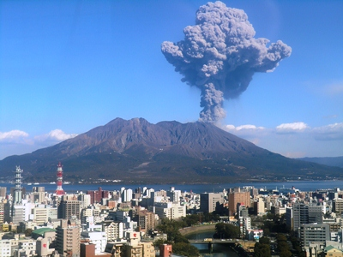
Be always active, like Sakura-jima!
Notes:
Sometimes Sakurajima emits enormous energy by eruption like Noumi san. Please be always active like Sakurajima.

Slide 3
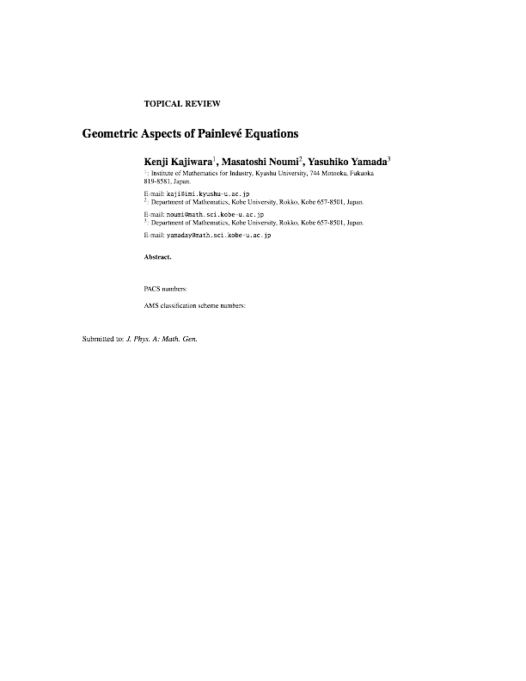

Slide 4

project started from Sep. 2013, working together once a month for 3-5 days. 95% finished, now 118 pages
Based on eight point configuration in P¹ x P¹ (Sakai used nine points in P²), focused mainly on discrete Painlevé equations
Reader-friendly explanations(perhaps). NO definitions or theorems ;-)
How to find the point configuration from a given equation
Root systems and affine Weyl groups
Construction of discrete Painlevé equations including a compact expression of the elliptic Painlevé equations
Equations, hypergeometric solutions, Lax pairs Bäcklund transformations, consistent with the degeneration of point configurations (as much as possible)
Root data with Dynkin diagram automorphisms
Preprint will appear in … hopefully,
May? ;-)
Notes:
We have been working hard to finish before this meeting, but unfortunately we could not.
Some ingredients in Sakai’s theory was difficult to reach or customize, and some were undocumented. We tried to explain those practically useful ingredients as much as possible.
First we explain how to find the point configuration by regularization of the equation and how to identify the root systems. After learning the root systems, we explain how to use it for Painleve eqs, construction, hypergeometric solutions and so on. Then we provide with lots of concrete data useful to study and use the Painleve equations.

Slide 5



Integrable Discrete Deformations of Discrete Curves:
Geometry and Solitons, Old and New
Kenji Kajiwara
Institute of Mathematics for Industry
Kyushu University
Jun-ichi Inoguchi (Yamagata University)
Nozomu Matsuura (Fukuoka University)
Yasuhiro Ohta (Kobe University)
Representation Theory, Special Functions and Painlevé Equations
RIMS, 4 March 2015
Notes:
I would like to talk about some recent works on applications of integrable systems, focused on the classical relationship with geometry, , expecting some industrial application in future

Slide 6


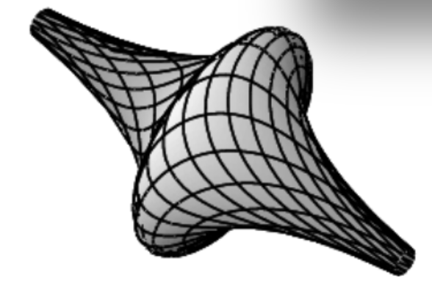


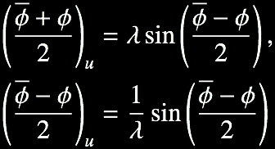
Classical Differential Geometry as a Source of Integrable Systems (1/2)
Surface with negative constant Gaussian curvature
(u,v): “Chebychev net”
Integrability condition (Gauss-Codazzi equation)
Sine-Gordon equation
(picture by Matsuura)
Bäcklund transformation (1875)
Notes:
いそげ

Slide 7


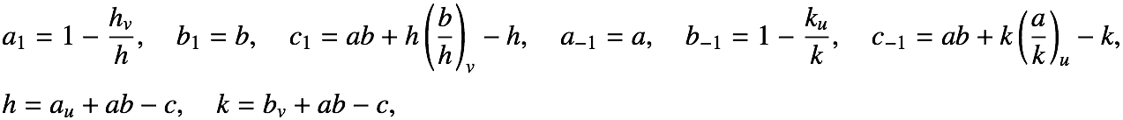

Classical Differential Geometry as a Source of Integrable Systems (2/2)
Sufrace parametrized by conjugate net in RP^{N-1}
surface
homogeneous coordinates
(u,v): local coordinates
“conjugate net”
Laplace transform
h, k: “Laplace invariants”
Two-dimensional Toda lattice equation (Darboux, 1889)
Notes:
いそげ詳しくいわない

Slide 8
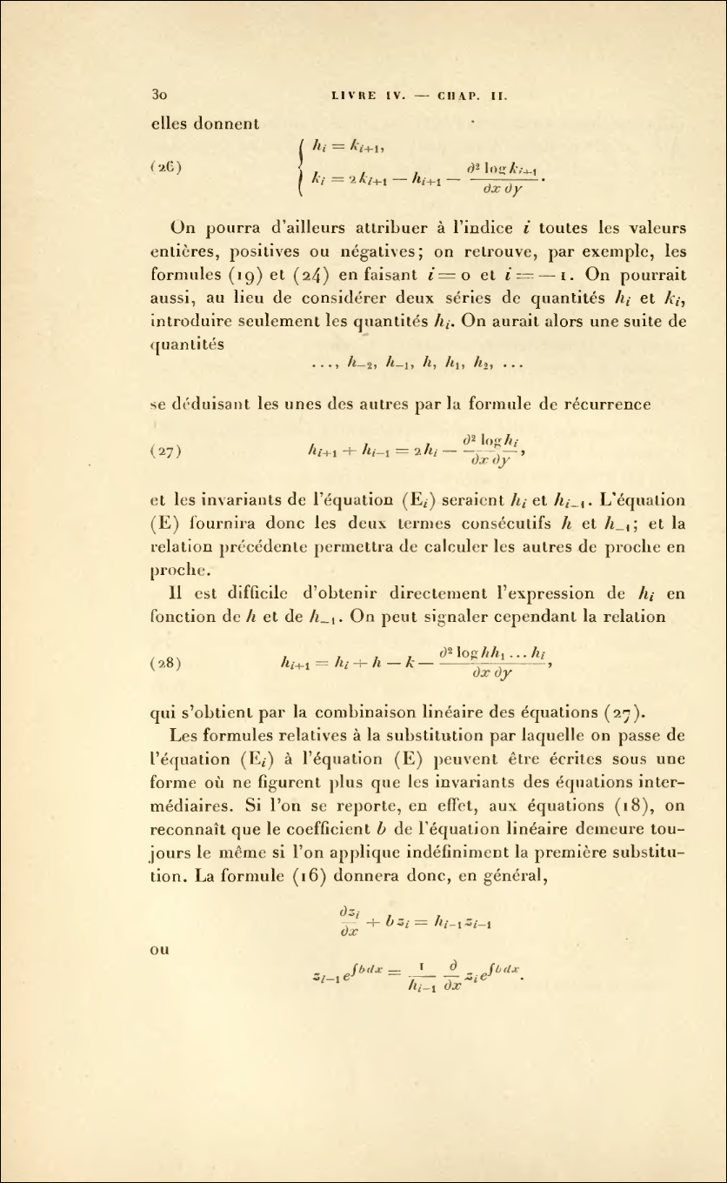
Notes:
まく

Slide 9
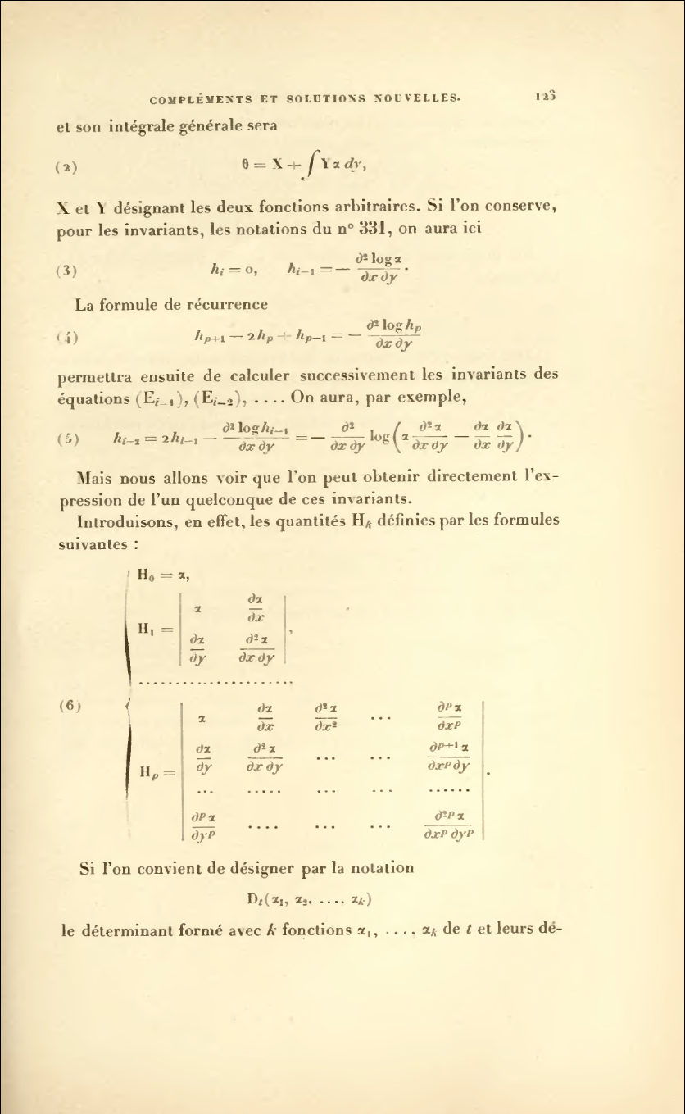
Notes:
In this way, integrable systems have been found in the context of classical differential geometry.

Slide 10









Plane Curve and Frenet Formula
Plane curve:
x : arc-length
Frenet frame:
Frenet formula:
κ: curvature
Notes:
いそげ

Slide 11







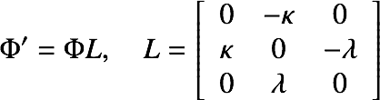
Space Curve and Frenet-Serret Formula
arc-length parametrized curve:
Frenet frame：
Frenet-Serret formula (1847)
curvature
torsion
Notes:
いそぐ

Slide 12




Deformation of Plane Curves and Soliton Equation (1/2)
Frenet formula
t: deformation parameter
Isoperimetric deformation
isoperimetricity:
Deformation eq.
Notes:
いそげ
isoperimetric = arclength is preserved
gamma dot prims is PERPENDICULAR to T.

Slide 13



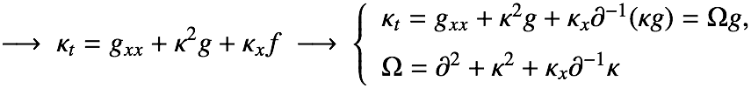



Deformation of Plane Curves and Soliton Equation (2/2)
Isoperimetric deformation of plane curves
Compatibility condition:
Recursion operator of mKdV hierarchy
specialization:
modified KdV eq.
Deformation of curves:
mKdV hierarchy
Lamb (1976), Goldstein-Petrich(1991)

Slide 14

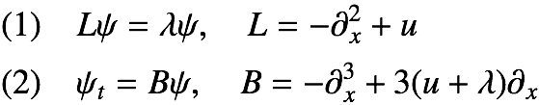



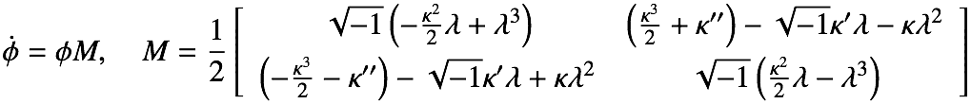
Why Integrable Systems? (1/2)
Integrable systems: compatibility of linear problem
KdV equation
auxiliary linear problem:
compatibility condition:
mKdV equation
Frenet formula!
λ = 0
M: Laurent polynomial in λ → AKNS hierarchy

Slide 15
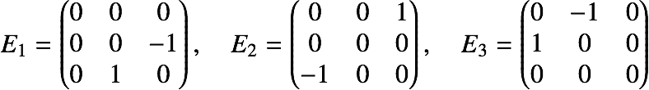

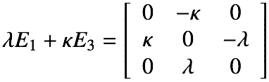





Why Integrable Systems? (2/2)
( ) correspondence
Frenet
-Serret
Soliton equations
mKdV
torsion-preserving
NLS
binormal flow
sine-Gordon
torsion-preserving
curvature-preserving
complex mKdV
Hasimoto
transformation
Notes:
What we want to do is to discretize those consistent with the theory of discrete integrable systems.

Slide 16
Discretization preserving integrability

Slide 17

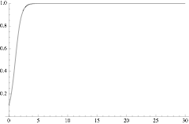




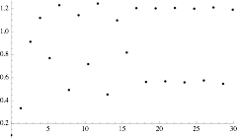
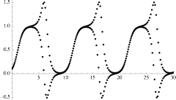
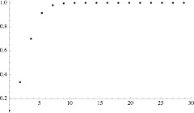

Discretization preserving integrability (1)
Basic idea: the logistic equation
Three discretizations
logistic map: chaotic
chaotic
“integrable”
Notes:
Let us consider to simulate the equation by the finite difference method.

Slide 18











Discretization preserving integrability (2)
Logistic equation
Discrete logistic equation
dependent variable transformation
linear eq.
solution

Slide 19
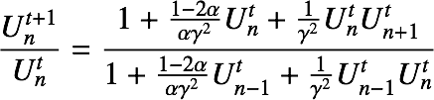





Discretization preserving integrability (3)
Burgers equation
discrete Burgers equation
Cole-Hopf transformation
diffusion eq.
Shock wave sol.

Slide 20

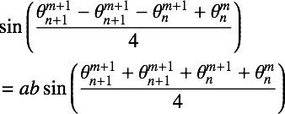


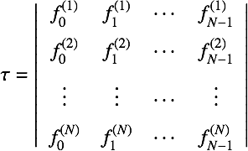
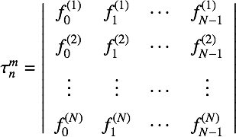




Discrete sine-Gordon equation
Sine-Gordon equation
discrete Sine-Gordon equation

Slide 21
Motion of discrete curves and preceding works
  Curves and solitons
    Hasimoto (1972): Vortex filament and NLS
    Lamb (1976): space curve and NLS, mKdV
    Goldstein-Petrich (1991): plane curve and mKdV
  Continuous motion of discrete curves
  Hisakado-Nakayama-Wadati (1995): a semi-discrete mKdV
  Doliwa-Santini (1995): dynamics on 3-sphere (R=1/λ, λ→0: plane curve)
  Nishinari (1998): semi-discrete mKdV + discrete Cosserat elasticity
  Hoffmann-Kutz (2004): semi-discrete mKdV
  Discrete motion of discrete curves
    Doliwa-Santini (1999): discrete sine-Gordon on 3-sphere
    Hoffmann (2000): discrete NLS
    Fujioka-Kurose(2008): discrete Burgers on complex hyperbola
  Pinkall-Springborn-Weissmann (2007): discrete NLS
  Inoguchi-K-Matsuura-Ohta (2012,2014) : discrete mKdV

Slide 22

















Isoperimetric Deformation of Plane Discrete Curves: discrete mKdV (1/3)
Discrete plane curve
Matsuura(2011), Inoguchi-K-Matsuura-Ohta(2012)
any three consecutive points are not colinear
Discrete Frenet frame
Discrete Frenet formula
Discrete Deformation
m: deformation parameter
Compatibility condition:
Notes:
We require the compatibility of the frame for the deformation.

Slide 23







Isoperimetric Deformation of Plane Discrete Curves: discrete mKdV (2/3)
Matsuura(2011), Inoguchi-K-Matsuura-Ohta(2012)
Discrete Frenet formula
Isoperimetric + equidistant deformation
isoperimetricity:
compatibility cond.
discrete mKdV eq.

Slide 24
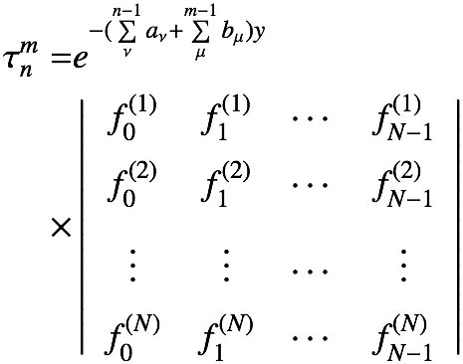

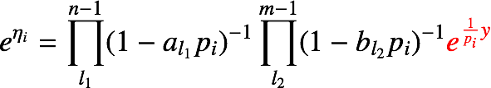
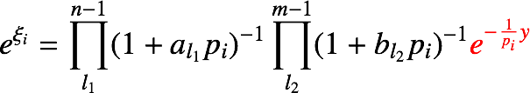


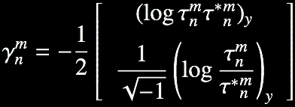

Explicit Formula
Note: Entries of determinant
discrete exponential
Notes:
γのCとしての表記間違い．1/2をトル

Slide 25
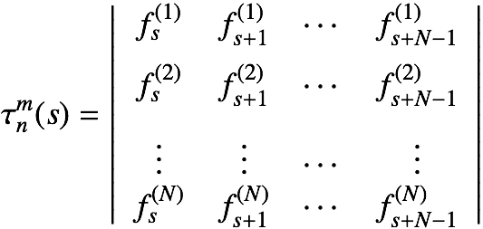



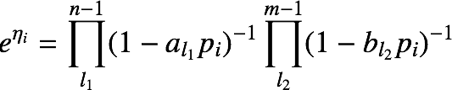

Bilinear Equation for dmKdV
Entries of determinant
Bilinear difference equation
Hirota-Miwa equation
2-periodicity:
reality:

Slide 26
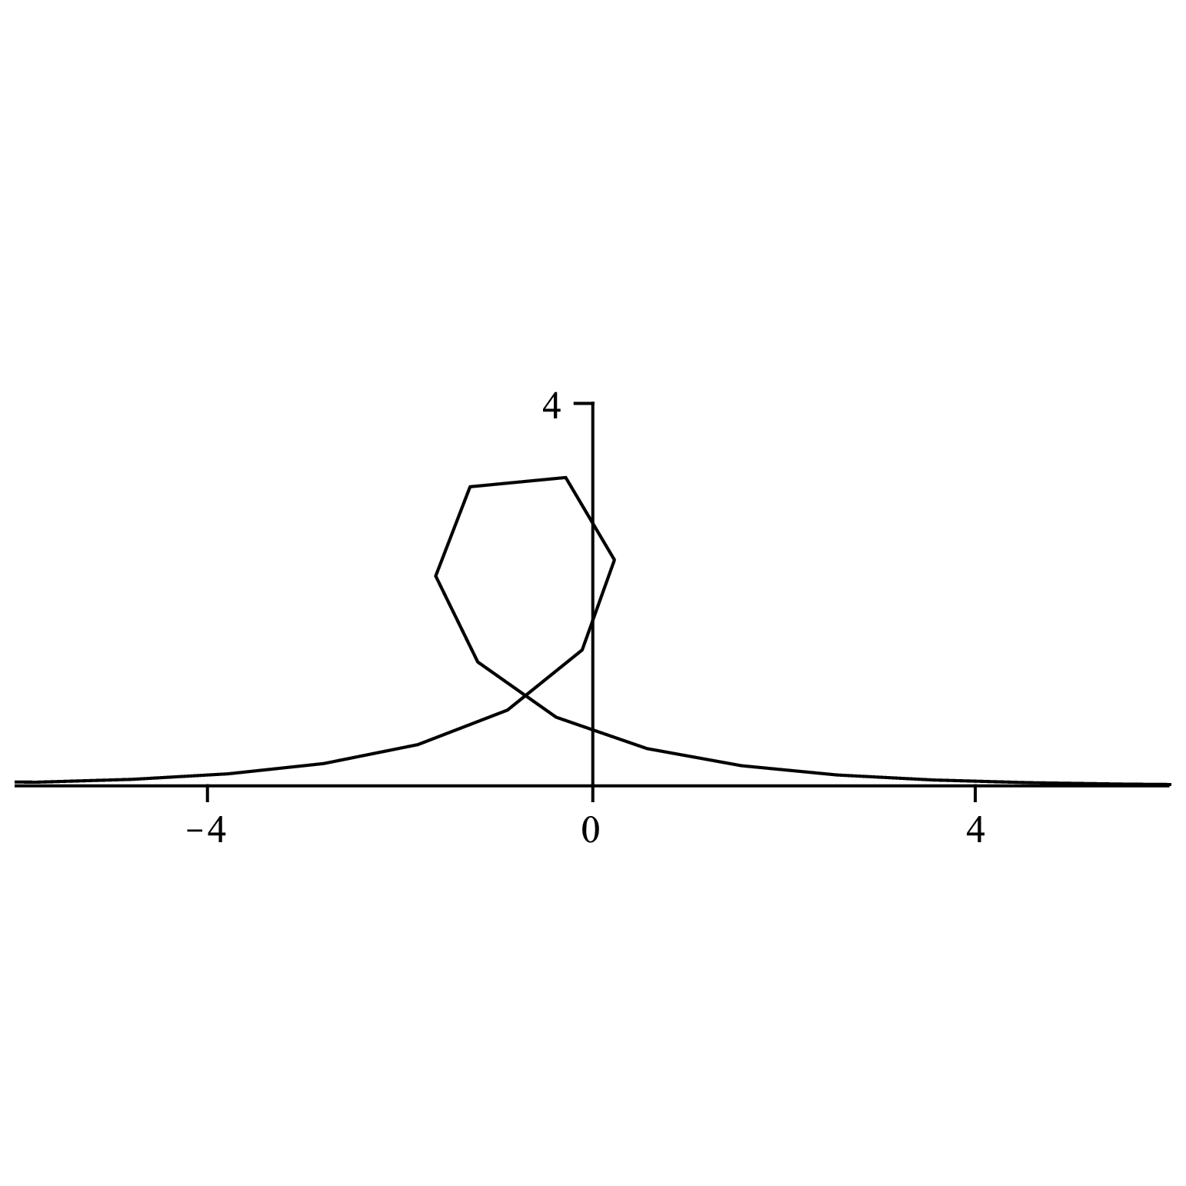
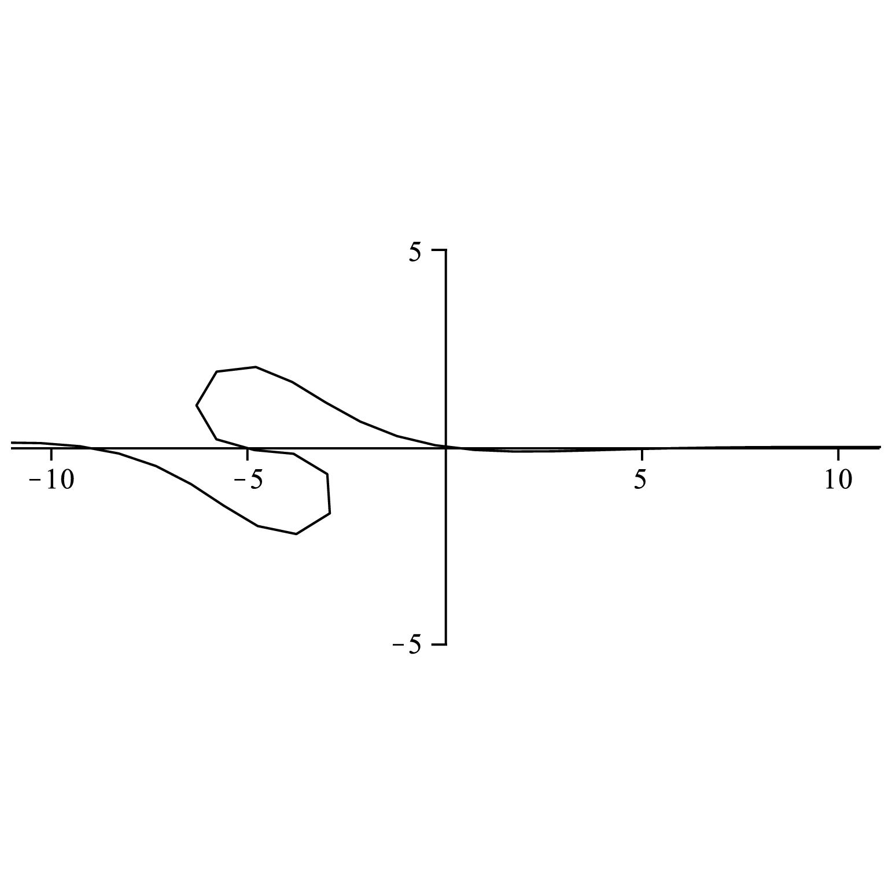
Isoperimetric Deformation of Plane Discrete Curves: discrete mKdV

Slide 27






Discrete mKdV equation
discrete mKdV
semi-discrete mKdV
mKdV
R. Hirota (1973) (semi-discrete), (1998) (discrete)

Slide 28


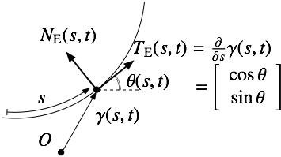





Conformal Deformation of Plane Curves in Similarity Geometry (1/4)
Similarity transformation group
Chou-Qu (2004), cf. Inoguchi’s book
linear conformal group
Euclidean geometry:
Frenet frame
Frenet formula
Similarity geometry：
Sim(2)-invariant parameter: similarity arc-length
Sim(2)-invariant curvature: similarity curvature
Similarity Frenet frame:
Similarity Frenet formula
Notes:
linear conformal group = orthogonal group + scale change (zooming)
Recently this framework was found to be convenient for some problems in Computer aided design. Also unexpected by-product is coming out on dynamics of fluid in the porus media, such as water infiltration model in the soil.

Slide 29




Conformal Deformation of Plane Curves in Similarity Geometry (2/4)
Similarity Frenet formula
Conformal deformation
compatibility condition:
eliminate f
Recursion operator of Burgers hierarchy
specialization:
Burgers equation

Slide 30








Conformal Deformation of Plane Curves in Similarity Geometry (3/4)
Burgers equation
Cole-Hopf transformation:
Burgers hierarchy
Recursion operator
Deformation equation
specialization:
Burgers hierarchy

Slide 31







Conformal Deformation of Plane Curves in Similarity Geometry (4/4)
Conformal deformation of curves
Deformation eq.
linearization
Compatibility with deformation equation implies:
Representation formula of curves

Slide 32
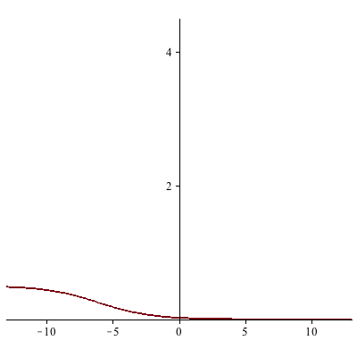
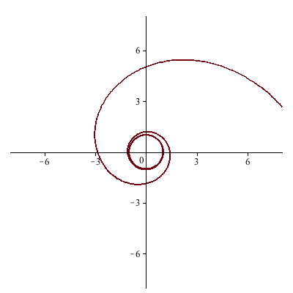

Slide 33
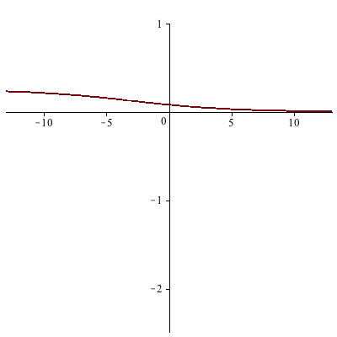
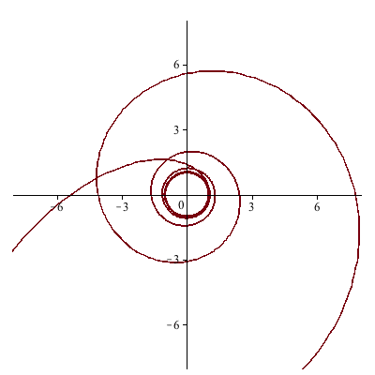

Slide 34
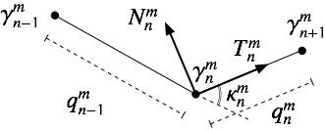






Conformal Deformation of Discrete Plane Curves (1/4)
Discrete curves
Discrete similarity frame
Discrete similarity Frenet formula
Conformal deformation

Slide 35








Conformal Deformation of Discrete Plane Curves (2/4)
Deformation
conformality
Equations for similarity Frenet frame
compatibility:
Eliminate f under specialization (for simplicity)
Recursion operator of discrete Burgers hierarchy!
Solve H in terms of g:
Deformation eq.
for am=0, κn=ε

Slide 36


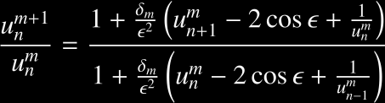

Conformal Deformation of Discrete Plane Curves (3/4)
Deformation equation
Specialization:
(a variant of ) discrete
Burgers equation
Linearization of discrete Burgers eq.
Continuous limit
Burgers eq.

Slide 37

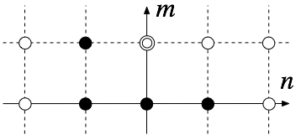
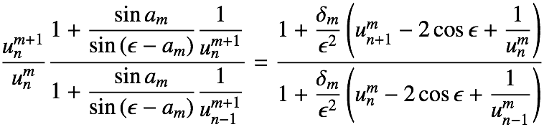


Conformal Deformation of Discrete Plane Curves (4/4)
Effect of a: smooth curves
Independent variable transformation (←chain rule) does not work well for discrete cases → effect of a is nontrivial
Discrete case
Representation formula
discrete curves

Slide 38
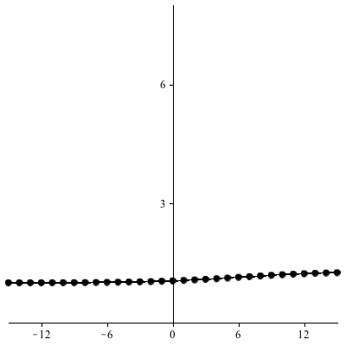
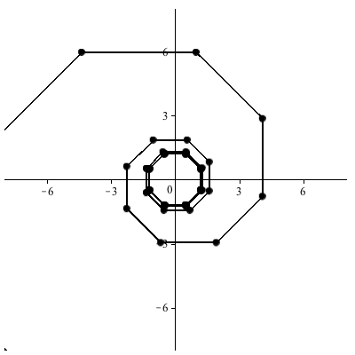

Slide 39
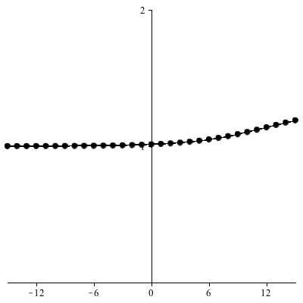
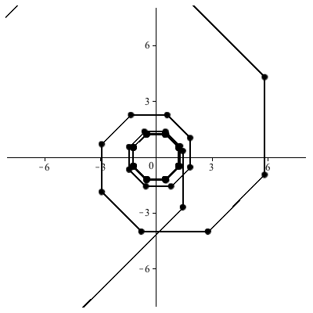

Slide 40



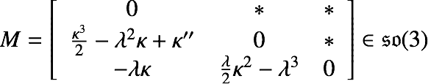


mKdV Flow on Smooth Space Curves
arc-length parmetrized curve
Frenet frame：
curvature
torsion: constant
mKdV flow
Deformation of Frenet frame
torsion-preserving
isoperimetric deformation
compatibility condition:
mKdV:
Lamb (1976)
Notes:
basic technique is to introduce a frame which is an orthonormal basis of R^3attached to each point of curve, and describe the deformation w.r.t. the frame.

Slide 41
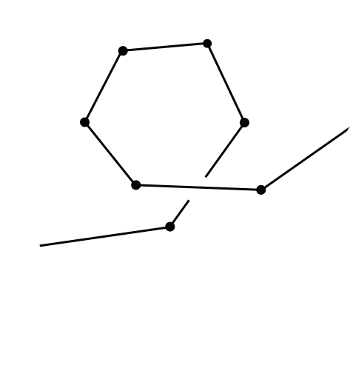
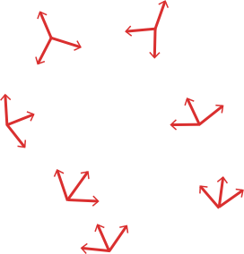




Discrete Deformation of Discrete Space Curves (1/5): Frenet Frame
Inoguchi-K-Matsuura-Ohta, J. Phys. A 47 (2014) 235202
Discrete Frenet Frame:
tangent vector:
Key:
binormal vector:
: osculating plane
normal vector:
Notes:
tangent vector is a unit vector in the direction of the segment.

Slide 42





Discrete Deformation of Discrete Space Curves (2/5): Frenet Formula
torsion:
Discrete Frenet-Serret formula
Eyring (1932)
Notes:
We consider to adjust the red frame to the black one. Note that Bn-1, Bn, Nn are on the same plane since they are perpendicular to Tn-1. First rotate wrt the third axis….

Slide 43










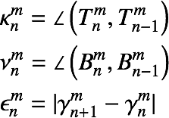


Discrete Deformation of Discrete Space Curves (3/5):Deformation
: space discrete curve with constant torsion λ.
Determine
by
Key!
torsion:
deformation parameters
chosen s.t.
constant in n
This deformation preserves torsion and arc-length.
It admits two kinds of discrete flows.
σ>0 → discrete mKdV
σ<0 → discrete sine-Gordon
It admits arbitrary choice of two flows at each step.
The choice of two flows is controlled by the deformation parameter bm
Notes:
形式的には平面曲線の場合と全く同じ！
wを定める式は人為的に見えるが，実はL,Mの両立条件から定まってしまうものである．

Slide 44
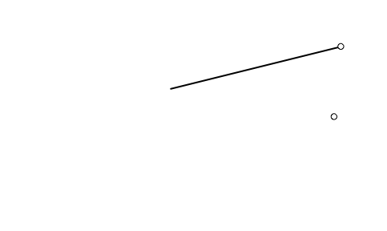
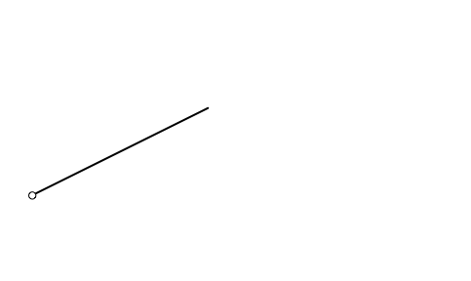

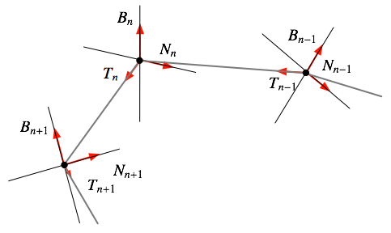





Discrete Deformation
Discrete Deformation of Space Discrete Curves (4/5)
definition of torsion:
(1) start from a discrete space curve γn with constant torsion λ
(2) move an arbitrary point (e.g. γ0) to arbitrary position on the osculating plane.
δ: moving distance and w0: rotation angle are the parameters of deformation.
δ is chosen as
parameterize δ as
(3) make a copy of the circle of radius δ on the osculating plane of each point
(4) move other points to the positions satisfying:
(a) on the circle (equidistant condition)
(b) preserving the arc-length (isoperimetric condition)
(c) on the lower half plane of the osculating plane (opposite side of N w.r.t. T)

Slide 45




Discrete Deformation
Discrete Deformation of Space Discrete Curves (5/5)
Frenet-Serret
deformation
(i):
(ii):
compatibility condition
(i): discrete mKdV
(ii): discrete sine-Gordon

Slide 46




Continous deformation of
smooth curves
Discrete deformation of
discrete curves

Slide 47










Hodograph Transformations: mKdV and WKI
mKdV
WKI elastic beam eq.
loop solitons
Hodograph transformation
Geometric meaning
x: arc-length
Hodograph transformation
WKI:
equation for
Notes:
mKdV: Lagrange description 曲線上での描像
WKI: Euler description 固定座標での描像

Slide 48



Discrete Hodograph Transformations
Discrete curve:
Discrete hodograph transformation:
Discretization of loop soliton systems: complex Dym, WKI, Short pulse eqs. etc.
Maruno’s talk

Slide 49
Integrable systems can contribute to (discrete) differential geometry
Geometric objects: system of linear equations (Gauss-Weingarten eq.) + compatibility condition (Gauss-Codazzi eq.) 〜 integrable systems
Construction of geometric objects: (i) solve nonlinear equations arising from the compatibiity condition (ii) solve linear equations with coefficients given in (i).
→ explicit construction is often difficult and valuable.
Explicit reconstruction of the curves (by means of the τ functions).
General case is usually hopelessly complicated (in particular, discrete deformation): (some of) integrable models give feasible models with good properties. But the matching with geometric context is highly non-trivial.
Future Problems
Model of discrete deformation of space discrete curves with varying torsion → discrete NLS and others
Discrete surfaces (discrete elliptic sine-Gordon etc.), elasticity (non-integrable)
Nearly integrable deformations…(Dym + external source etc.)
Notes:
In the context of discrete surfaces, we encounter with various equations which were not paid much attention from the point of solitons (nonlinear waves).

Slide 50





Geometry sheds light to unexplored integrable systems
sinh-Gordon (hyperbolic)
Reduction of KP (2DTL)
discrete sinh-Gordon
(hyperbolic)
sinh-Gordon (elliptic)
CMC surface
sinh-Gordon (elliptic) (Ohta, 2010)
Discrete CMC surface?
Reduction of DKP!
Notes:
discretization of this equation was not paid attention because of lack of motivation from physical (nonlinear waves) point of view, but mathematically important. In this way, geometry gives a good motivation to re-investigate the soliton equations.

Slide 51




相似幾何における平面離散曲線（３）：離散Burgers階層
等角変形
として f を消去：
離散Burgers階層の再帰演算子！
離散Burgers階層：
l=2:

